Slide 1
Multi-Jurisdiction Cross-Border Patent Litigation:
A Global Affair
December 15, 2020

Slide 2
Before we start
Any slide decks will be available during the program to download.
All panels are recorded and added to our webinar video archive, available at www.ipwatchdog.com.
If you have audio/video difficulty try refreshing/restarting the browser.
If you have questions for the panel, please use ASK A QUESTION. Chat is for you to communicate among yourselves during the webinar.
You can “vote up” questions letting us know it is a popular question.
At the end of the webinar, we will provide a link to a FEEDBACK SURVEY. We would greatly appreciate it if you can take 1-2 minutes to give your thoughts.

Slide 3
Speakers
Zoë Butler
David Marques
Gene Quinn
Christine Yun Sauer
Powell Gilbert
Darts-IP
IPWatchdog
Robins Kaplan
Zoe is an experienced litigator particularly known for her expertise in advising clients in complex patent disputes, often with an international element. Zoe has acted for a range of clients from telecoms to electronics/software companies to pharmaceutical and biotech companies.
David is a legal analyst and coordinator of the patent case-law unit at Darts-ip, part of Clarivate. He is a patent attorney and a jurist, with academic knowledge in both law and biology, and is specialized in patent litigation information, trends and data.
Gene a top commentator on patent law and policy, is the founder of IPWatchdog and a Top 300 IP Strategist. In 2014, Mr. Quinn was named one of the top 50 most influential people in IP by Managing IP Magazine. And from 2017 to 2020, he has been recognized by IAM Magazine as one of the top IP strategists in the world.
Christine is trial lawyer with a chemistry background. She has advised clients on IP disputes, patent office trials, and licensing monetization efforts across a vast range of technologies and industries. She represents plaintiffs and defendants ranging from individual inventors to Fortune 500 companies in district court, the PTAB, and the International Trade Commission.

Slide 4
Multi-Jurisdiction Cross-Border Patent Litigation: A Global Affair
Patent litigation is increasingly a multi-jurisdiction, cross border affair that requires strategic consideration. In order to make a strategic decision, it is imperative that patent owners understand the balance between risks and benefits for each jurisdiction.
The United States is known internationally for greater discovery, but even within the U.S. there are significant variations. The U.S. International Trade Commission can offer exclusion orders and cease and desist orders, the Patent Trial and Appeal Board can invalid patents and frequently does just that, and district courts across the country range from patent owner friendly in the Eastern and Western Districts of Texas, to district courts that can be rather inhospitable to patent owners, particularly when they are suing large multinational corporations.
Just as critically, these variations exist on a global scale as well. The United Kingdom has shown a willingness to award worldwide royalties, in China successful patent owners receive injunctions in almost all cases, many increasingly find Germany the best of all worlds, but others will say it is no panacea.

Slide 5
Patent families with multi-jurisdiction litigation
5000+
patent families had litigation* in more than 1 country/jurisdiction in the last 10 years
*including patent assertions, validity challenges and other actions such as contract disputes

Slide 6
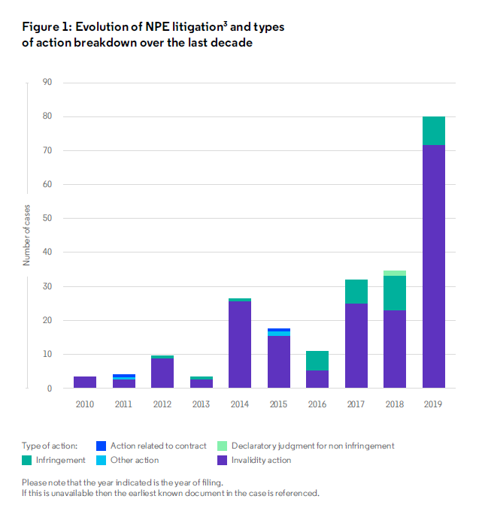
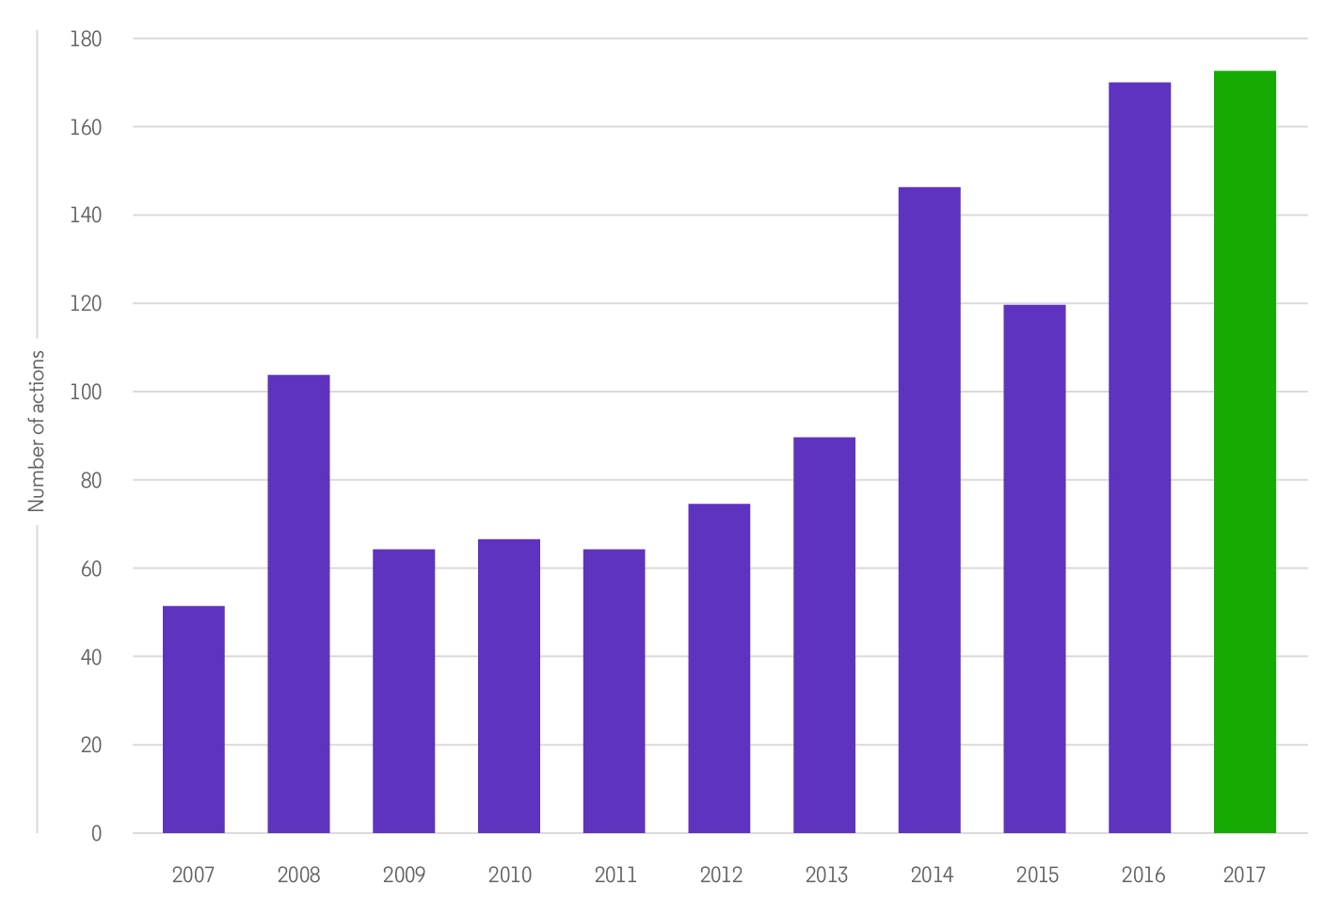
NPE Litigation outside the U.S.
Source: IP Asia Report, Clarivate, 2020
Source: NPE Litigation in Europe, Facts and Figures, Darts-ip, 2018

Slide 7
Most popular courts in the universe of multi-jurisdiction litigation
LG Düsseldorf
Patents Court - EWHC
TGI Paris
NJ District Court
Federal Court (Canada)
LG Mannheim
Texas Eastern
California Northern
Rechtbank den Haag
LG München

Slide 8
Avg. length – 1st instance infringement proceedings
Source: Darts-ip, timeframe: 2010-2018, (includes patent assertions, validity challenges and other actions such as contract disputes)

Slide 9
Success rate of infringement actions
Note: all industries and technologies have been aggregated.
Source: Darts-ip, timeframe: 2009-2018, figure represents an aggregation of first instance infringement outcomes from all national courts, all industries and all technologies.

Slide 10
One size does not fit all in Europe
“In Europe it is worth considering what the different national courts can offer in terms of speed, procedural tools, flexibility of relief – so what’s the best strategy can differ per case.”

Slide 11
The availability of injunctive relief
Preliminary Relief vs. Permanent Relief
US vs. Europe vs. China vs. Brazil
Time to Injunction
U.S. quick at ITC, but other jurisdictions even quicker
Bond Requirements
Difference between getting an injunction and enforcing it

Slide 12
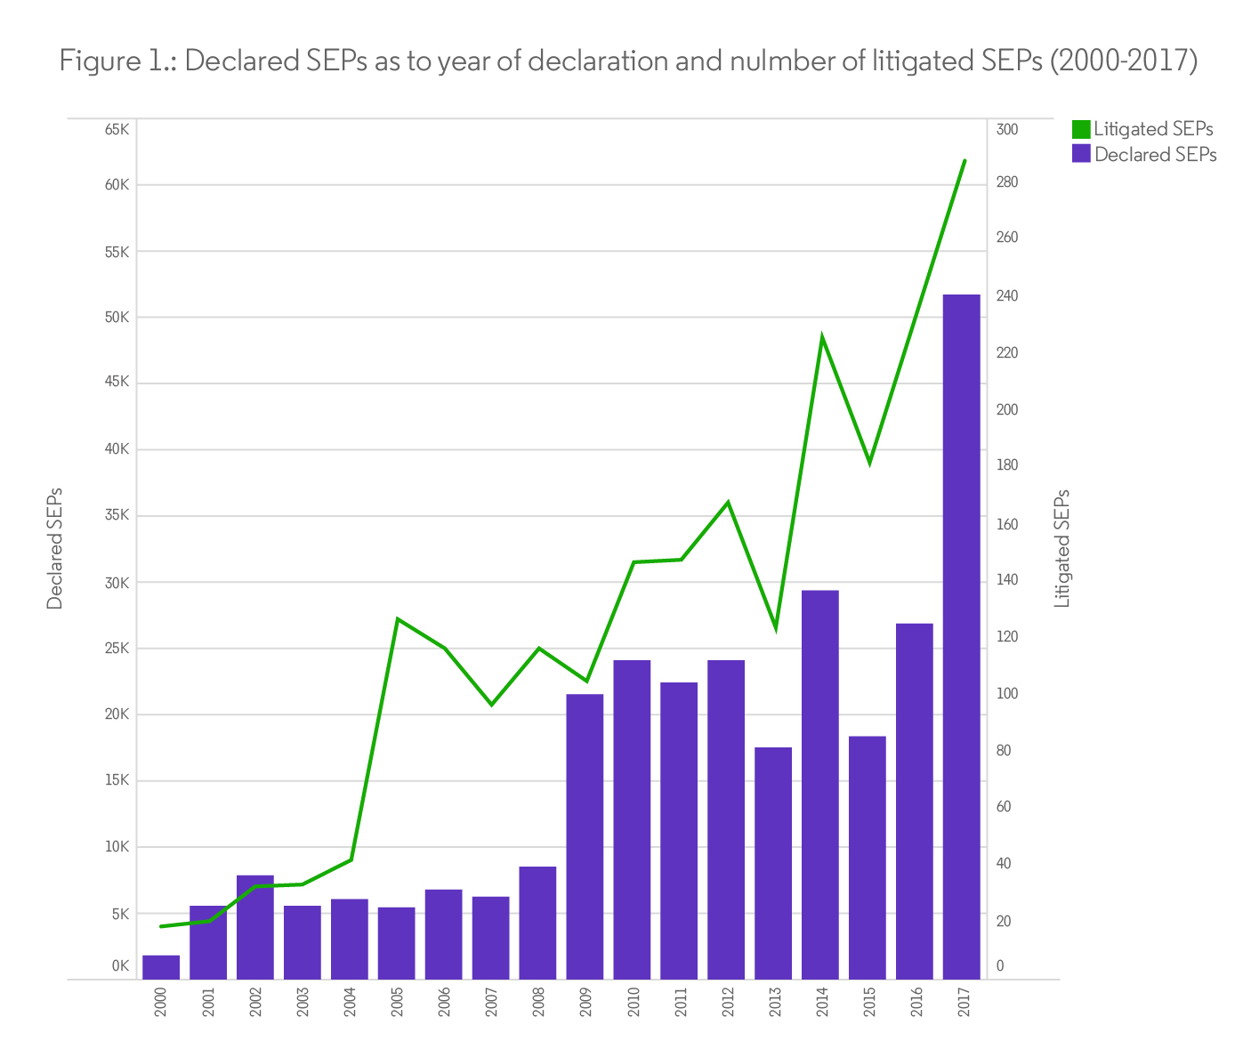
SEP litigation in a nutshell
Unwired Planet v. Huawei (UK)
Worldwide royalty
Sisvel v. Haier (Germany)
FRAND terms may be different for different licensees, and licensee must give SEP holder adequate declaration of willingness to license
FTC v. Qualcomm (US)
Reversed district court determination that Qualcomm’s licensing practices were unlawful, antitrust violations
Continental Automotive v. Avanci (US)
Alleged violation of FRAND asserted to be Antitrust violation. Dismissed.

Slide 13
Comparing international litigation across generations
Source: Darts-ip (Insights), SEP declarations by data partner: IPLytics.
Multi-Jurisdiction Cross-Border Patent Litigation: A Global Affair

Slide 14
Q&A
Please type your question into the Q&A box on your screen.

Slide 15
THANK YOU
For more information about Clarivate and its patent litigation data, tools, and services contact:
Claire Butaye
Claire.Butaye@Clarivate.com

