Slide 1
Research smarter with Web of Science & EndNote
Essential tips for every researcher
Jamal El Ouahi
Head of Customer Education Services
June 2020
Notes:
Thanks for coming

Slide 2
Context
Finding the relevant research in your field is critical to a successful research project
This can be one of the hardest, most time-consuming challenges for academics.
The research ecosystem is a sprawling, ever-changing landscape.
Each field has a rich and divergent history, and new avenues for investigation are springing up every day.

Slide 3
Proposition
Few steps every researcher should take to leverage the citation network to complete an in-depth, comprehensive search for literature in Web of Science.
Insights about:
How you can find an article
Quickly assess its impact
Create alerts to keep track of new papers in your field

Slide 4
5 Steps
Choose the right database for your search
Master the keyword search
Filter your results and analyze for trends
Explore the citation network
Save your searches and set up alerts

Slide 5
1. Choose the right database for your search

Slide 6
1. Choose the right database for your search
The myriad search engines, databases and data repositories can be tricky for researchers to navigate.
They all differ in reliability, relevancy and organization of data.
The Web of Science is publisher-neutral, carefully-curated by a team of expert editors

Slide 7
1. Choose the right database for your search
The Web of Science Core Collection database only includes journals that have met rigorous quality and impact criteria
It includes billions of cited references captured from globally significant journals, books and proceedings (check out its coverage)

Slide 8
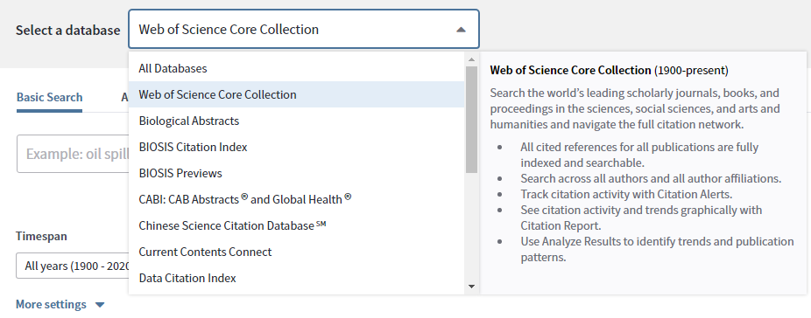
1. Choose the right database for your search

Slide 9
2. Master the keyword search

Slide 10
2. Master the keyword search
Your chosen keywords or search phrases cannot be too inclusive or limiting
They require constant iteration as you become more familiar with your research field.
Read our guide on search tips to learn more. You can also view our Quick Reference Guide to help get you started with your literature search on Web of Science.

Slide 11
Powerful Search

Slide 12
3. Filter your search results and
analyze trends

Slide 13
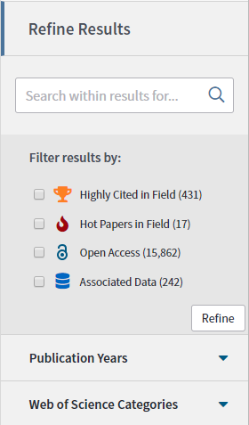
Filter your Results

Slide 14
Sort publications

Slide 15
Institutions
Funding Agencies
Authors
Journals
Open Access
Books
Conferences
Countries
Analyse Search Results

Slide 16
4. Explore the citation network

Slide 17
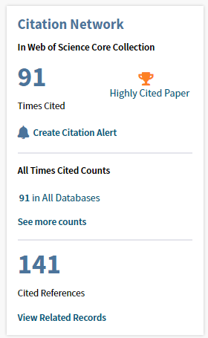
4. Explore the citation network
Identify seminal research in any field by paying attention to the number of times a paper is cited.
Track the advancement of research as it progresses over time by analyzing the papers that cite the original source (this will also help you catch retractions and corrections to research).
Track the evolution of research backward in time by tracking the research that a particular paper cites.
View related references – if papers share citations (calculated from bibliographic coupling), they’re likely discussing similar topics.

Slide 18
5. Save your search and set up alerts

Slide 19
5. Save your search and set up alerts
Save time and stay up-to-date with new research in your field by saving your searches and setting up email alerts.
This means you can return to your search at any time, and stay up-to-date about new papers included in your search result.

Slide 20
EndNote Online
Collect, manage, share and format your references

Slide 21
Context
Sourcing, organizing and formatting citations is tedious work, but crucial to publishing robust research. With this in mind, the number of citations is on the rise:
Citations indexed in the Web of Science Core Collection in 2019
Citations used per research paper on average in 2019
Growth in
total number of citations in past 10 years

Slide 22
EndNote
Win more time for your research content
It’s no longer necessary to spend hundreds of hours manually collecting and curating your research materials and formatting bibliographies.
EndNote will help you automatically create, format and update bibliographies with the convenience of remote access.

Slide 23
EndNote
Using EndNote, you can:
Easily collect and save large libraries of references to take with you and access remotely,
Add citations and complete your bibliography while you write, without the need to use disparate systems,
Choose from hundreds of stylistic formats, which can be converted to match the requirements of any new journal you submit to.

Slide 24
Demo

Slide 25
Thank you!

Slide 26
Web of Science
World class data to support world class research
Notes:
SECTION INTENT:
Define WoS (platform vs CC) & clarify what your customer subscribes to
Communicate the unique value of the Web of Science

Slide 27
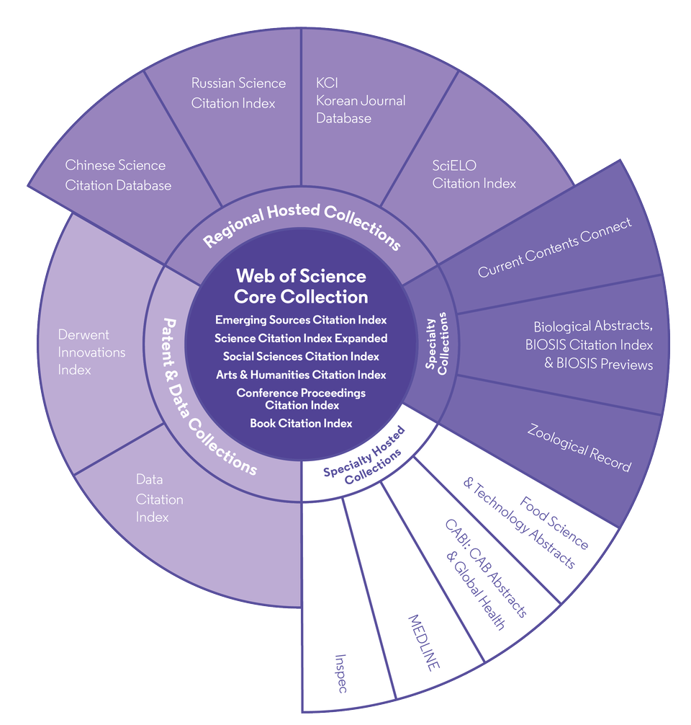
Web of Science Platform
Multidisciplinary research experience across the sciences, social sciences, and arts and humanities
34,000+
87 million
Journals across the platform
Patents for over 43 million inventions
21,000+
8.9 million+
Total journals in the Core Collection
Data Sets and Data Studies
1.8 billion+
Backfiles to 1900
Cited references
With cover-to-cover indexing
166 million+
218,000+
Records
Conference proceedings
12.6 million
111,000+
Records with funding data
Books
Statistics as of February 2020

Slide 28
Web of Science Core Collection
Research with confidence using a publisher-neutral citation index
Science Citation Index Expanded
Social Sciences Citation Index
Arts & Humanities Citation Index
Emerging Sources Citation Index
Conference Proceedings Citation Index
Book Citation Index
21,000+ journals indexed cover-to-cover
Multidisciplinary
International
Influential
Powerful citation network with complete cited reference search, cited reference linking and navigation
Unbiased journal selection and curation
Source data for Journal Impact Factor
Master Journal List

Slide 29
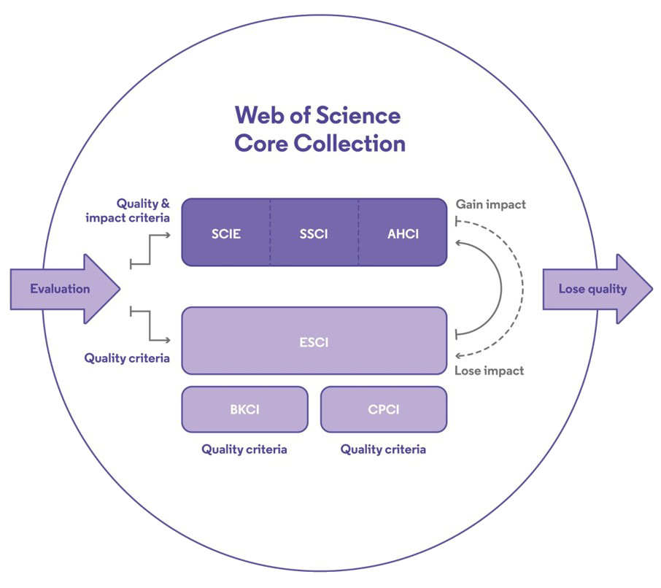
Editorial integrity
Research with confidence using a publisher-neutral citation index
Journals are curated by experts with:
Find what you need more quickly
Make high stakes decisions about research funding, resource allocation, and people with data that is independent of bias
150 years of experience
Fluency in 12 languages
0 affiliations with any journals or publishers
Using:
28 criteria
More information

Slide 30
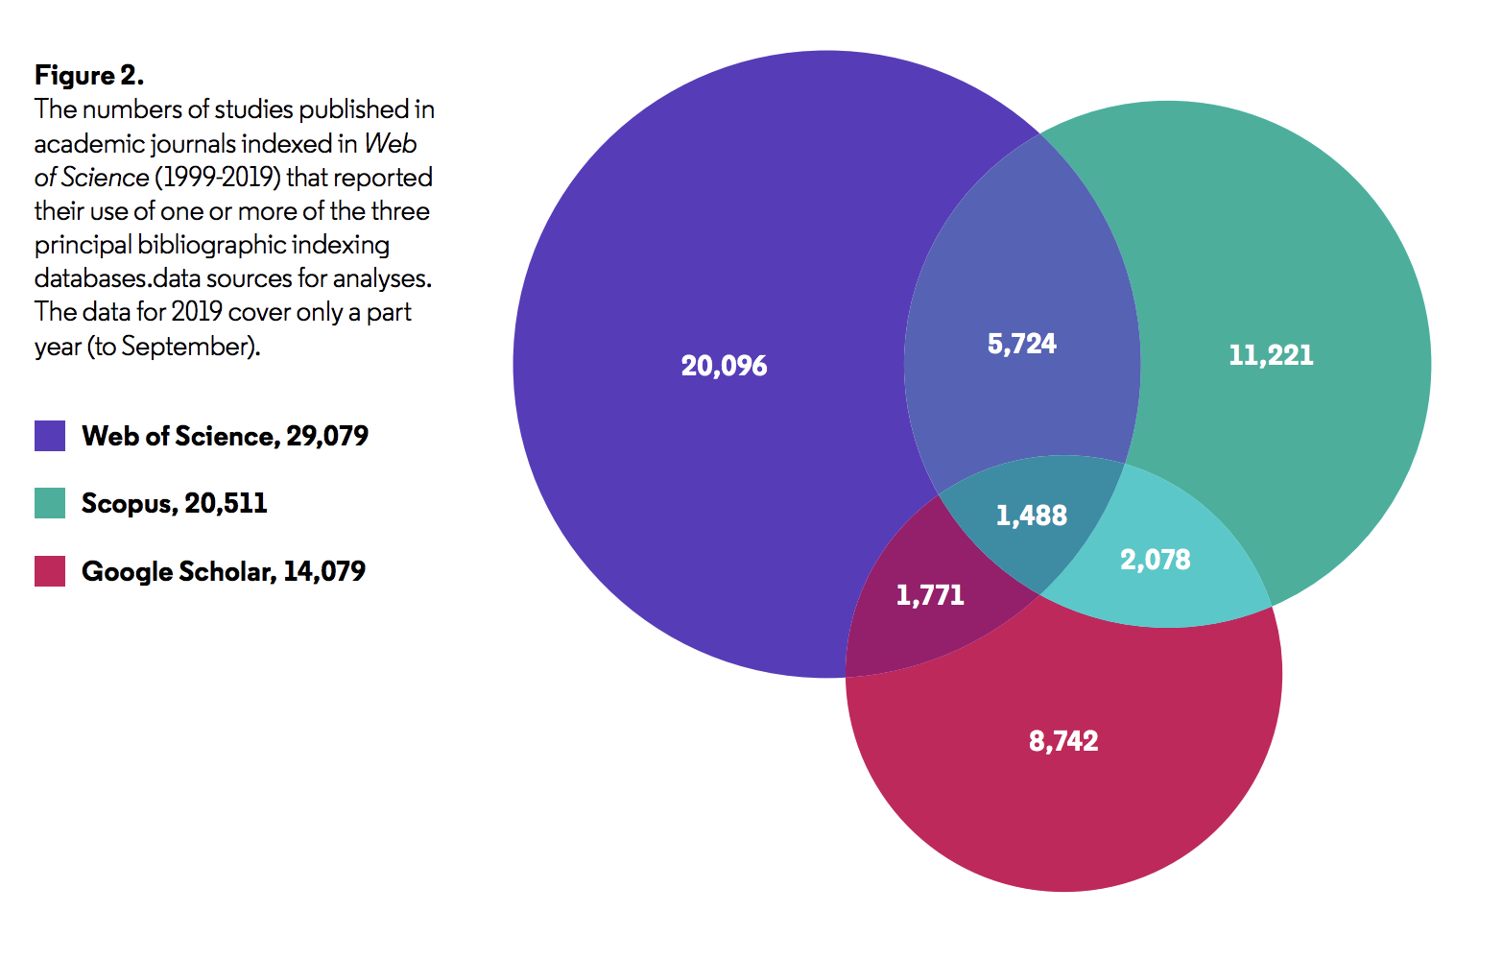
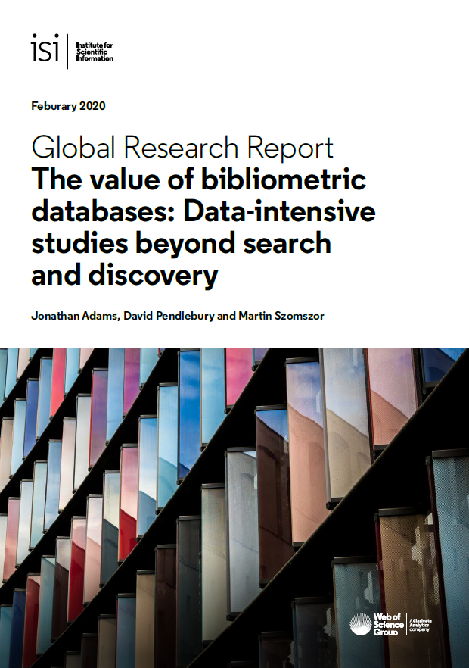
More researchers rely on the Web of Science Core Collection than on Scopus and Google Scholar for systematic review and research evaluation.
Read ISI's Value of Bibliometric Databases Report

Slide 31
Independent studies confirm Web of Science quality indexing
Web of Science data provide you with discovery and analytics superior to competitor tools
“…the data recorded in [Web of Science] is generally more curated than the data in Scopus. Scopus is a combination of data that have been collected from several sources, and there are a number of telltale signs…
Côté, G., Roberge, G., & Archambault, É. (2016). Bibliometrics and Patent Indicators for the Science and Engineering Indicators 2016: Comparison of 2016 Bibliometric Indicators to 2014 Indicators.
“It turns out that according to our citation-based criteria, Web of Science performs significantly better than Scopus in terms of the accuracy of its journal classification system.
Wang, Q., & Waltman, L. (2016). Large-scale analysis of the accuracy of the journal classification systems of Web of Science and Scopus. Journal of Informetrics, 10(2), 347–364. doi:10.1016/j.joi.2016.02.003
“The largest proportion of articles with funding information was found in Web of Science (29%), followed by PubMed (14.6%) and Scopus (7.7%).
Kokol P, Vošner HB. (2018). Discrepancies among Scopus, Web of Science, and PubMed coverage of funding information in medical journal articles. Journal of the Medical Library Association. 2018, 106(1), 81-86. doi:10.5195/jmla.2018.181

