Slide 1
ICANN68 Recap Virtual Policy Forum
June 30, 2020

Slide 2
Meet the presenters
Statton Hammock
V.P., Head of IP Strategy, Government and Industry Relations, MarkMonitor
Brian King
Director of Internet Policy & Industry Affairs, MarkMonitor

Slide 3
Agenda
ICANN68 meeting at-a-glance
Registration data (WHOIS policies)
EPDP Phase II final report
DNS abuse
COVID-19 response
ICANN compliance
Policy working group updates
Subsequent Procedures working group
Rights Protection Mechanisms working group

Slide 4
MarkMonitor presence at ICANN
Advocate
On behalf of our clients’ intellectual property rights
Encourage policies that enhance consumer trust and safety on the Internet
Participate
In ICANN’s policy development process working groups and constituency meetings
Develop relationships
With ICANN senior officials, strategic partners, governments and law enforcement for the greater benefit of our clients

Slide 5
ICANN68 recap
Meeting at a glance
Reduced four-day meeting format
No welcome ceremony or public forum
Approximately 1,100 remote participants out of 1,154 registrations
Meeting schedule focused on individual multi-stakeholder group policy work and outreach with a focus on a few cross-community high interest topics
High interest sessions
COVID-19 and DNS abuse
Subsequent Procedures Working Group final reports
GAC sessions on the Registration Data Policy
Goal:
Explain why ICANN issues are relevant to brand owners and internet users.

Slide 6
EPDP
1
Where are we now?
Phase II policy development
Highlights of the phase II initial report
Users must be accredited; varying accreditation levels
Response SLAs exist and tighten over time
Requests cannot be denied solely because they relate to IP
Uniform requirements for request submission
Denials must include rationale, and must be sent to ICANN
Biggest issues for IP owners
Very limited automated use cases, not currently including IP
Details on evolutionary ‘mechanism’ remain undecided
Much left to registrar discretion:
Financial, technical, legal viability may be subjective
Subjective ‘balancing test’ will apply to all IP requests
Phase 1: public data, and one-off requests for redacted data
Phase 2: system for standardized access/disclosure (SSAD) for accessing redacted data
Phase 3: “legal vs. natural,” accuracy, evolving the SSAD

Slide 7
DNS abuse
2
Why is this important?
Registries and registrars are contractually required to address and mitigate various forms of DNS abuse but there is a debate within ICANN over the precise definition of ‘abuse.’
Registries and registrars generally agree on five categories of abuse
Malware
Botnets
Phishing
Pharming
Spam as delivery method for the above
Abuse does not include content that infringes the IP rights of others
Registrars and registries are not required to address forms of abuse that manifest
ICANN announced that it will not ‘police’ content

Slide 8
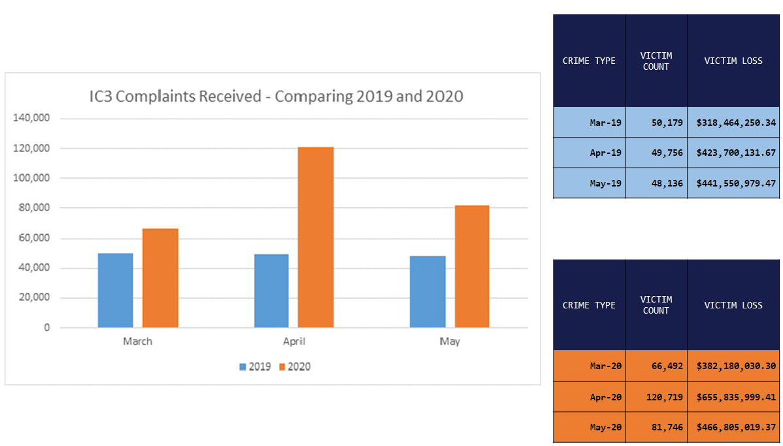
DNS abuse: COVID-19 response
2
Complaints to FBI
Marked increase in complaints submitted to www.ic3.gov
FBI referred 1,349 domains to registrars as of June 12, 2020
ICANN68 Governmental Advisory Committee Presentation

Slide 9
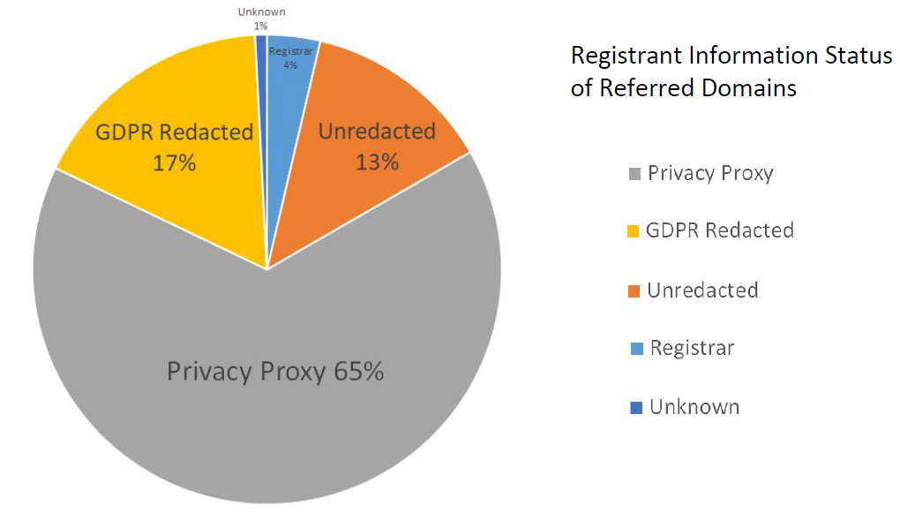
DNS abuse: COVID-19 response
2
Industry stakeholders
82% of abusive domains’ WHOIS data was redacted
Some ccTLDs and registrars monitored and blocked proactively
Registration of COVID-19 linked domains reached nearly 20,000 per day in March
ICANN68 Governmental Advisory Committee Presentation

Slide 10
ICANN compliance
3
Why is this important?
ICANN Compliance is tasked with enforcing its contractual requirement on Registries and Registrars.
ICANN Compliance was not actively engaged in working sessions for this virtual meeting, prompting several in the ICANN community to voice complaints about perceived lack of enforcement with contract provisions.
ICANN is the only party that can enforce compliance
If contracts are unenforceable then legislation may be required to mandate compliance with laws
ICANN multi-stakeholder model of internet governance could be in jeopardy if governments have to intervene

Slide 11
Subsequent Procedures working group and the GAC
4
New gTLD: Round II
Determine what, if any, changes may need to be made to the Introduction of New Generic Top-Level Domains policy recommendations from 8 August 2007.”
Current PICs in Specification 11, Section 3.a and 3.b should remain
Single-registrant TLDs (including .Brand TLDs) exempt from 11.3.b monitoring
Private resolution of string contentions
Some GAC members want to review other options
SubPro developing a way to prevent ‘gaming’ the system
‘Reducing incentives for submission of frivolous applications’
Initial report recommendations + public comments = final report
Draft final report in July 2020. Will be posted for public comment for 40 days.
Final report expected to be delivered to GNSO Council by December 2020.

Slide 12
New gTLD Round II Subsequent Procedures (SubPro Working Group)

Slide 13
Rights Protection Mechanisms (RPMs) working group
5
Next steps
Policies on brand protection
Overview
Phase 1 is evaluating RPMs established for the New gTLD program
Status updates
Finished review of all first-phase RPMs: TMCH, Sunrise, Trademark Claims, TM-PDDRP, URS
Generally positive or neutral outcomes for brand owners, no notable losses of RPMs. For example:
IP owners want ‘mark+’ Sunrise
Domain investors want Sunrise limited to TLDs corresponding to goods & services
‘Tie’ resolved by no change to current policy in many cases
Initial Report recommendations + public comments = Final Report
Final report target date is October 2020
Phase II of the work will be a review of the UDRP, slated to begin as early as Q4 2020

Slide 14
Review of rights protection mechanisms (RPMs)

Slide 15
Coming Soon:
ICANN69 Annual General
Virtual Meeting
October 17-22, 2020

Slide 16
Q&A
Please type your question into the Q&A box on your screen.
For more information on MarkMonitor solutions, services and complimentary events contact us: email: field.marketing@markmonitor.com
website: www.markmonitor.com

Slide 17
Get involved!
Intellectual Property Constituency (IPC) https://www.ipconstituency.org/
Business Constituency (BC) https://www.bizconst.org/
Domain Name Association (DNA) https://thedna.org/
Brand Registry Group (BRG) https://brandregistrygroup.org/

Slide 18
Thank you
clarivate.com/markmonitor

