Slide 1
How to build an effective CMC strategy
Building a CMC strategy aligned to commercial and pharmaceutical needs of today
Sam Kay
11/03/2021

Slide 2





Defining what a CMC strategy is
Create goals for the yield of a product, while balancing the quality and reliability of manufacturing
A CMC strategy is a set of aims to align the CMC of each product to the overall corporate strategy to gain a competitive advantage
Ensure reliable and continual manufacturing of product to avoid shortages
De-risk the manufacturing process, ensuring sites require minimal maintenance and minimal regulatory interventions
Ensure quality of the product matches the regulatory requirements
Flexible to ensure strategy can react to regulatory changes in multiple territories
Notes:
INTENT OF THIS SLIDE: Define relevant product and service offerings to that can address their challenges
[when talking to CROs: With todays continued shift to outsourced models, the need for CROs to guide and advise customers on the regulatory landscape is growing. Our regulatory solutions are all designed to help you navigate this landscape, efficiently and with confidence.]
How do you ensure you’re referencing the most up-to-date documents each day? Cortellis Regulatory Intelligence is your single source to navigate the regulatory landscape and efficiently drive strategic decisions. A team of regulatory experts and local consultants take the hard work out of manually compiling and tracking all the info, freeing up your resources to focus on more value-added work.
If you need a more customized approach to access, distribute and analyze the latest regulatory intelligence, you can work with our consulting team to design a customized solution that meets your exact needs.
The Centre for Innovation in Regulatory Science provides an international forum for industry, regulators, HTA and other healthcare stakeholders to meet, debate and develop regulatory and reimbursement policy through the innovative application of regulatory science and to facilitate access to medical products through these activities.
BioWorld Today is your single, unbiased source for pharma news, while BioWorld MedTech provides daily updates on the medical device industry.

Slide 3
Corporate strategy vs CMC strategy
Start at the top level – the mission statement
Work your way down to the corporate strategy
This feeds into the product strategies
Which dictates the CMC strategy
Example of a CMC strategy for a generics firm:
to be a global leader in generics and biopharmaceuticals, improving the lives of patients.
Capturing market share while maintaining High quality medicines which are affordable and efficacious.
Targeted sales to capture market share in a disease area, while ensuring high quality and maintaining affordability
Secure API production, more localized manufacturing, high yield manufacturing, cheap manufacturing processes & focus on QA activities.

Slide 4
Poll question
Does your organization have a well-defined CMC strategy?
Yes – we have a well-defined strategy
We’re working on it
We haven’t started
We don’t have a strategy

Slide 5
How do you build a strategy
Three methods which are used to build strategies
Use the three methods to build a strategy
Justification for why the strategy is a good strategy
Allows for flexibility in rapidly changing environments
PESTEL analysis –
Political
Economic
Social
Technological
Environmental
Legal
Porters 5 forces analysis:
Power of suppliers
Power of buyers
Threat of new entry
Industry rivalry
Threat of substitute
SWOT analysis –
Strengths
Weaknesses
Opportunities
Threats

Slide 6
How does a strategy work?
Information is a cornerstone of a strategy
Plan
Strategy
Intelligence
Use intelligence to create a strategy
The strategy dictates the operational plan
The plan is a list of activities, prioritised, to provide structure to CMC activities
Activities such as lifecycle management and new drug applications are carried out in operations
Operations

Slide 7




Workflow of how to build a strategy
Careful planning is required to build a robust strategy
Defining the strategy
Identify what questions needs to be asked
Gather the intelligence
Aim to answer the questions
Take note of the sources of intelligence
Build the strategy
Input answers into the strategy methodology
Ensure alignment with corporate/product strategy
Ensure communication is open
Decide on the strategy methodology
Contextualise the intelligence
Review the strategy
Ongoing process of revalidation of strategy
Communicate changes to strategy from new intel
Notes:
INTENT OF THIS SLIDE: Present customer challenges Cortellis Regulatory Intelligence can address
It’s obvious that regulatory requirements are difficult to track given that there are new changes almost every day and there is a lack of harmonization across all the regions you work in. If you and your team aren’t referencing the most recent documents, you risk facing citations, fines, and failed submissions. Ultimately resulting in wasted time, money, and resources.
Probing Questions:
Are you confident you have the latest/greatest regulatory requirements? How do you ensure your colleagues are aware of these?
How do you ensure you’re not missing requirements that could result in penalties or even potential legal issues if not acted upon in a timely manner?
How do you guarantee regulatory compliance in the various countries where you do business?
How much time do you spend selecting the right information for different stakeholder groups to ensure company-wide compliance?
How much time do you spend monitoring regulations and comparing country requirements?
How much time are you able to spend analyzing the impact of regulatory changes?
Is that enough?
How complex is it to build global regulatory strategies and follow-up on them to make sure they don’t need to be revised?
How does your regulatory strategy account for potential issues that may delay the product approval?

Slide 8
Textbook example of how to create a CMC strategy
An example of how ‘AwesomePharma’ would build a strategy
AwesomePharma is a made-up company looking to build a CMC strategy
Their mission statement is to “be the best at manufacturing cheap medicines”
Their corporate strategy is to “undercut competition and grow market share in the generics space”
They are looking to launch a new oncology small molecule generic into the EU and Chinese markets
You work in the CMC department. They want you to build their CMC strategy by next month in time for the corporate team meeting

Slide 9
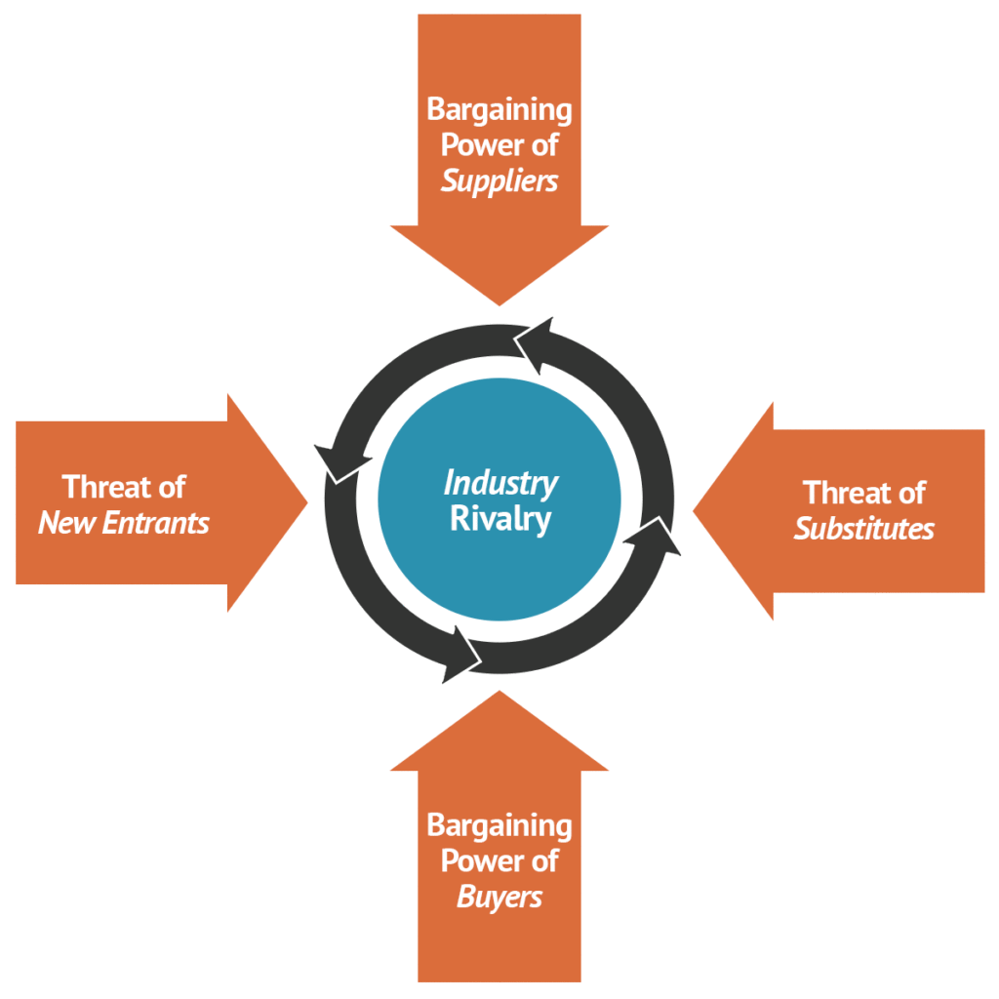
Step 1, part 1: How will you build your strategy?
You have 3 options to choose from – PESTEL, Porters 5 forces and SWOT.
Your company is looking at growing market share as a focus, so you chose Porters 5 forces and SWOT analysis combined
SWOT
SWOT
SWOT
SWOT
SWOT

Slide 10
Step 1, part 2: What questions will you ask?
Power of suppliers:
How many CMOs can manufacture your drug in the EU and China? Who are they?
Prices? Quality? Speed? Reliability?
Same questions for API and excipient providers, as well as logistics, QA and storage.
Threat of substitutes:
Is there other drugs which are first line in those markets? Do they control market share?
Industry rivalry:
Who is my competition in those markets? What is their market share?
What is their mission statements? Will we have a race to the bottom with prices?
Can we undercut their prices?
Threat of new entry:
Who has similar products already in the EU and China?
Who has the same drug in different markets?
Power of buyers:
Is the price controlled by government or free market? Do I need to go through a HTA?
Does quality matter to the buyers? Does security of supply matter to the buyers?

Slide 11



Step 2: Answering those difficult questions
Where to explore data to make informed strategies
Focus on high quality data. High quality data leads to better strategy decisions which results in more efficient operations
Comprehensive databases enables more time spent answering questions rather than looking for the information in the first place
Look for ways for the information to be immediately useful to build a strategy. If you must comprehend the intelligence every time prior to use, its time wasted.
Notes:
INTENT OF THIS SLIDE: Present sample use case
One of the most popular uses of Cortellis Regulatory Intelligence is to track regulations. Since Cortellis is updated daily, you can let the system work for you by setting up custom alerts that will push new information to you when it is added to the system.
If you need a quick and easy summary of all regulations regarding a specific topic, our team of regulatory experts compile Regulatory Summaries that link to all original reference documents.

Slide 12

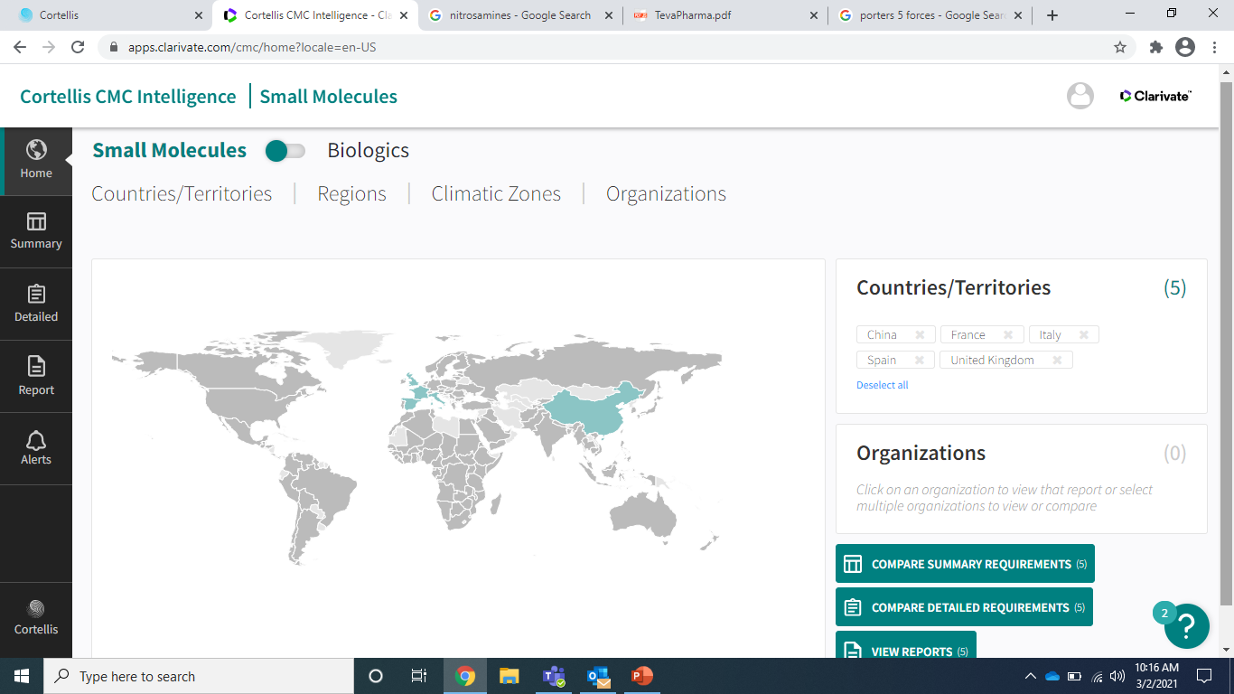


Step 2: Answering those difficult questions
Using Clarivate’s high quality data to answer those questions
Using CMC intelligence, you can rapidly identify CMC requirements in over 137 countries. With high quality data, you can make confident decisions on CMC strategy
On average, 2 hours a week is spent on intelligence gathering. The time spent could be cut by 30%, enabling more time to be spent on value-add activities.
Notes:
INTENT OF THIS SLIDE: Present sample use case
One of the most popular uses of Cortellis Regulatory Intelligence is to track regulations. Since Cortellis is updated daily, you can let the system work for you by setting up custom alerts that will push new information to you when it is added to the system.
If you need a quick and easy summary of all regulations regarding a specific topic, our team of regulatory experts compile Regulatory Summaries that link to all original reference documents.

Slide 13
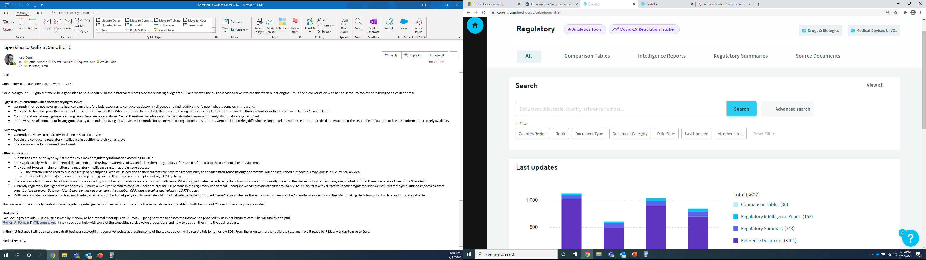


Step 2: High quality data
High quality data leads to better decisions
From identifying documents to be added into the system, to the multiple rapid checks in place before the data is consumable, quality is built into Cortellis Regulatory Intelligence. The vast experience of the editorial team ensure manual translation of documents, as well as validation of information.
Cortellis regulatory intelligence is the gold standard of high-quality regulatory information and intelligence. As a result, not only do 90% of the top 30 pharma companies in the world rely on the data, but also why regulatory agencies also use the data.
Notes:
INTENT OF THIS SLIDE: Present sample use case
One of the most popular uses of Cortellis Regulatory Intelligence is to track regulations. Since Cortellis is updated daily, you can let the system work for you by setting up custom alerts that will push new information to you when it is added to the system.
If you need a quick and easy summary of all regulations regarding a specific topic, our team of regulatory experts compile Regulatory Summaries that link to all original reference documents.

Slide 14
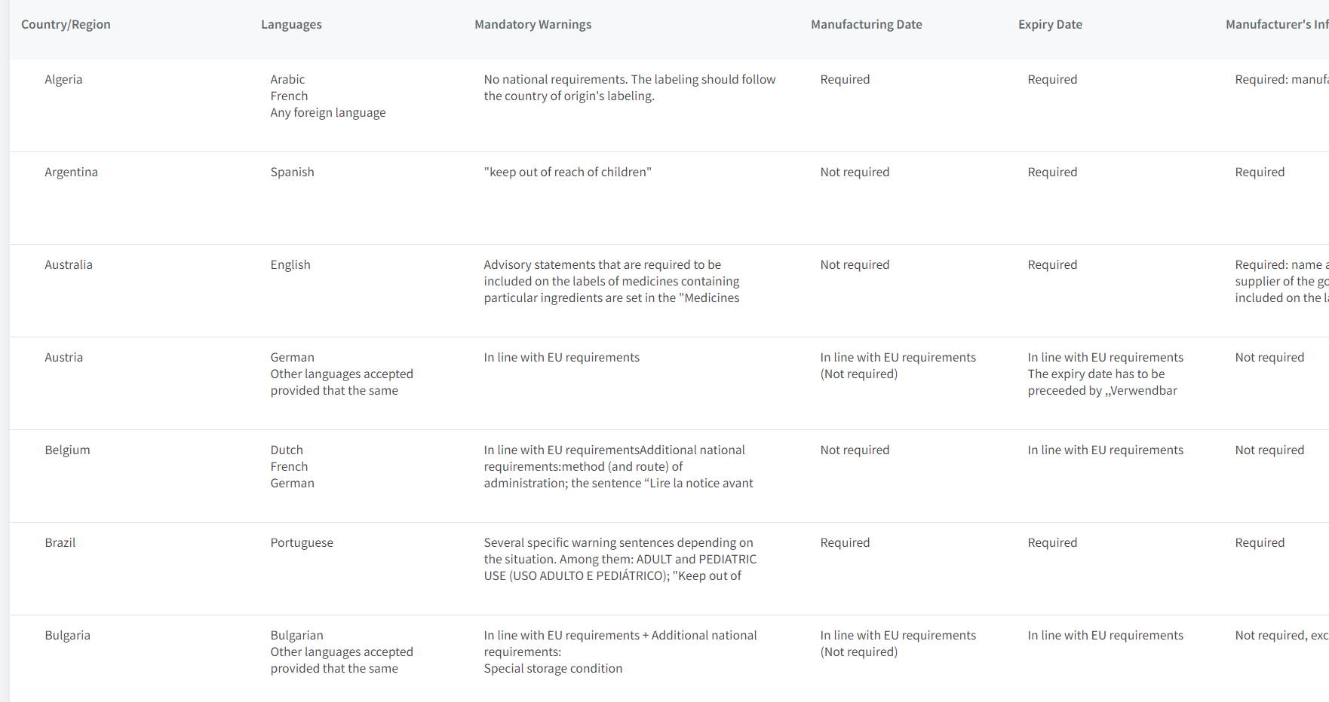

Step 2: Increasing value add activities
Enable the time sensitive regulatory team to conduct value-add activities
The time saved from having a regulatory intelligence solution can be reallocated to value-add activities. However, those activities can be further enhanced by Cortellis regulatory intelligence:
Identify regulatory barriers prior to hitting them.
Explore draft regulations in CRI for major markets
Facilitate internal harmonization of processes using the comparison tables
Enable agile regulatory strategies, outmaneuvering the complex regulatory environments
Notes:
INTENT OF THIS SLIDE: Present sample use case
One of the most popular uses of Cortellis Regulatory Intelligence is to track regulations. Since Cortellis is updated daily, you can let the system work for you by setting up custom alerts that will push new information to you when it is added to the system.
If you need a quick and easy summary of all regulations regarding a specific topic, our team of regulatory experts compile Regulatory Summaries that link to all original reference documents.

Slide 15
Step 3: Build the strategy
You now have the information and questions answered using robust intelligence, taking note of the sources of information.
With this information, you can carry out SWOT analysis for each part of porters 5 forces.
You need to share the information across the organisation to enable alignment of strategy across the organisation.
Input and share intelligence across the organisation and allow meaningful alignment of strategy. This opens the door to more robust CMC strategies

Slide 16
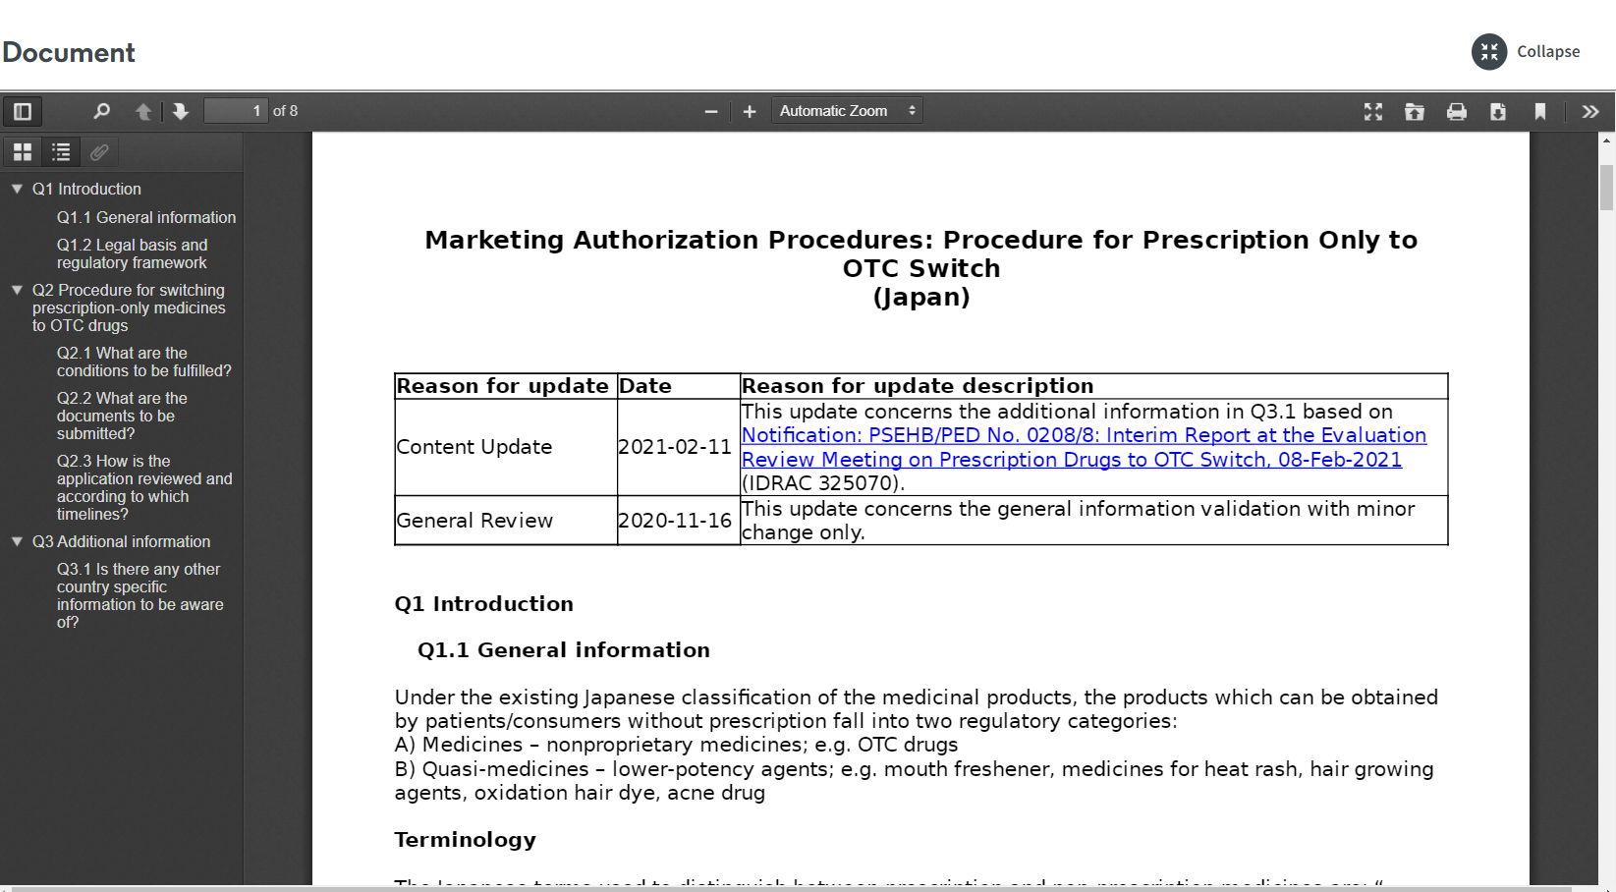




Step 4: Review the strategy
Constant monitoring of intelligence sources is required to keep the strategy up to date.
By assigning regulatory updates to the strategy teams, an optimised workflow can be created allowing for effective distribution and tracking of regulatory intelligence. All documents in Cortellis are downloadable and thus, can be shared easily.
Simplified example workflow:
Alert automatically received for new legislation for China
Strategic team for China discuss to explore the impact
Decision is made that there is an impact on supply
Summary documents and regulations are downloaded, then shared with all parts of the organisation which are impacted.
Notes:
INTENT OF THIS SLIDE: Present sample use case
One of the most popular uses of Cortellis Regulatory Intelligence is to track regulations. Since Cortellis is updated daily, you can let the system work for you by setting up custom alerts that will push new information to you when it is added to the system.
If you need a quick and easy summary of all regulations regarding a specific topic, our team of regulatory experts compile Regulatory Summaries that link to all original reference documents.

Slide 17
A review of the process
How to build a CMC strategy
Defining the strategy
Identify what questions needs to be asked
Gather the intelligence
Aim to answer the questions
Take note of the sources of intelligence
Build the strategy
Input answers into the strategy methodology
Ensure alignment with corporate/product strategy
Ensure communication is open
Decide on the strategy methodology
Contextualise the intelligence
Review the strategy
Ongoing process of revalidation of strategy
Communicate changes to strategy from new intel
Notes:
INTENT OF THIS SLIDE: Present customer challenges Cortellis Regulatory Intelligence can address
It’s obvious that regulatory requirements are difficult to track given that there are new changes almost every day and there is a lack of harmonization across all the regions you work in. If you and your team aren’t referencing the most recent documents, you risk facing citations, fines, and failed submissions. Ultimately resulting in wasted time, money, and resources.
Probing Questions:
Are you confident you have the latest/greatest regulatory requirements? How do you ensure your colleagues are aware of these?
How do you ensure you’re not missing requirements that could result in penalties or even potential legal issues if not acted upon in a timely manner?
How do you guarantee regulatory compliance in the various countries where you do business?
How much time do you spend selecting the right information for different stakeholder groups to ensure company-wide compliance?
How much time do you spend monitoring regulations and comparing country requirements?
How much time are you able to spend analyzing the impact of regulatory changes?
Is that enough?
How complex is it to build global regulatory strategies and follow-up on them to make sure they don’t need to be revised?
How does your regulatory strategy account for potential issues that may delay the product approval?

Slide 18
Thank you
Sam Kay
Saman.kay@clarivate.com
+44 (0) 7508 853 256
clarivate.com

