Slide 1

Building a stronger patent portfolio
Strategies for data-driven portfolio management
The views and opinions in this webinar are those of the contributors and
do not necessarily represent official policy or position of Clarivate™.
May 25, 2023

Slide 2




Speakers
Michael Flannery
Rosemary Bassilakis
Lydia Binek
Ricardo Horiuchi
Vice President Solution Consulting
Moderator
Assoc. Director, Patent Analytics
Sr. Solution Consultant
Sr. Solution Consultant

Slide 3
Agenda
Patent portfolio management trends
Diagnosing a non-optimized portfolio
Asking (and answering) key patent portfolio
management questions
  Evaluating R&D alignment
  Benchmarking peers
  Assessing opportunities
  Weighing protection
  Mitigating risk
Key takeaways
Q&A

Slide 4
The current state of patent portfolio management
Strategic asset
75% indicate patents are necessary for enabling further innovation
Portfolios growing in size
69% report patent portfolios have increased in the last year
Widespread enforcement
46% are enforcing patents with new litigation at least 1x per month on average
More licensing
45% intend to increase their licensing activities in the coming year
More difficult to manage
57% say building and managing patent portfolios is becoming more challenging

Slide 5







Symptoms of a non-optimized portfolio
Too many patents covering the same area → too highly concentrated
Examiners’ citing the company’s own patents when issuing rejections for new applications → overlapping coverage
Too few patents for the company’s R&D expenditure → patent output bottlenecks
A high proportion of patents are allowed to lapse early → alignment issues
Patents aren’t being enforced or licensed → patent quality
Executives don’t know what’s in their patent portfolio → awareness issues
Purpose of the patent isn’t known → value disconnect

Slide 6
Discussion
Asking (and answering)
key patent portfolio management questions

Slide 7

Question 1
How does our innovation output compare to others?

Slide 8
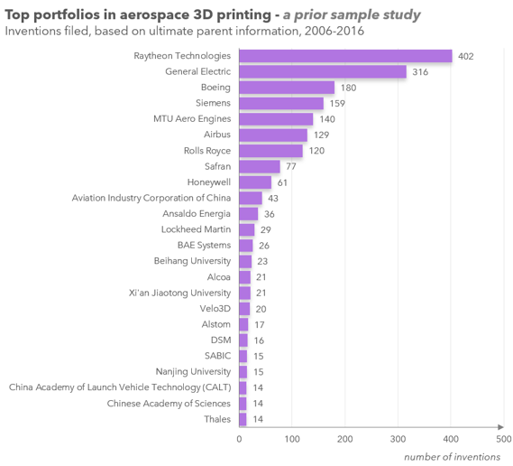
Question 1
How does our innovation output compare to others?
Volume of activity comparison in a technology domain

Slide 9
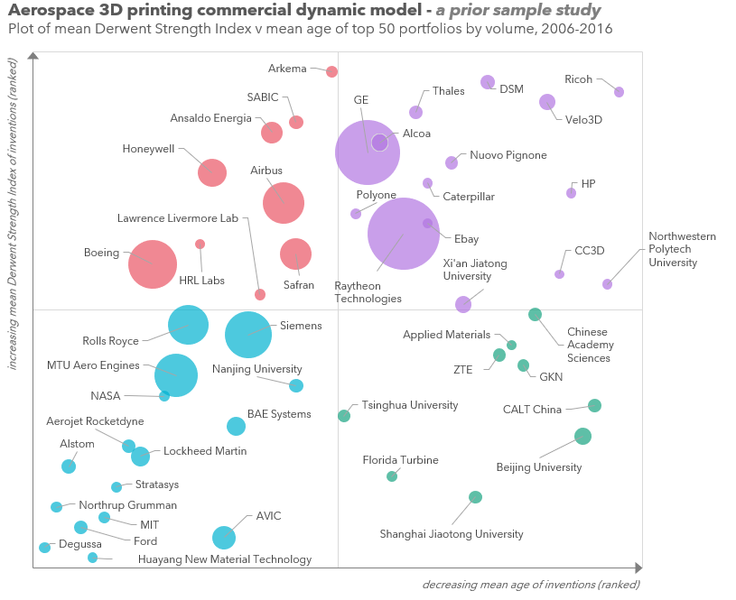
Question 1
How does our innovation output compare to others?
Derwent Strength IndexTM leverages parameters that map to desirable features: influence, globalization, success, technical footprint, and age
Commercial dynamic model considers age, strength and volume
  Upper right (purple): Emerging
  Upper left (red): Primary
  Lower left (blue): Inactive
  Lower right (green): New entrant

Slide 10
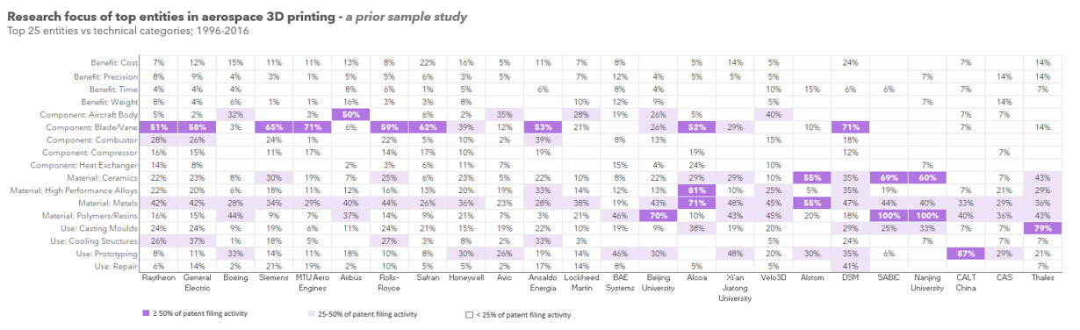
Question 1
How does our innovation output compare to others?
Is your portfolio technically broad, uniquely focused, or are there opportunities to explore?

Slide 11
Question 1
How does our innovation output compare to others?
DSM has a broad portfolio

Slide 12
Question 1
How does our innovation output compare to others?
Unique high focus is seen for:
  Thales in the use of 3D printing in casting moulds
  CLT China in prototyping
  Alcoa in high performance alloys

Slide 13
Question 1
How does our innovation output compare to others?
Boeing's and Airbus’ portfolios have opportunities in components other than aircraft body

Slide 14

Question 2
Is our innovation supporting growth strategies?

Slide 15
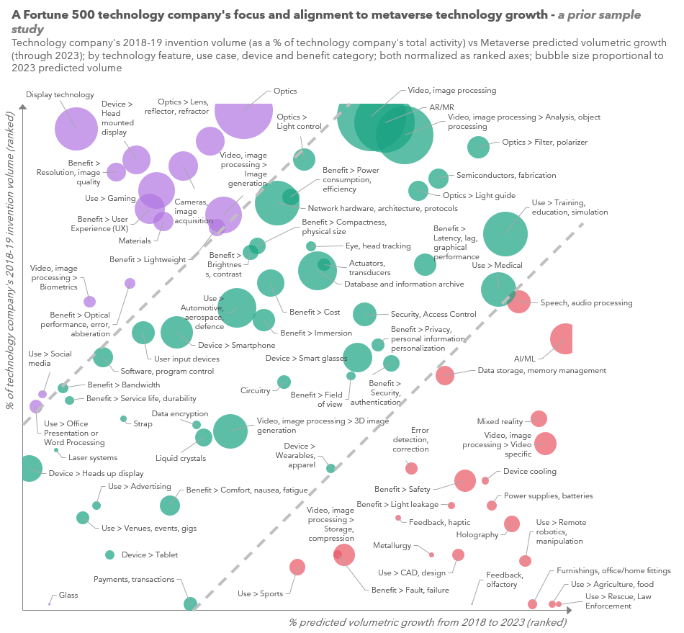
Question 2: Is our innovation supporting growth strategies?
Comparison of a company’s 'recent' technical focus to the predicted growth of technical categories overall
Upper left (purple): high company focus but low predicted growth → continue to invest? E.g. Use in Gaming and Display technology and Optics features
Bottom right (red): high growth but low company focus → missed opportunities? E.g. Uses in Rescue / Law Enforcement, Agriculture, and Remote robotics
Middle (green): correlation between company’s focus and growth categories

Slide 16

Question 3
How strong is our current patent protection for key technologies?

Slide 17
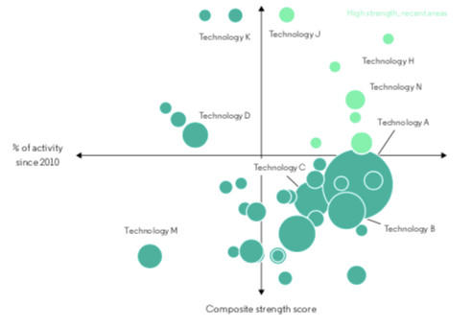
Question 3:
How strong is our current patent protection for key technology categories?
Technology Categories by Patent volume, strength and percentage of grants since 2010
Analysis of patent protection by technology category: volume, proportion of filing activity and strength
Is your patent filing activity focused on your most important technologies, in both frequency and recency?
Are your strongest patents protecting your most important technologies?
Light green: High strength and high percentage of grants since 2010

Slide 18

Question 4
How are our new patents performing?

Slide 19
Question 4: How are our new patents performing?
New patents: biggest future expense and potential
CustomStrength scores: create your own composite scores to evaluate new patents
What are the indicators / performance metrics to consider?
  Citation
  First claim word count
  Number of claims
  Type (application or grant)
  Number of inventors
  Relevance (technical areas)
  Time to grant (priority year- filed year)
  R&D spend

Slide 20

Question 5
What companies may be attempting to circumvent our patent rights, and how should we respond?

Slide 21
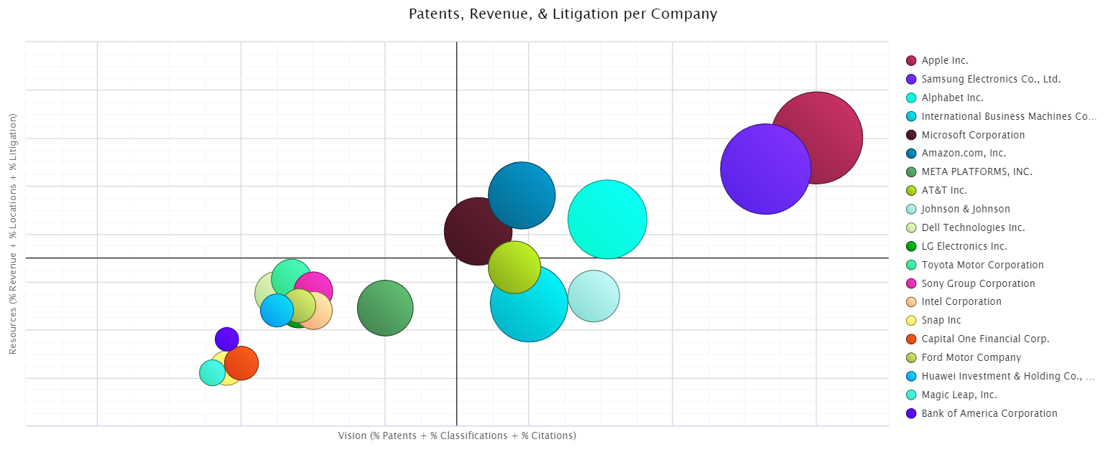
Question 5:
What companies may be attempting to circumvent our patent rights, and how should we respond?
3
1
Forward citation expansion:
Identify companies of potential concern
Bubble market map:
Prioritize companies based on resources, litigation activity and size and strength of patent portfolios
Litigation history:
Potential partner or licensing candidate, or more likely to counter-assert
Resources (% Revenue + % Locations + Litigation)
4
2
Vision (% Patents + % Classification + Citations)

Slide 22
Key takeaways
Consider applying the Dynamic Model to combine analysis of age, strength and volume to help you identify potential gaps or areas of concentration
Review new patents regularly using quantitative and strength prediction metrics to manage long term maintenance expenses
Evaluate the strength of your protection by technology category to ensure filing activities are focused on your most strategically important technology categories
Identify organizations of most concern with analysis that combines citations, company size and resources, and litigation history

Slide 23

Questions
Please type your question into the Q&A box on your screen.
Want to learn more?
Simply fill out the survey at the end of the presentation for more information.

Slide 24
Thank you

