Slide 1


Qualified Journals and Criterias:
The Importance of Peer Review
21 May 2020
Josh Dahl
Product Director, Clarivate
Ali Şahin
Publications Director, AVES

Slide 2




Questions during the webinar?
All attendees are muted by default
Enter questions into the WebEx chat or hold until the Q&A
If we don’t get to your question during the Q&A, we will follow up via email
A link to the recording and slides will be sent to you shortly after the webinar

Slide 3
Qualified Journals and Criterias:
The Importance of Peer Review
21 May 2020
Josh Dahl
Product Director, Clarivate
Ali Şahin
Publications Director, AVES

Slide 4
Agenda
An introduction to Publons
What do we mean by ‘an international, high quality journal’?
What have we learned about peer review?
    - The Global State of Peer Review Series
      - Publication Peer Review study
      - Grant Peer Review study
AVES and Publons
Q&A

Slide 5

An introduction to Publons
Turning peer review into a rewarding activity

Slide 6

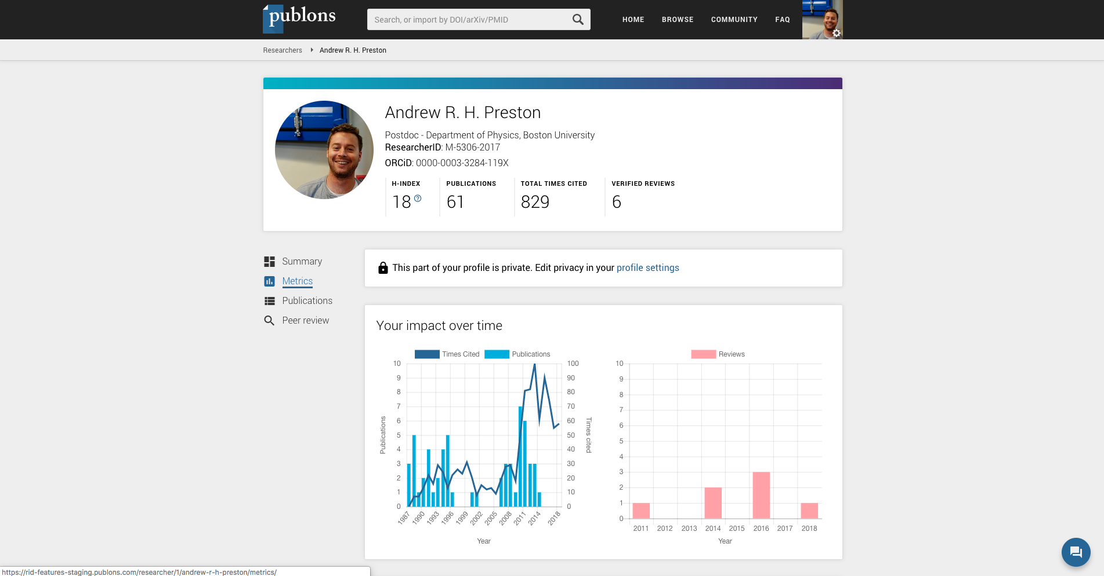
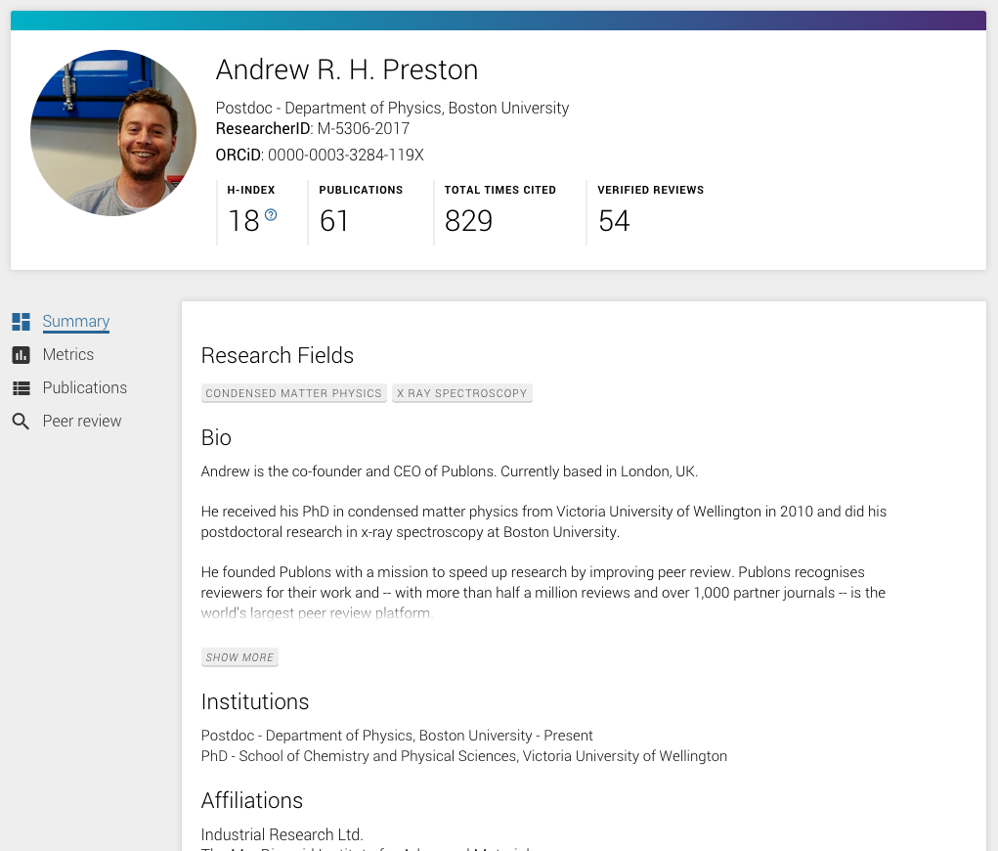
Researchers use Publons to track journal peer review and editorial work
2 million users (May 2020).
7-10k new sign ups each week.
Publons provides researchers with ready-to-use evidence of the peer review and editorial work they perform.
It is free and easy to use.

Slide 7
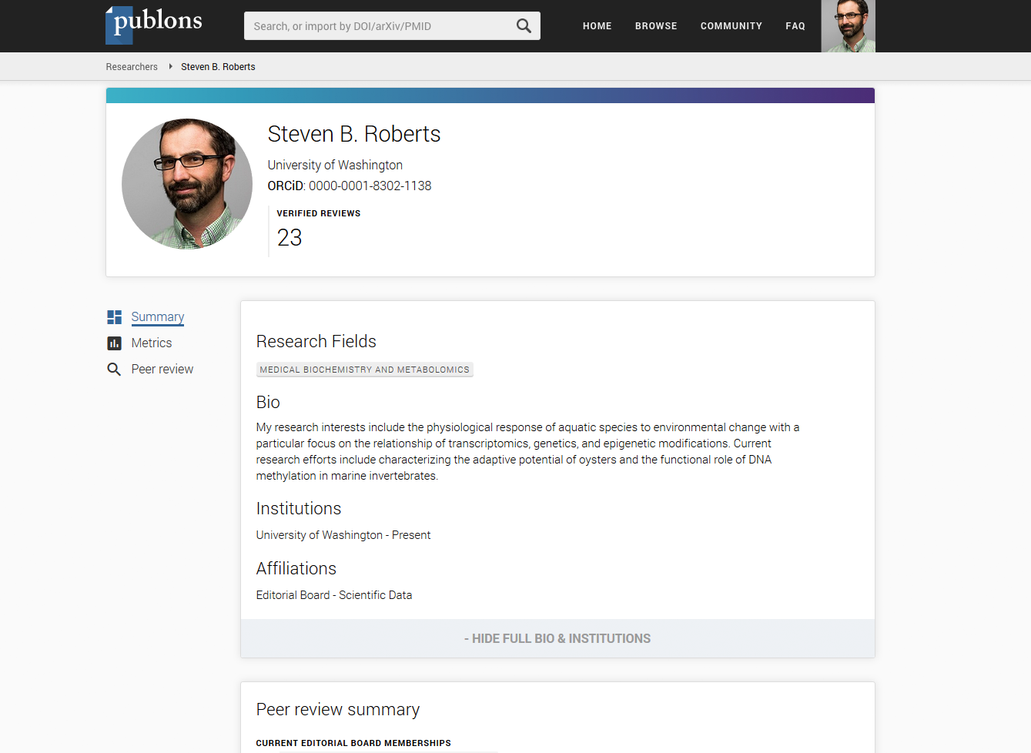
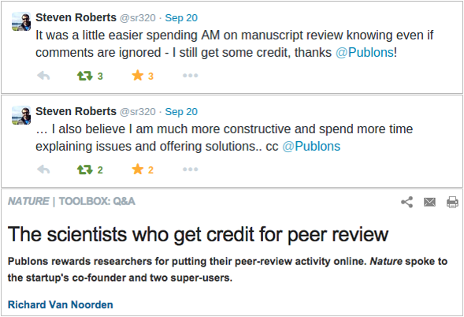
Getting greater recognition
for their critical work defending science and research.

Slide 8


























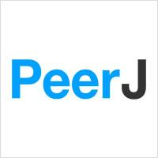



Where is Publons today?
2M+
7M+
8,000
100+
1,000
RESEARCHERS
REVIEWS
INTEGRATED JOURNALS
PUBLISHERS
NEW USERS A DAY

Slide 9
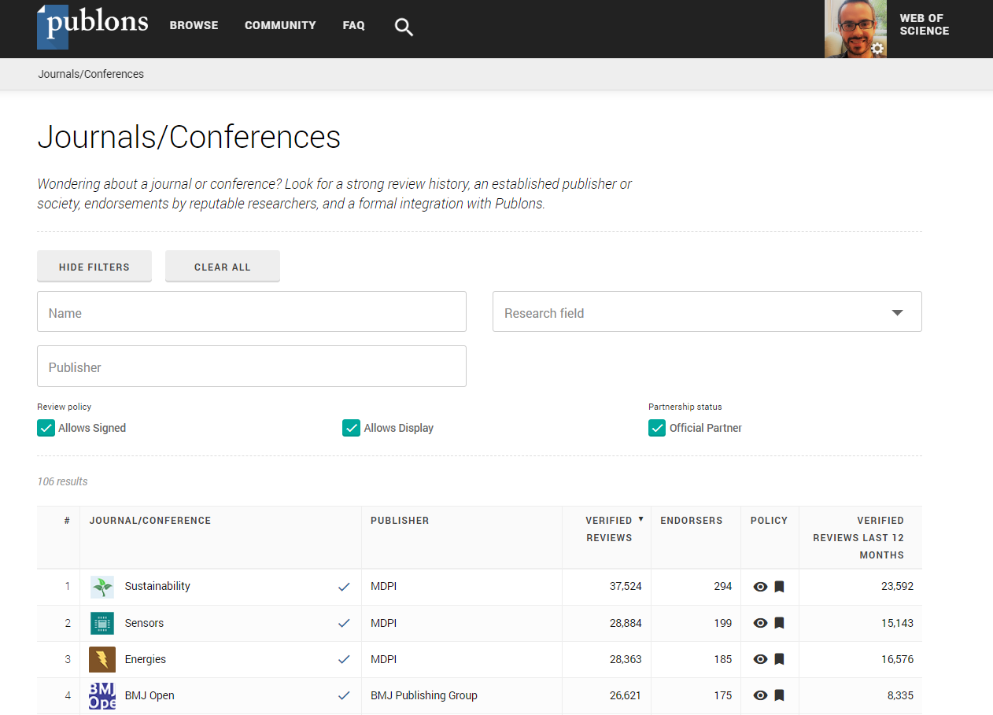
What sort of journals are on Publons?
Any journal in the world can have some kind of presence on Publons, so that...
Any researcher doing a review can get recognition for their work, which we think is best for research.
So, how do we differentiate?

Slide 10
What sort of journals are on Publons?
search
filter
sort

Slide 11
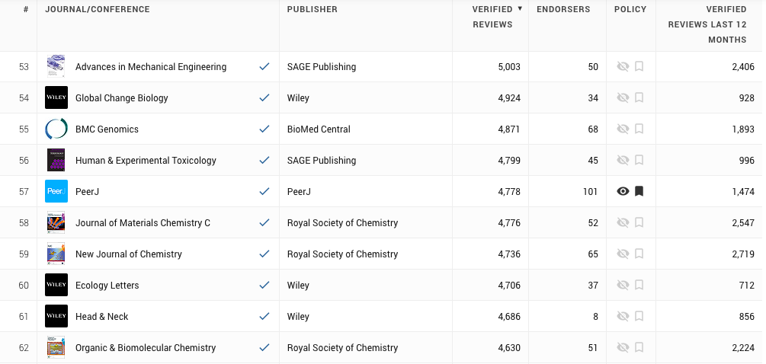
What sort of journals are on Publons?
Have they been endorsed by peers?
Have Publons verified their reviews?
Are they integrated with Publons?

Slide 12
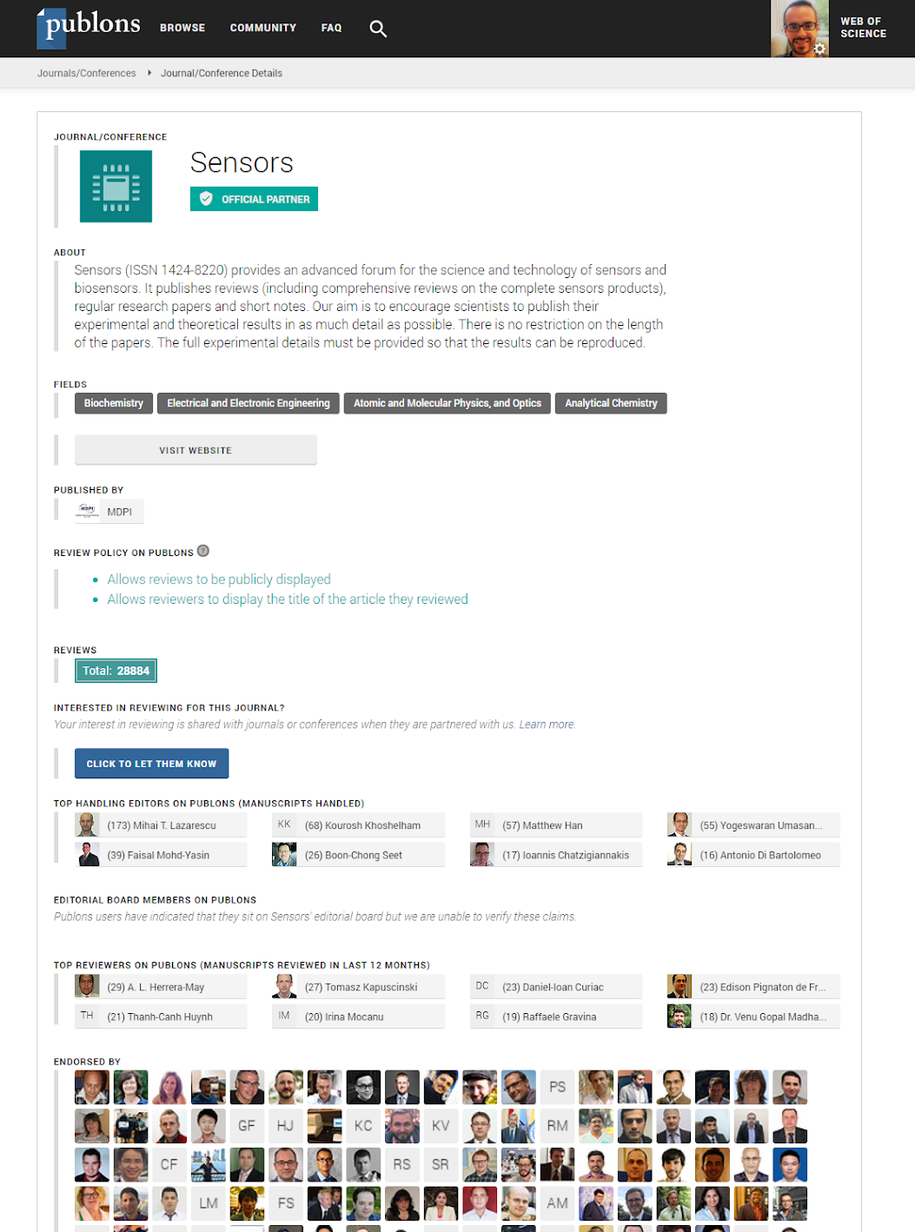
What can a researcher understand about these journals?
How many reviews does this journal have on Publons?
Are they verified?
Do any have review content added? If so is the review thorough?
Does the publisher/journal have any editors on Publons?
Are any of the researchers listed as editorial board members for the publisher’s journals on Publons?

Slide 13
What do we mean by
‘An International, High Quality Journal’?

Slide 14
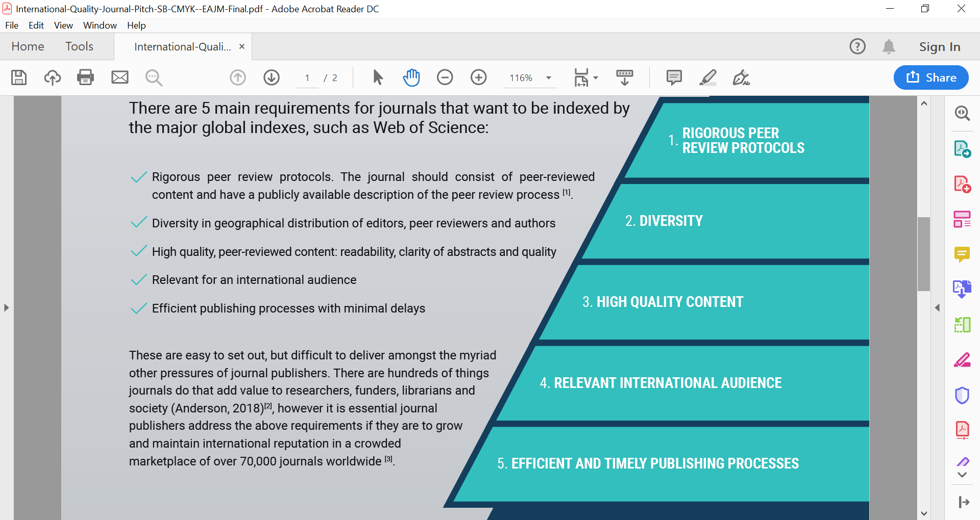
5 Key Characteristics
There are 5 main requirements for journals that want to be indexed by the major global indexes:
✔ Rigorous peer review protocols. The journal should consist of peer-reviewed content and have a publicly available description of the peer review process.
✔ Diversity in geographical distribution of editors, peer reviewers and authors
✔ High quality, peer reviewed content: readability, clarity of abstracts and quality
✔ Relevant for an international audience
✔ Efficient publishing processes with minimal delays

Slide 15
What have we learned about peer review?

Slide 16

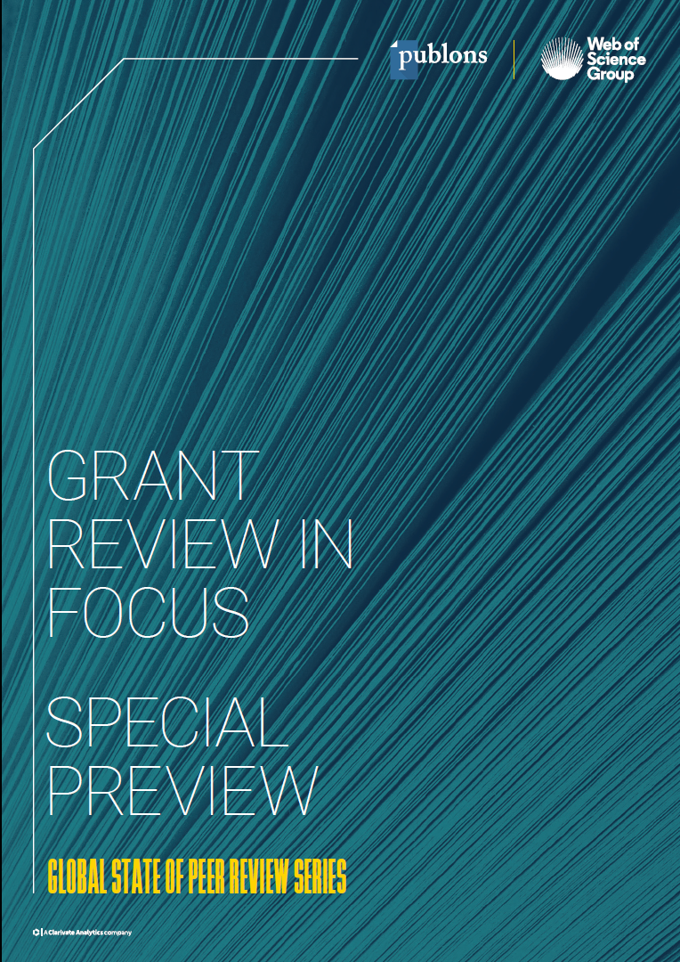
The Global State of Peer Review Series
What is it?
As stewards of rich data sets on peer review, Clarivate aims to openly share our insights with the research community - for evidence-based debate and informed decision-making.
Inaugural report published in September 2018, focused on publication peer review, and freely available.
Grant Review In Focus publishing in autumn 2019, focused on grant peer review, and freely available.
The first time cross-publisher and cross-funder data on peer review has been available at this scale.
How do we do it?
By combining data from
Largest-of-their-kind peer reviewer surveys (>15k responses in total)
ScholarOne (7,500+ journals, 2.8 million submissions/year)
Web of Science / Journal Citation Reports
Publons
Funder and Publisher interviews
ScholarOne

Slide 17
Publication Peer Review analysis

Slide 18
Key Themes
We asked four key questions
How efficient is the peer review process?
What do we know about the quality of peer review?
Who is doing peer review?
What does the future hold?
Key themes
Efficiency
Quality
Transparency
Diversity

Slide 19
Efficiency

Slide 20
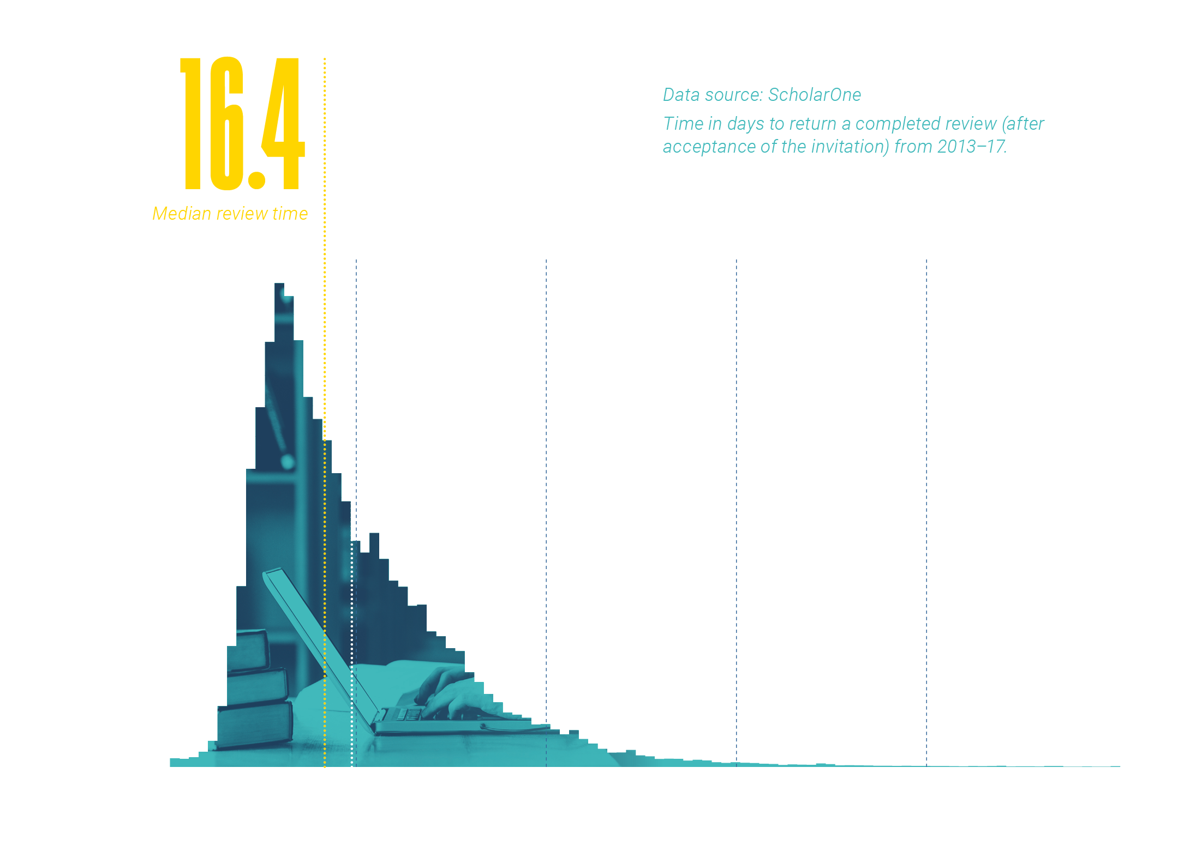
Efficiency
How long does it take to complete a review?

Slide 21
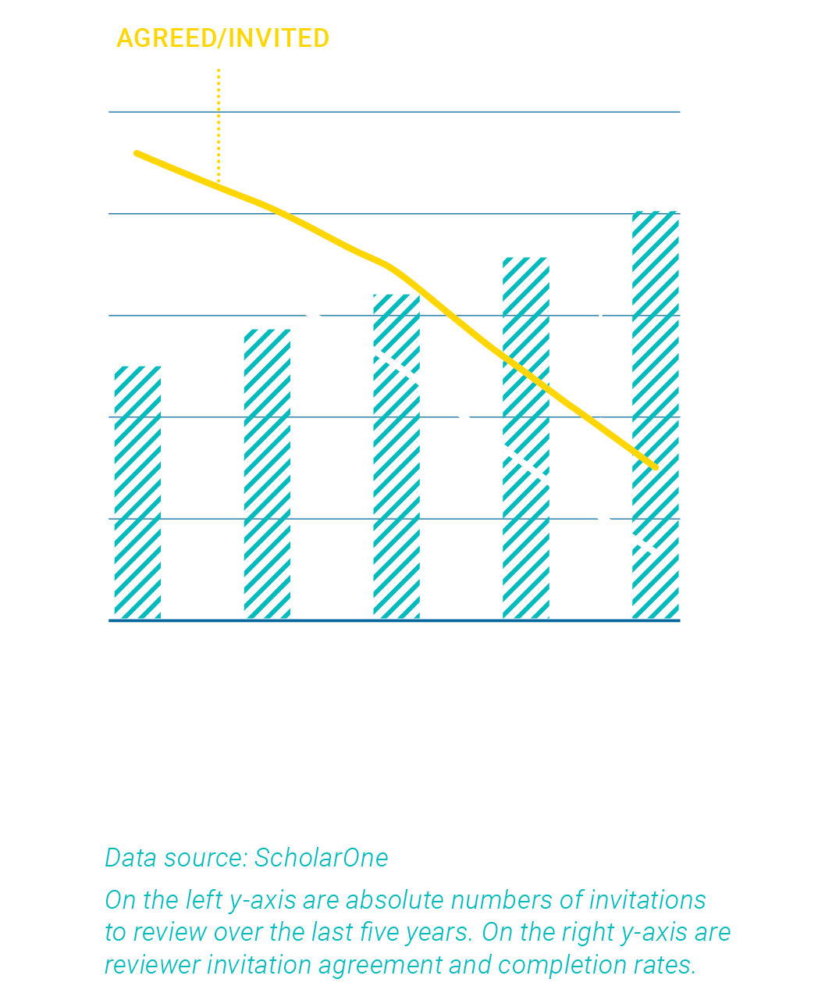
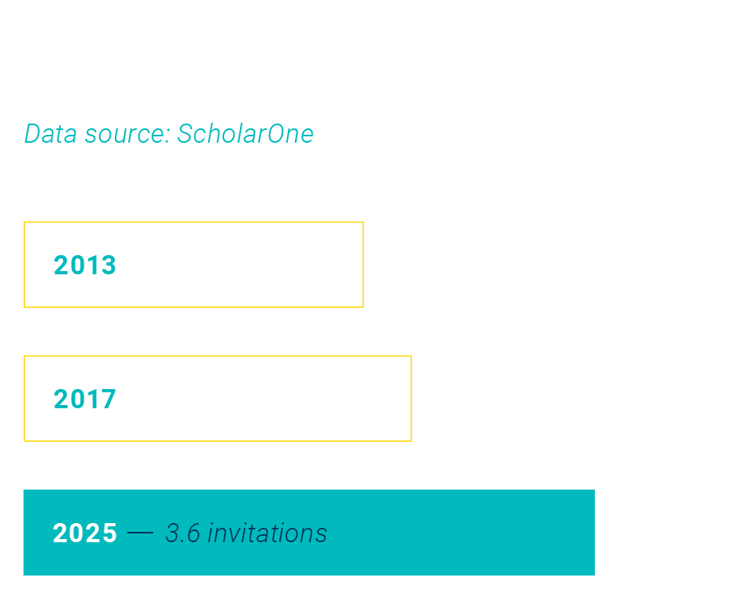
Efficiency
It’s getting harder to get review done
Notes:
Number of reviewers invited per year is going up (bar), but the acceptance and completion rate is going down (line).

Slide 22
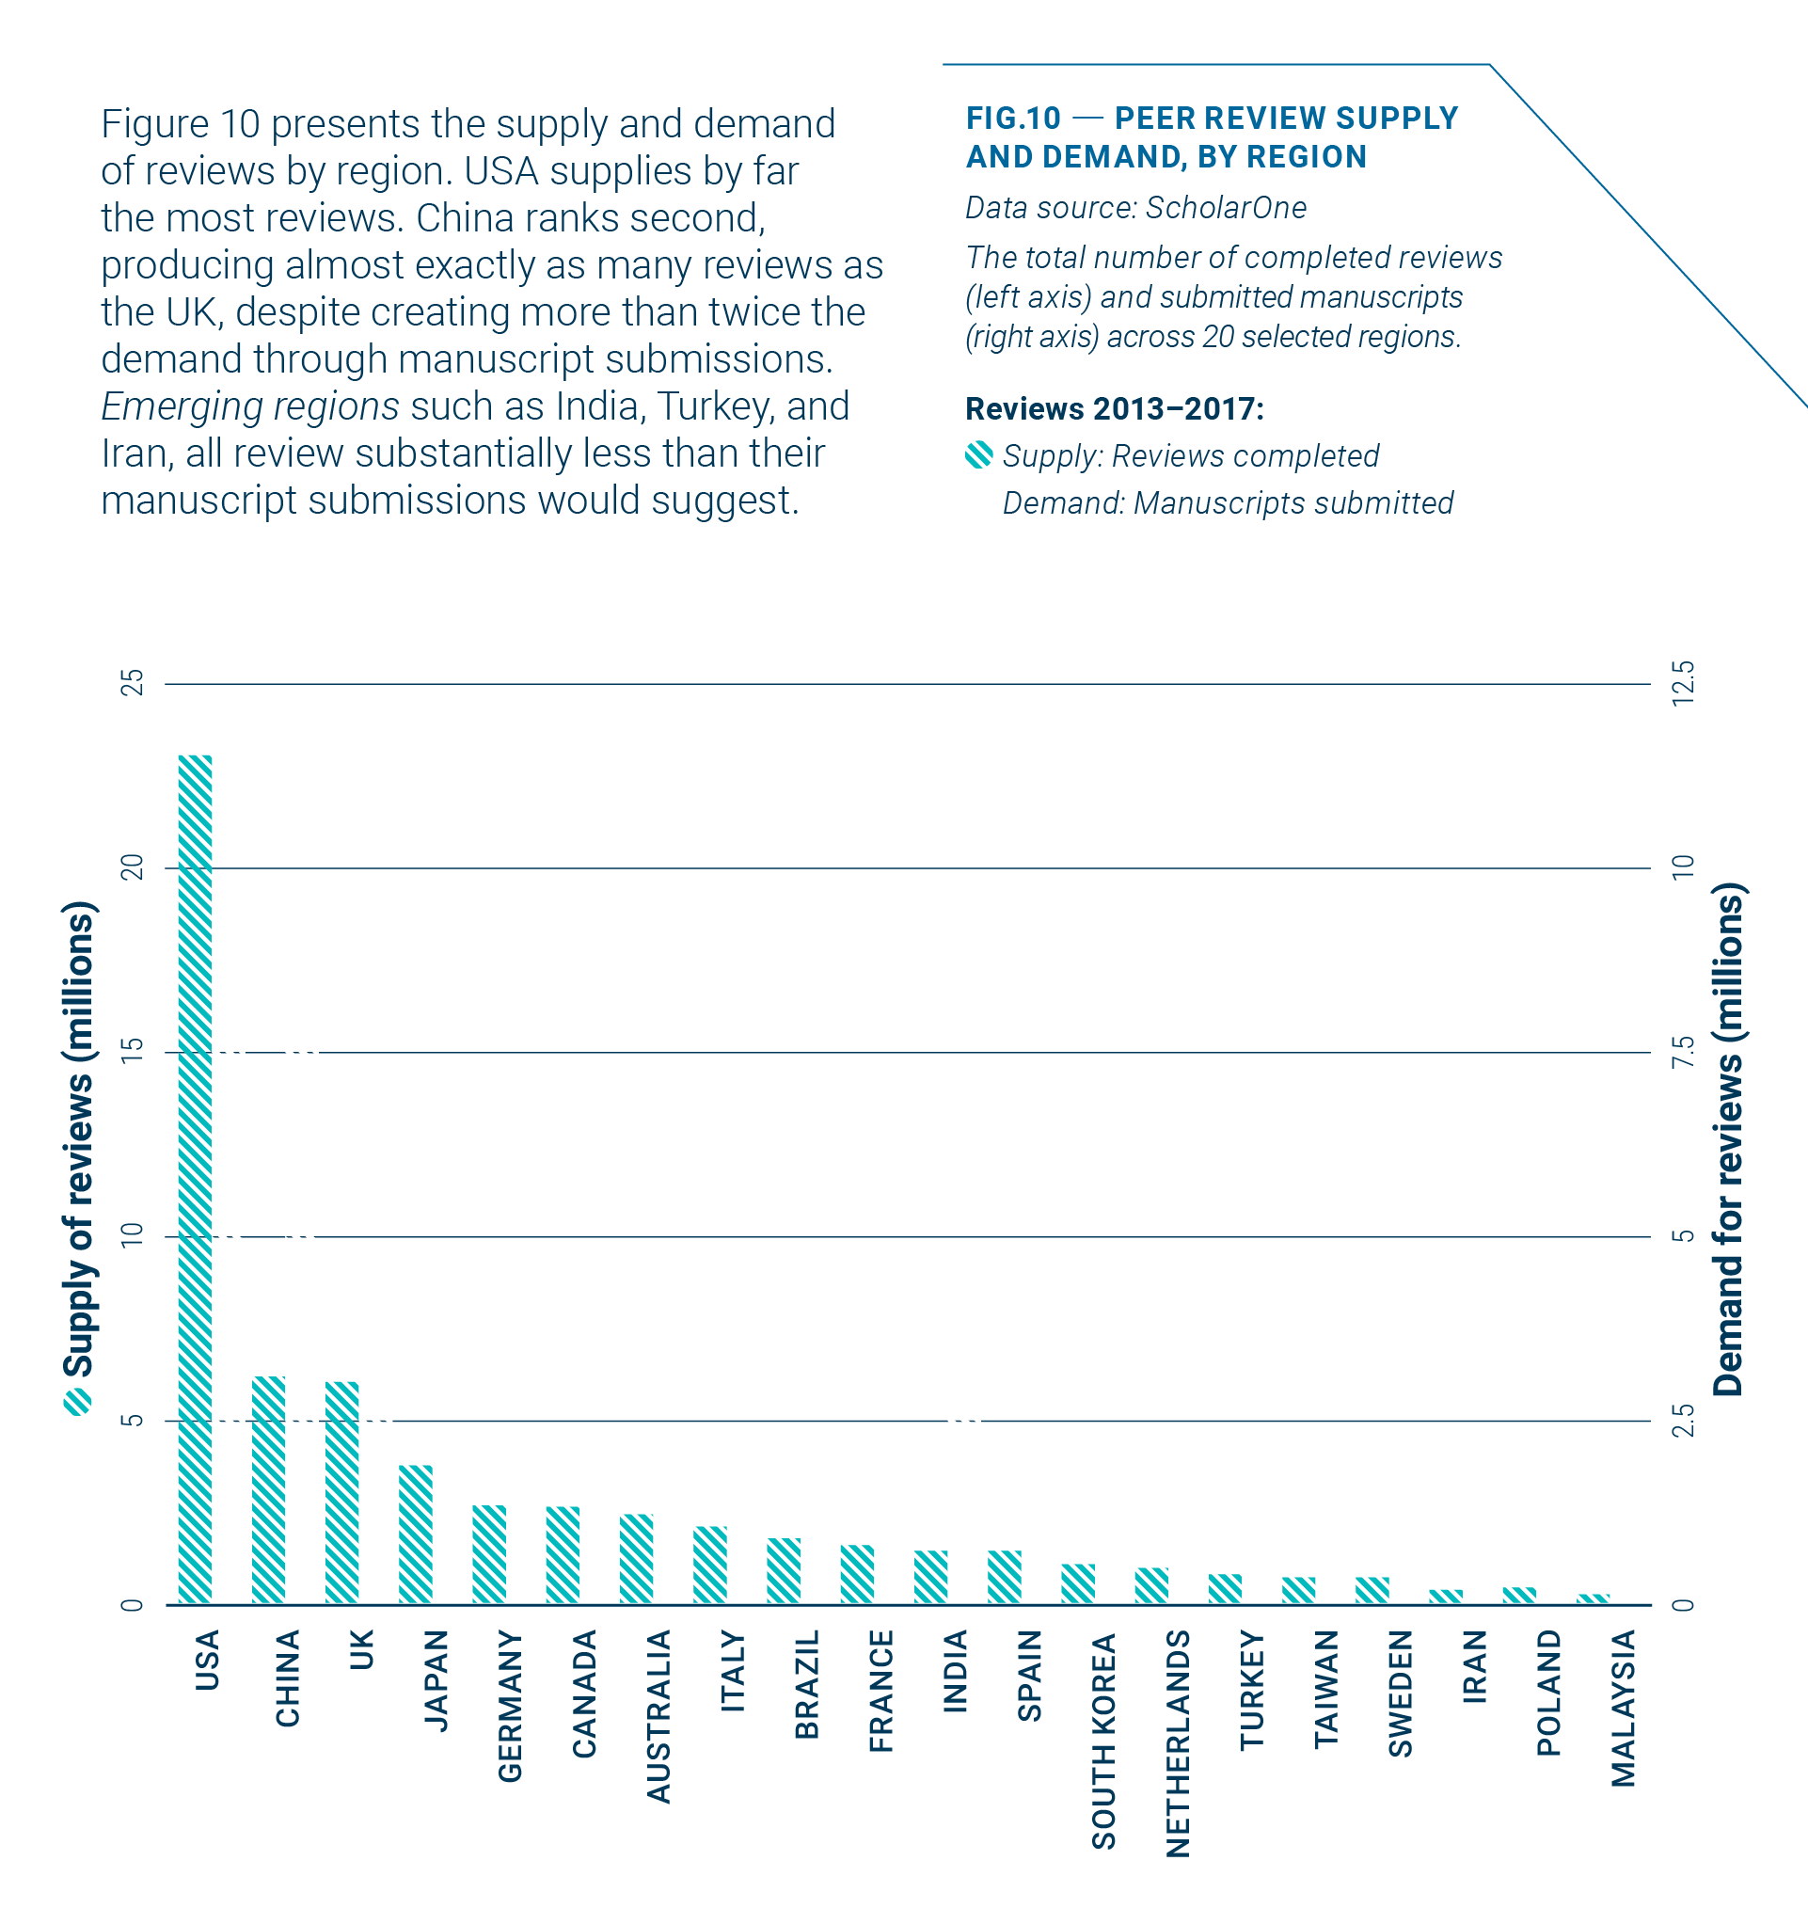
Efficiency
Global supply and demand for peer review
are not evenly matched
Notes:
Blue bar is reviews completed and white bar is manuscripts submitted. So big disparities - China and India. A Review Gap. Where blue bar is higher they are clearly being overloaded.

Slide 23
Quality

Slide 24
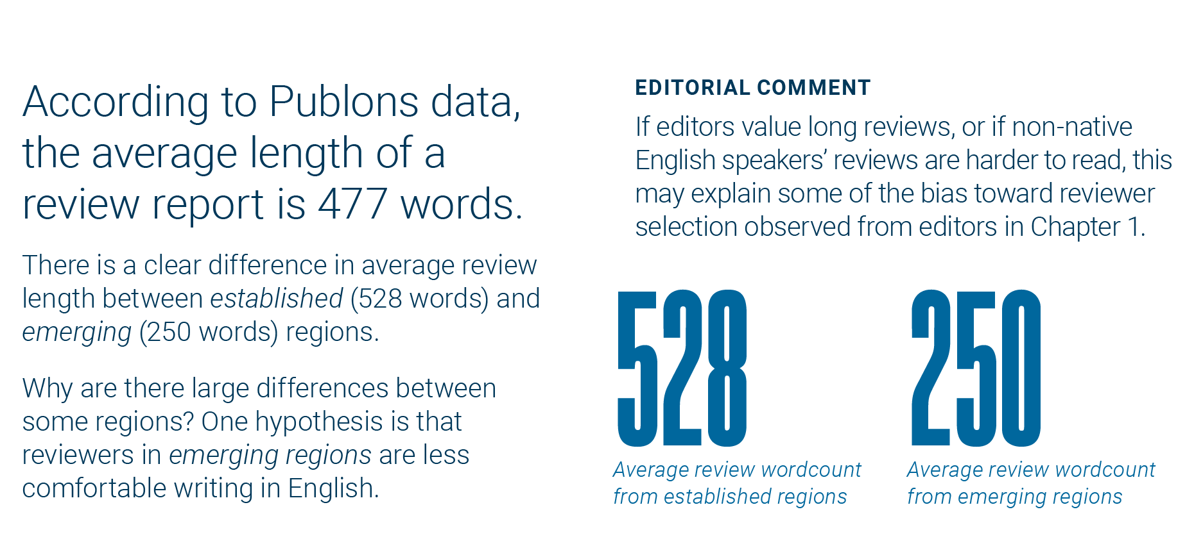
Quality
Does size matter? How long is a review?
Notes:
Anecdotally, higher Impact Factor journals tend to have longer reviews.

Slide 25
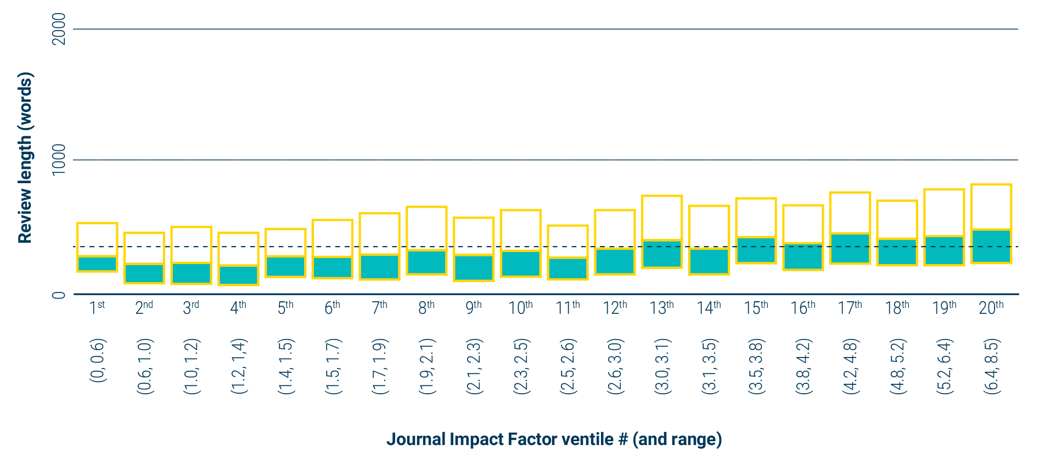
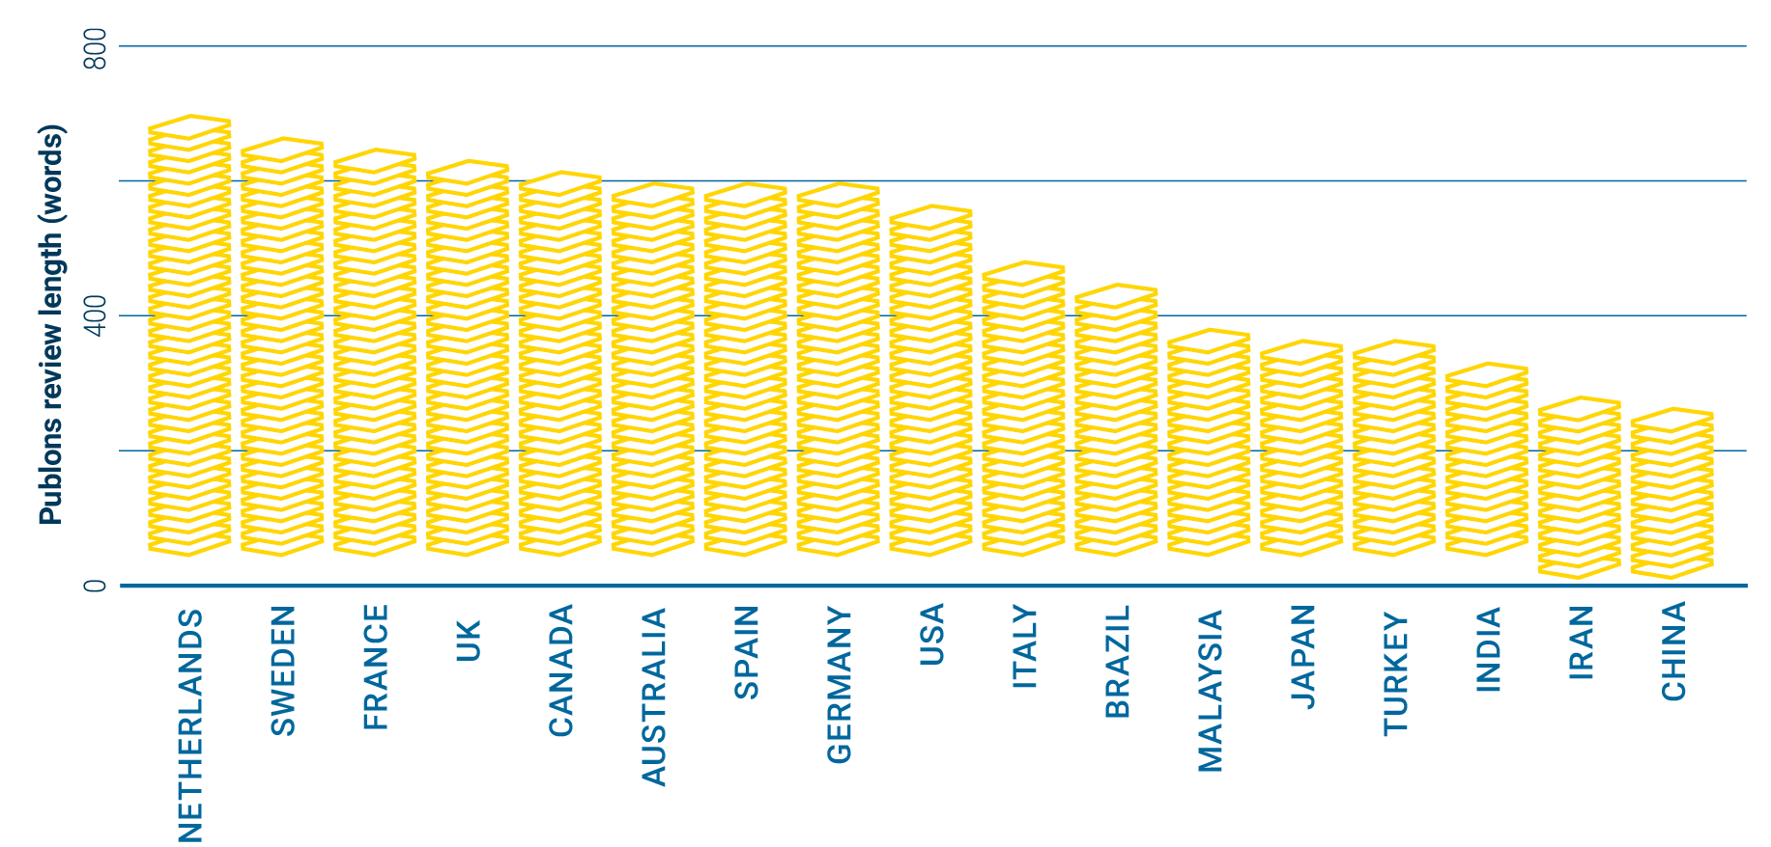
Quality
What affects the length of a review?
We observe a shift to longer reviews with increasing JIF
There is a clear difference in average review length between established and emerging regions
Notes:
Where the white meets the blue is the median. As IF goes up, review length goes up. Fairly sharp drop from established regions to emerging. (Emerging in terms of reviewing and writing for Western journals.)

Slide 26
Transparency

Slide 27
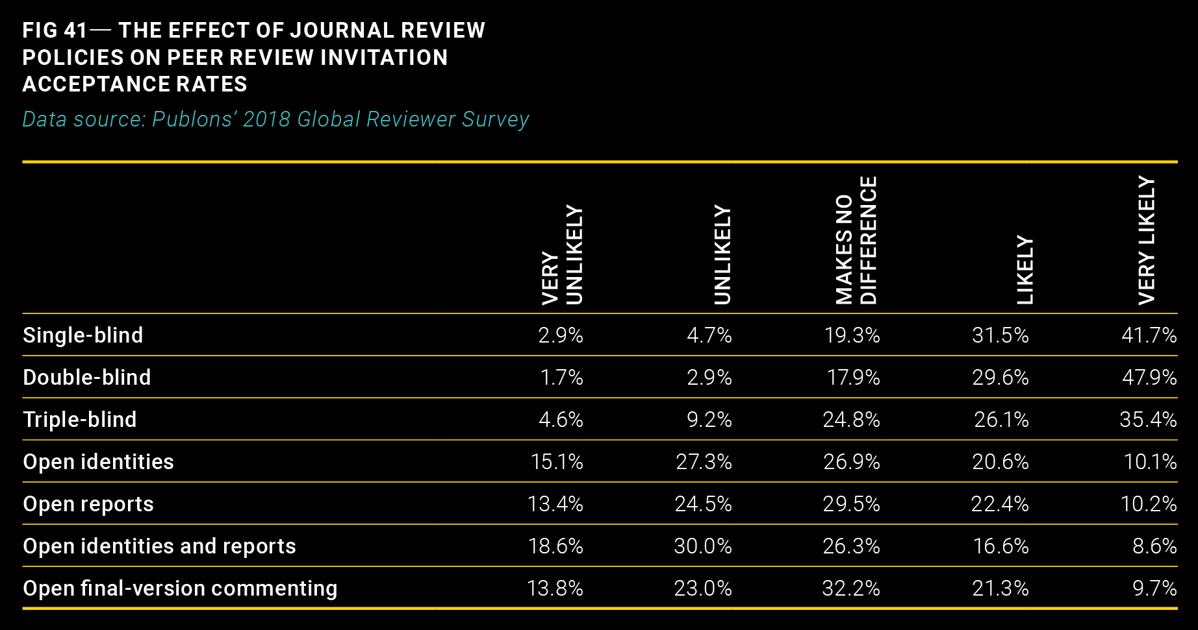
Transparency
Does review policy make a difference to
invitation acceptance rates?
Reviewers seem more likely to accept invitations from journals using blinded review models

Slide 28
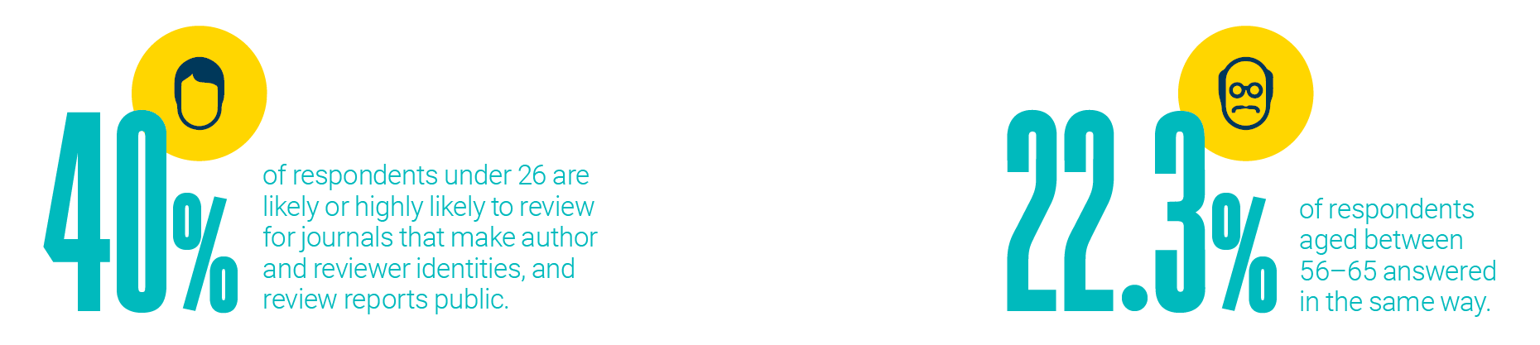
Transparency
Are there differences in attitude to review openness
across age groups?
Could attitudes be shifting as a new generation of researchers enter the ecosystem?
Or are researchers becoming less favourable to openness as they get older?

Slide 29
Diversity

Slide 30

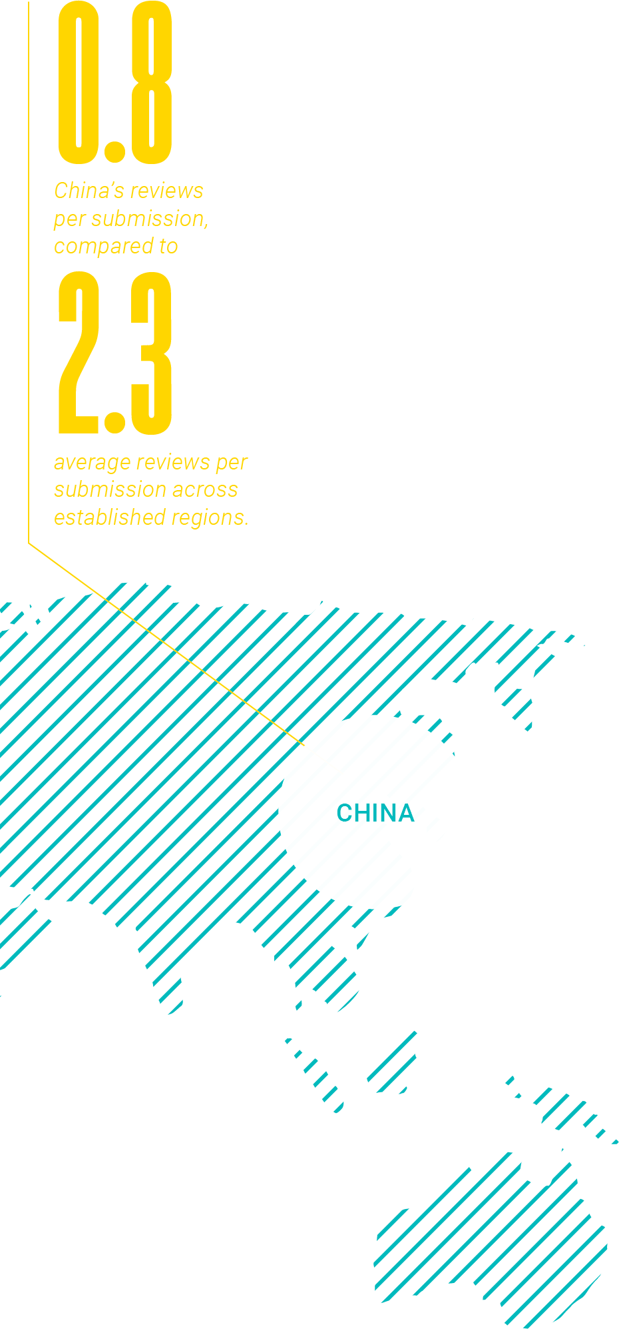
Diversity
Geographic
Established regions review more than emerging regions relative to their respective article outputs.
Editors are disproportionately selected from established regions
Editors disproportionately select reviewers from their own region.
Absolute review contributions are growing in all regions, but more rapidly in emerging regions. China, in particular, is rapidly increasing review output.

Slide 31
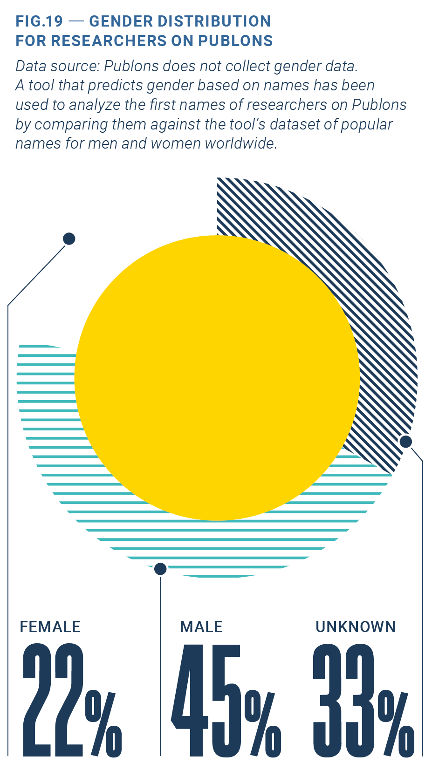
Diversity
There are few studies of gender in peer review, but early indications are that male participation is higher than female.
Using an algorithmic approach, which predicts gender based on name and region, the following gender distribution has been estimated for researchers on Publons.
While much more data are needed to draw firm conclusions, it seems women are underrepresented in peer review, or possibly in research as a whole
Gender

Slide 32
Grant Peer Review in Focus

Slide 33
Grant Peer Review in Focus
What is it?
A deep-dive into the current state of global grant peer review
Get a free copy on the Publons website here:
publons.com/community/gspr/grant-review
Developed by Publons and the Web of Science
Draws on unique data and insights
The most extensive survey on grant peer review ever conducted - 4,500+ researchers
These researchers have reviewed for over 800 funders across 95 countries
Deep-dive interviews with a sample set of surveyed researchers
Web of Science and InCites datasets on the research output of over 1,000 funders
Exclusive interviews with a range of global funders

Slide 34
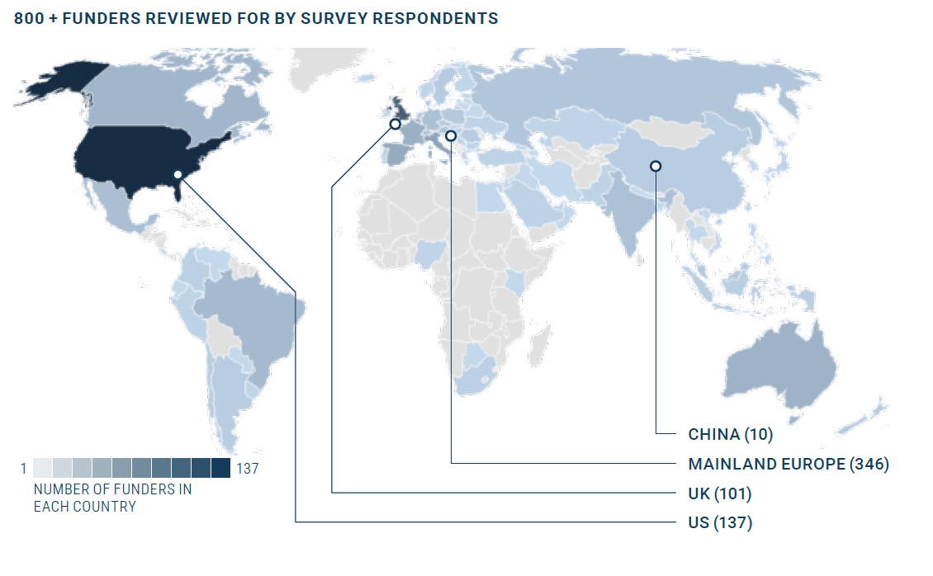
A Global Perspective

Slide 35
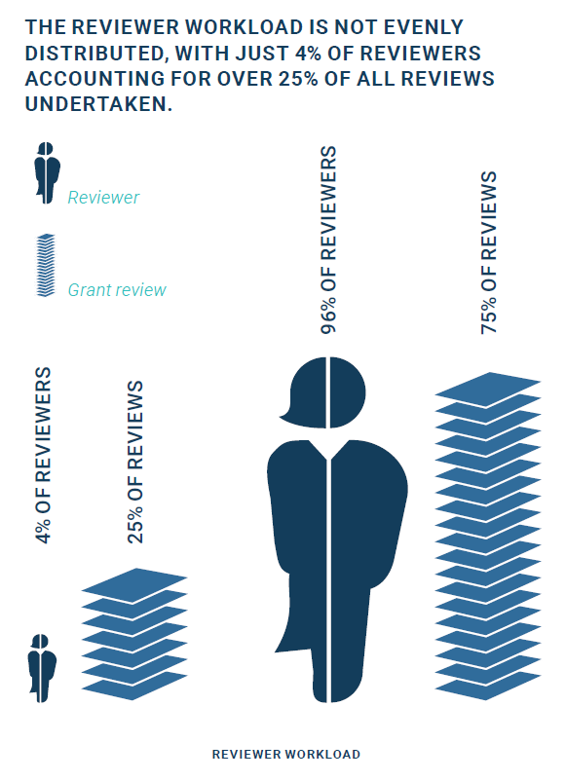
Sneak Peek
Some of the report’s thought-provoking findings include:
Peer review is consistently recognized as a bulwark of quality, with 78% of researchers agreeing it is the best way to allocate funds to the best research.
  However, researchers also identify perceived failings of the peer review process in the report, including unfair treatment of junior researchers, for example.
Grant peer review is a time-intensive endeavour. Funders spend up to 6 hours per application finding reviewers, and grant reviewers spend an average 10 days per year on reviews.
Finding peer reviewers is proving increasingly difficult for funders, with funders now having to invite at least 3 reviewers to secure 1 reviewer.
The reviewer workload is not evenly distributed, with just 4% of reviewers accounting for over 25% of all reviews undertaken.

Slide 36
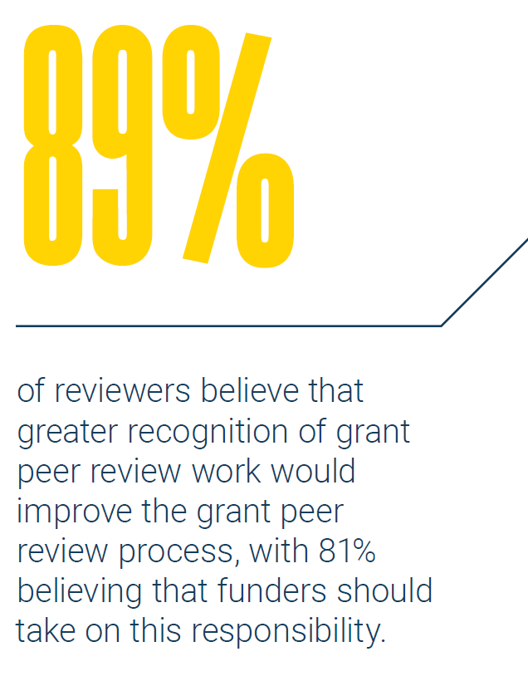


Sneak Peek
Cash is not a significant incentive to review, coming 6th in a list of initiatives that would make researchers more likely to review, with reviewer recognition coming top.
Researchers are dissatisfied with the transparency of the grant peer review process, with 60% believing that greater transparency of review identity would have a positive impact on the process. This is even higher than publication peer reviewers (40%).
40%
60%
of publication peer reviewers
of grant peer reviewers
...believe that more transparency of review identity would have a positive impact on peer review.

Slide 37
What to take away from these studies?

Slide 38
Key takeaways
Make data-driven decisions on peer review
These reports mark the first time that we have cross-publisher and cross-funder insights on peer review: who’s doing it; how efficient it is; review quality and the big peer review trends to be worried or excited about.
What have we learnt?

Slide 39
Key takeaways
Make data-driven decisions on peer review
It’s getting harder to get review done
“Demand for peer review is increasing concurrent with reviewers becoming less responsive to review invitations”
There are ways we can fully diversify the reviewer pool
Peer review training can introduce more researchers to the reviewer pool, sooner
Incentive structures vary by region - can they be reformed?
Actively seek out reviewers from emerging regions
Incentives matter
The future of peer review is fraught with uncertainty.
Researchers, however, have a clear idea of what will make a difference:
80%+ of survey respondents in both our publication and grant peer review studies stated that greater recognition and career incentives to peer review would have a positive impact on the peer review process.
The rise of China
“China surpassed the UK in review output in 2015, and continues to grow rapidly, but still lags behind most established regions in terms of reviews per submission”

Slide 40
What % of your researcher experience strategy addresses reviewers?

Slide 41
AVES and Publons

Slide 42


AVES
İstanbul-based independent publisher
20+ years of experience
30 open access journals
Provides services to universities and learned societies
20 journals on ScholarOne
19 journals with Publons
Reviewer Connect client since launch
Publons Partner as of 2018
Journals of the region
Mostly owned by societies and universities
Managed by volunteers
No/little APC or subscription revenue
Competing to create regional and/or international impact
avespublishing.com

Slide 43
Challenges
Attracting good research
Providing fast and constructive peer review to help research meet its maximum potential
Timely publication
Allocate time to improve journals – managing the peer review process is not the only duty of editors
avespublishing.com

Slide 44
Reviewer Connect
Reduced the amount of time our editors spend looking for reviewers
Reduced time commitment - easier to recruit editors
Helps manage larger (>1000 submissions) journals with a relatively small team
Helps smaller (<100 submissions) journals to reach out to international researchers
Reduced workload for core reviewers – delays burnouts (perspective)
Connect with younger researchers < > contribution from younger researchers
Constructive and thorough reviews
Faster decisions
Editor Feedback
Journals will need to assign multiple reviewers to receive a review – but the reviews received through reviewer connect will be thorough and will improve the paper
The editors are able to track their own reviewer pool via RC
Being able to quickly access publications of suggested reviewers is convenient
avespublishing.com

Slide 45
Reviewer Recognition
We have always been looking for ways to motivate reviewers and acknowledge their contributions
Donations to non-profits, gifts, physical certificates, money and other attempts to incentivize
Academic incentives are no longer granted to reviewers
Too many other journals competing to have the same reviewers contribute
Past review upload
1500 reviewers, 3500 reviews (90% after partnership)
33.5% uptake rate
41% uptake rate in 2020 (+20% YoY)
Reviewer satisfaction 8.7/10 in 2020
avespublishing.com

Slide 46
Q&A

Slide 47
Thank you!
Josh Dahl
Product Director, Clarivate
Ali Şahin
Publications Director, AVES

