Slide 1

Journal Citation Reports
2023 Annual Release
Deron Morgan | Customer Success Consultant

Slide 2


Journal Citation Reports™ (JCR ™) overview
Expanding the Journal Impact Factor ™ (JIF) to Emerging Sources Citation Index & Arts & Humanities Citation Index
Displaying JIF to one decimal place
Emerging Sources Citation Index (ESCI)
Journals API
JCR Integrations
Agenda
Clarivate 2023

Slide 3





With 30,000+ scholarly journals published globally, it’s more challenging than ever to assess scholarly journals. How do you…
…find journals consistent with our values to showcase your research?
…ensure your library collections support rigorous research and teaching?
…make data-driven decisions about your open access strategy?

Slide 4
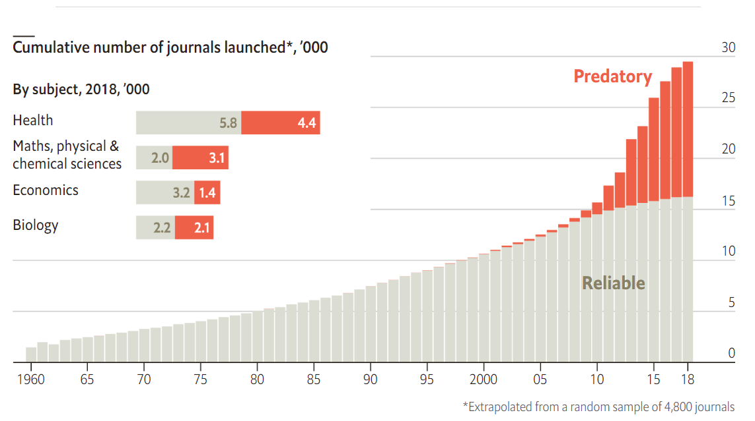
Questionable publishing practices are on the rise
These models can undermine public trust in research and research integrity and represent significant waste of research resources
Source: The Economist, May 2020.

Slide 5

Providing content, data, and metrics you can trust
Selectivity provides a curated collection
Meticulous indexing provides a reliable data foundation
Expert analysis provides trustworthy metrics

Slide 6






Confidently navigate the growing complexities of journal publishing
Web of Science Core Collection is your trustworthy research foundation
Publisher neutral
In-house curation
Vetted OA content
Our independent experts select journals for inclusion to provide you with a dataset of the world’s leading publications that is free of potential industry bias or conflict of interest.
Rigorous curation processes guard against inclusion of hijacked journals. Databases that rely on algorithmic approaches* or outside review lack consistency and oversight.
Access open access papers from reputable journals that have been vetted against our 28 evaluation criteria for quality and impact.
Journals
Conferences
Books
Over 21,000 journals across the Science Citation Index Expanded, Social Sciences Citation Index, Arts & Humanities Citation Index, and the Emerging Sources Citation Index.
Over 300,000 conferences covered in the Conference Proceedings Citation Index.
Over 141,000 books covered in the Book Citation Index.
*https://retractionwatch.com/2021/05/26/how-hijacked-journals-keep-fooling-one-of-the-worlds-leading-databases/

Slide 7

What is the Journal Citation Reports™

Slide 8




Make better informed decisions with publisher-neutral journal intelligence
Assess the world’s leading journals with Journal Citation Reports
Quickly find a list of trustworthy, influential journals in all disciplines. Each journal profiled has met the rigorous quality standards documented in the Web of Science Core CollectionTM editorial selection process.
Work with credible metrics derived from accurate and complete data. Journals displaying evidence of excessive self-citation and citation stacking have their JIFs suppressed from Journal Citation Reports to support research integrity in scholarly publishing.
Easily uncover the relationship between article and journal citations to better understand a journal’s role in the network of scholarly communications. Access to article data helps you follow best practices for research evaluation.
Evaluate journals with a multidimensional view of a journal’s impact and influence. View citation metrics alongside descriptive open access statistics and contributor information that provide a holistic picture of each journal.
Selectivity
Quality control
Transparency
Multiple impact views

Slide 9

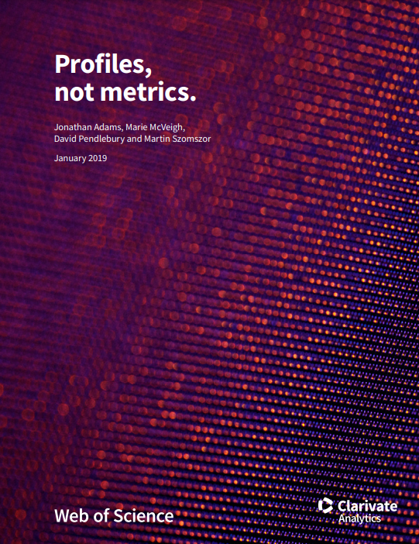
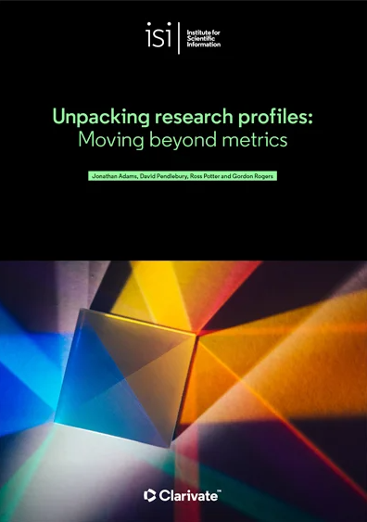
Paving the way for more responsible research assessment
Visualizations support sound, responsible research assessment.
Visualizations unpack the richer information that lies beneath an indicator.

Slide 10
Evolving JCR to enhance responsible journal evaluation
“The JCR answers these basic questions… who uses a particular journal? How frequently? For what purposes?”
– Dr. Eugene Garfield
More indicators
% Articles in Citable Items, Journal Impact Factor Percentile, and Normalized Eigenfactor added
Data transparency
Enhanced profile provides full transparency on JIF
2015
2018
2020
2023
2021
Open access
Gold open access data introduced
Simplification
JIF expansion and complete profiles for all journals
Normalized indicators & content expansion
Addition of AHCI and ESCI titles and the new Journal Citation Indicator (JCI)

Slide 11
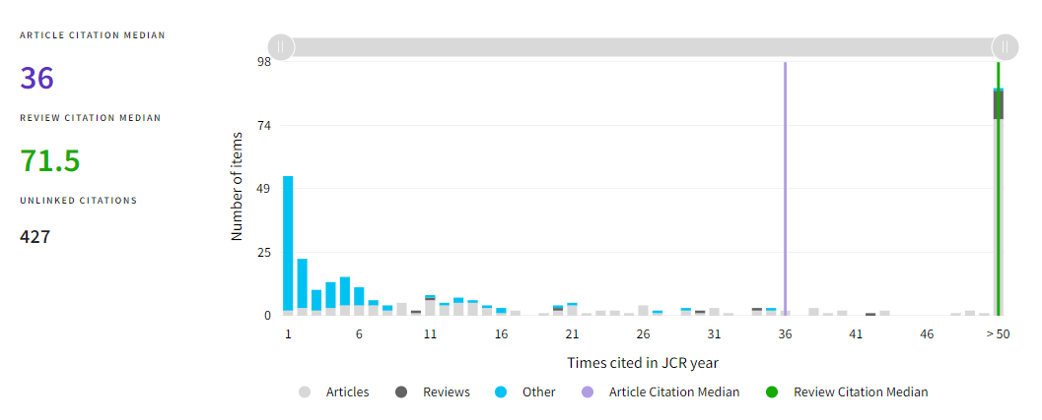
Increasing the transparency of JIF

Slide 12
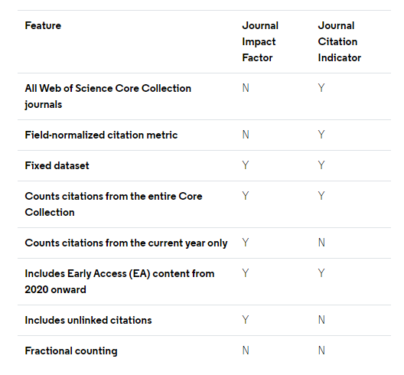
Offering a wide array of metrics for journal evaluation
Complementary metrics: Journal Citation Indicator (JCI) and Journal Impact Factor (JIF)
Citations from all documents in this year...
Journal Impact Factor (JIF)
2018
2019
2020
2021
2021
2022
2023
...to items in the journal published in these 2 years
Journal Citation Indicator (JCI)
Citations from all documents in these years...
2018
2019
2020
2021
2022
2023
...to citable items in the journal published in these 3 years

Slide 13


Starting from the 2023 JCR release, the Journal Impact Factor (JIF) will be extended to all Web of Science Core Collection journals, including arts and humanities.
Almost 9,000 journals from more than 3,000 publishers will have a JIF for the first time
At minimum, there will be a 5% increase in journals from the Global South¹ that have a JIF
There will be an 8% increase in gold open journals than have a JIF
¹According to the United Nations definition: http://www.fc-ssc.org/en/partnership_program/south_south_countries

Slide 14

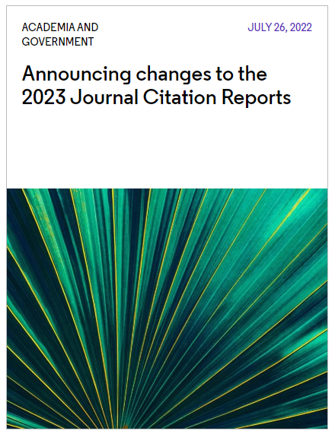
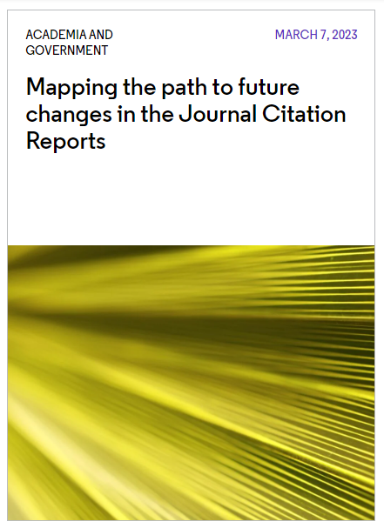
The JIF is now an indicator of trustworthiness as well as scholarly impact
Indicators of trustworthiness needed as scholarly record becomes increasingly polluted
Four journal indices in the WoS Core Collection
We are expanding the JIF from only the most impactful science and social science journals to quality journals across all disciplines:
Trustworthy journals with high scholarly impact
SCIE
(science)
SSCI (social science)
AHCI (arts & hum.)
ESCI (multidisciplinary)
Trustworthy journals
Currently has a JIF
Will be getting a JIF in June 2023
https://clarivate.com/blog/clarivate-announces-changes-to-the-2023-journal-citation-reports-release/
clarivate.com/blog/mapping-the-path-to-future-changes-in-the-journal-citation-reports/

Slide 15
Completing profiles over 2023 and 2024
 | Science (SCIE) | Social Sciences (SSCI) | Arts & Humanities (AHCI) | Emerging Sources (ESCI)
Journal Impact Factor | ✓ | ✓
Journal Citation Indicator | ✓ | ✓ | ✓ | ✓
Citation Distribution | ✓ | ✓
Category Ranking by JIF | ✓ | ✓
JIF Quartile | ✓ | ✓
We are taking a phased approach to provide transparency on the impact to JIF rankings and quartiles.
Current State
Journal Impact Factor | ✓ | ✓ | ✓ | ✓
Journal Citation Indicator | ✓ | ✓ | ✓ | ✓
Citation Distribution | ✓ | ✓ | ✓ | ✓
Category Ranking by JIF | ✓ | ✓
JIF Quartile | ✓ | ✓
June 2023
Journal Impact Factor | ✓ | ✓ | ✓ | ✓
Journal Citation Indicator | ✓ | ✓ | ✓ | ✓
Citation Distribution | ✓ | ✓ | ✓ | ✓
Category Ranking by JIF | ✓ | ✓ | ✓ | ✓
JIF Quartile | ✓ | ✓ | ✓ | ✓
June 2024

Slide 16
Change in display of decimal places in JIF will create more ties in rank and may impact the quartiles
JIF display to 3 decimal places
[Previously]
JIF display to 1 decimal place
[June 2023 JCR Release]
No ties in rank
Number of rank positions is equal to the number of journals
JIF quartiles are evenly sized by number of rank positions
JIF quartiles are evenly sized by number of journals
Introduction of ties in rank (i.e., multiple journals with the same JIF)
Number of rank positions is not equal to the number of journals
JIF quartiles are evenly sized by number of rank positions
JIF quartiles are not evenly sized by number of journals
Q1
Q1
Q2
Q2
Q3
Q3
Q4
Q4
Height of bar is representative of the number of journals in each JIF quartile

Slide 17



Journal Impact Factor (JIF) expansion
Building complete journal profiles for all editorially selected titles
All Web of Science Core Collection journals receive a JIF
JIF is displayed to one decimal point
JIF remains a selective metric
Simplification
More data
More journal and publisher representation
More open access coverage
More global representation
Increases the impact of your existing subscriptions by enhancing journal profiles
Helps researchers make more informed publication decisions
Simplifies collection management
Enables deeper journal impact analyses
Summary
Impact
Benefits

Slide 18
Journal Citation Reports 2023 annual release
2022 JCR data
21,522 total journals
13,668 Science journals
5,600 Gold Open Access journals
7,123 Social Sciences journals
112 countries worldwide
3,248 Arts & Humanities journals
254 research categories
9,136 titles with first time JIF

Slide 19
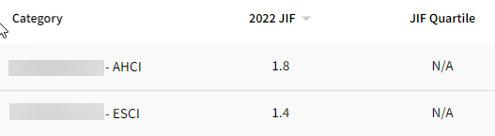

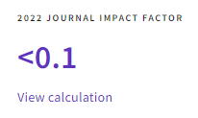
Appearance in Product
JIF value will now display for AHCI/ESCI.
Quartile, Rank, and Percentile will display as N/A as in prior years
The JIF will display to only one decimal place instead of 3
JIFs that would round down to 0 with the new one decimal structure will be displayed as <0.1

Slide 20

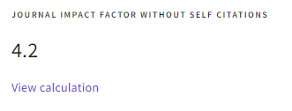
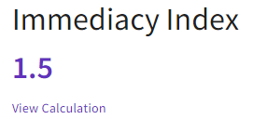
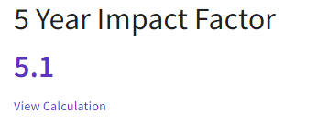
Appearance in Product
JIF without Self Cites, 5 Year Impact Factor, and Immediacy Index will also be expanded to journals in AHCI and ESCI and appear to 1 decimal

Slide 21

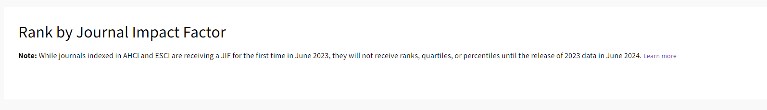
Appearance in Product
Journals in AHCI and ESCI will not have ranks or quartiles in the 2023 release, which will be clear on the respective journal profile pages

Slide 22
Emerging Sources Citation Index

Slide 23
“Giving all quality journals a JIF will provide full transparency to each and every article and citation that has contributed to a journal’s scholarly impact, helping to demonstrate its value to the research community.
It will also help level the playing field for all quality journals, including open access journals, recently launched or niche journals, or journals with a regionally focused scope and those from the Global South*.”
Dr. Nandita Quaderi
Editor-in-Chief & Vice President, Web of Science
*According to the United Nations definition: http://www.fc-ssc.org/en/partnership_program/south_south_countries

Slide 24



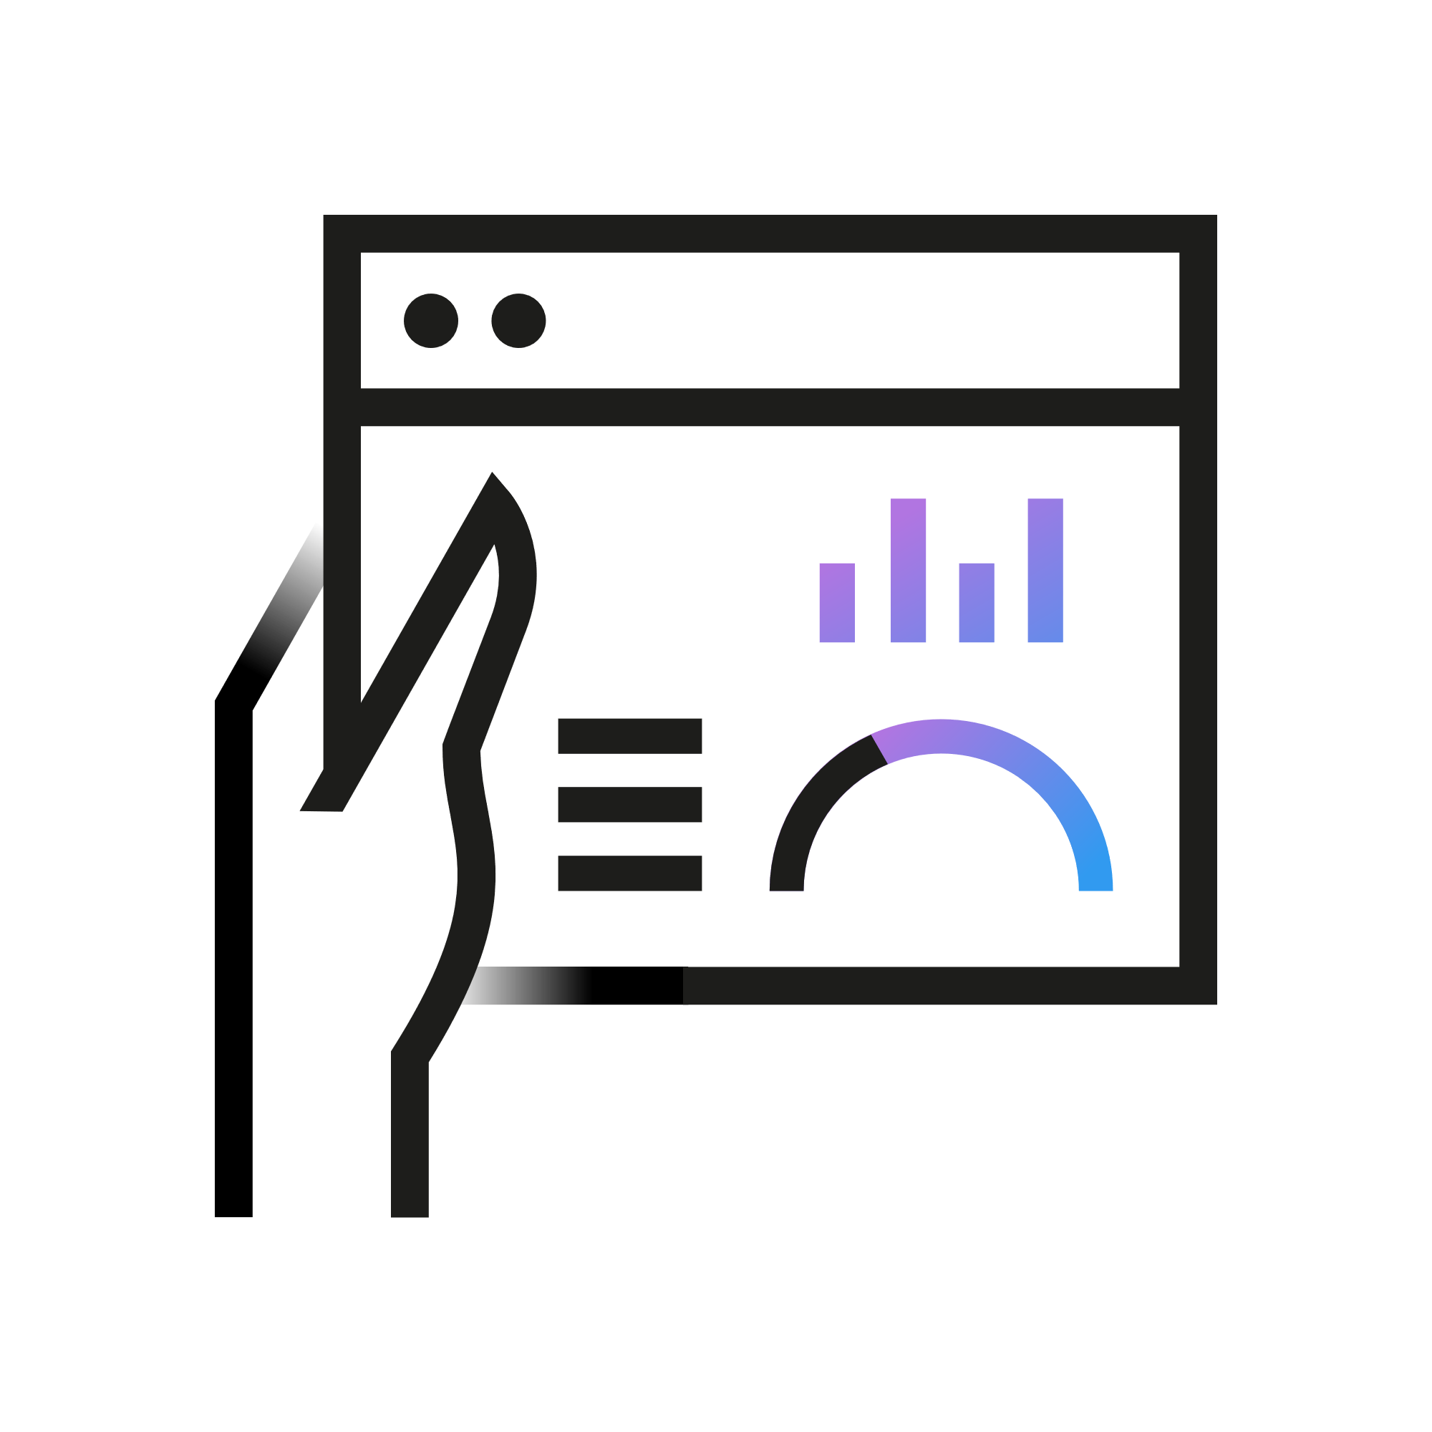
Expand your view of the global research landscape
Emerging Sources Citation Index covers over 8,000 journals across 250+ disciplines
Quality
Global view
Inclusivity
Assessment
Locate more trusted content from high-quality publications, especially those with open access publishing models.
Support increasing international collaboration with a discovery tool that ensures you see emerging global trends as they develop.
Gain a more complete picture of institutional and researcher output, particularly early career researchers and those publishing in the social sciences and humanities.
Provide researchers with an expanded view of their research impact and personal metrics.

Slide 25
Support interdisciplinary research programs
Emerging Sources Citation Index (ESCI) content addition by discipline
Connect more social sciences and arts & humanities research to your discovery network.
Statistics as of June 2023

Slide 26
Expand your view of the global landscape
Regional research growth with ESCI addition
Find the novel discoveries from researchers working in the "Global South“ and other regions.
SCIE, SSCI, AHCI journal output of affiliated authors
ESCI journal output of affiliated authors
Analysis was conducted using InCites Benchmarking & Analytics and includes countries/regions with at least 1,000 total papers published in indexed journals between 2005-2023. Statistics as of June 2023.
Statistics as of June 2023

Slide 27
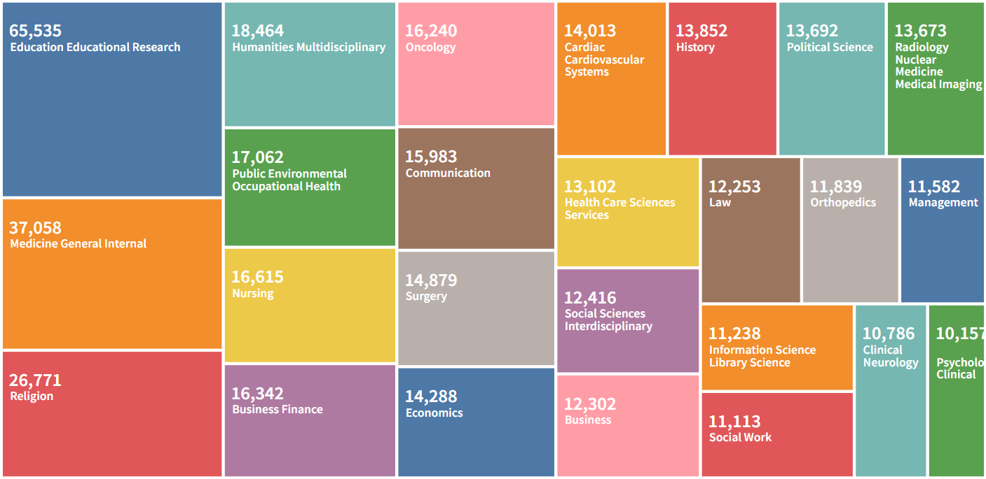
What does ESCI coverage look like in the United States?
Web of Science Category distribution: ESCI publications from
2005-2023 with at least one author from a US-based organization

Slide 28
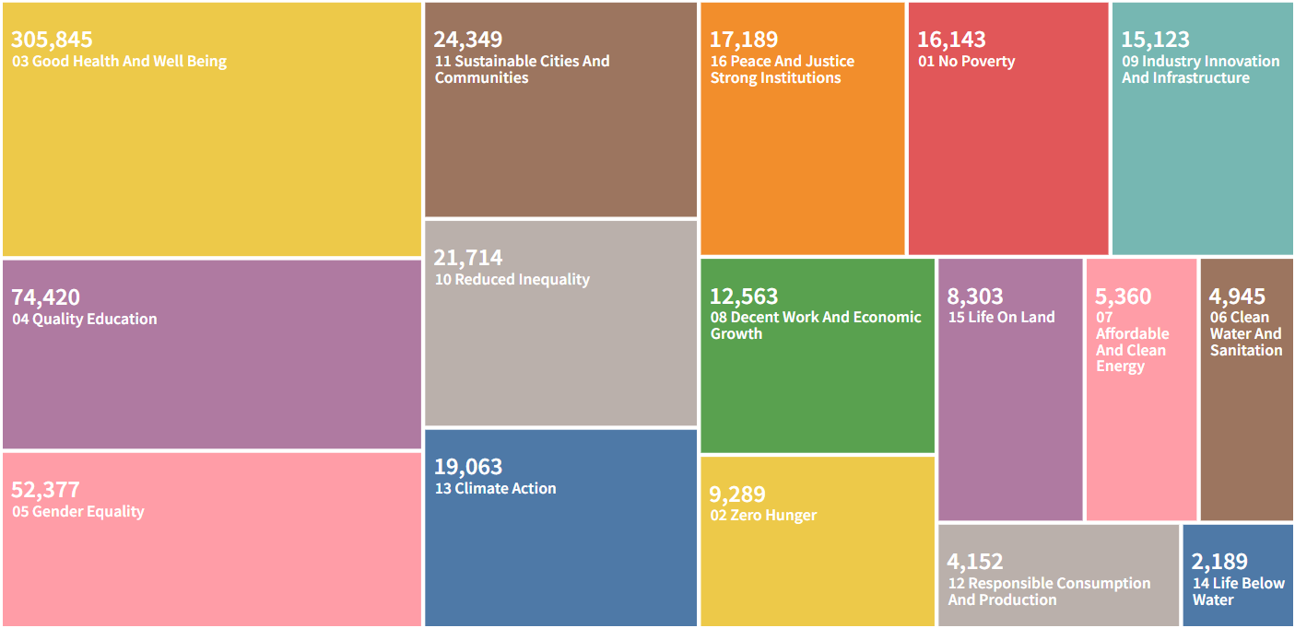
What does ESCI coverage look like in the United States?
UN Sustainable Development Goals distribution: ESCI publications from
2005-2023 with at least one author from a US-based organization

Slide 29


Web of Science™ Journals API
The Journals API complements our suite of RESTful Web of Science APIs to provide complete journal metadata and metrics from the Journal Citation Reports
Publication metadata
Publication metrics
Journal metadata/metrics
Researcher metadata/metrics
Web of Science Starter API Support search and data integration using limited Web of Science data re- turned as JSON or XML
Web of Science API Expanded Support search and data integration using full Web of Science data re- turned as JSON or XML
InCites API
Support bibliometric analysis and integration of document-level metrics
Web of Science Journals API Support bibliometric analysis and integration of journal-level metrics
Web of Science Researcher API Support bibliometric analysis and integration of researcher profile data
Coverage
21,000 +
journals covered* Includes the sciences (SCIE), social sciences (SSCI), arts & humanities (AHCI) and emerging sources (ESCI)
A wide array of journal metrics and descriptive data, including
Example use cases
Journal Impact Factor™
Journal Citation Indicator
Journal name & ISSN/eiSSN
Category and rank
Total cites
Immediacy Index
5-year JIF
JIF quartile
Average JIF percentile
Eigenfactor and Article Influence score
Cited/citing half-life
Citable items
Open access
Source data counts
Integrate with internal systems
For example, to pass Journal Impact Factors (JIFs) and Journal Citation Indicators (JCIs) to journal web pages
Bibliometric studies
Access and retrieve core journal metrics for entire categories of groups and journal to include in analyses
API usage
Journal
Query for all journals or by journal ID
GET cited and citing journals
GET journal metrics
Queries:
Boolean AND/+, OR and NOT operators are supported, along with ‘*’ wildcards. Queries can be filtered by values, ranges, and dates.
See https://developer.clarivate.com/apis/wos-journal for more information.
Category
Query for all categories or by category ID
GET cited and citing categories
GET category metrics
29

Slide 30
JCR integrations across Clarivate
Connecting JCR metrics for broader use

Slide 31
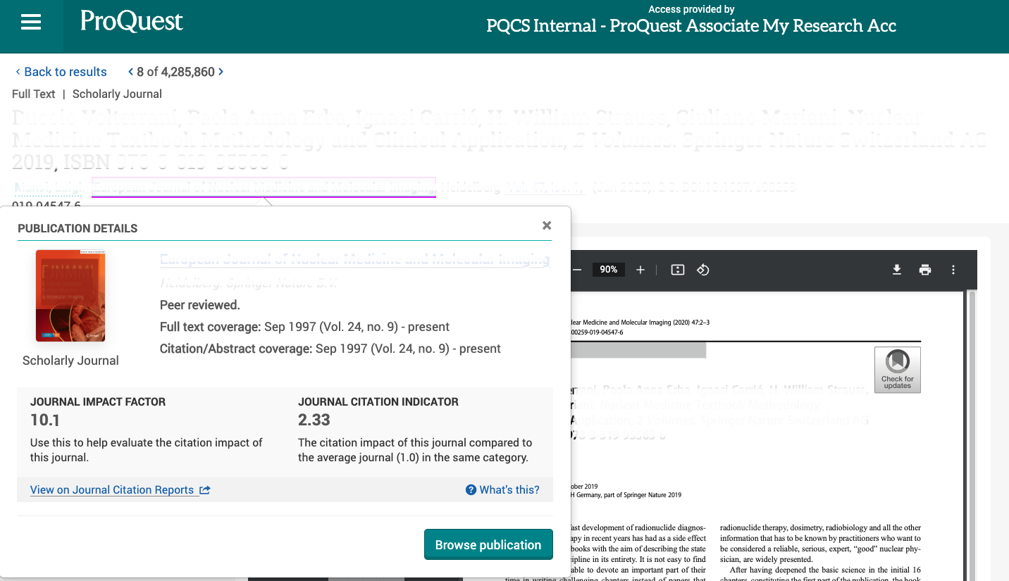
Web of Science Journal Citation Reports™ (JCR) Metrics on ProQuest Platform
Reference JCR metrics of a title for confident decision-making during the point of need for teaching, learning, and research.
ProQuest Platform—Publication Page Example
WoS Journal metrics integrated into ProQuest Platform
Helps users assess the world’s leading journals with publisher-neutral data
Gain insight into publications and documents to make informed, confident decisions at the point of user need
Display for mutual customers
Display for all PQP users
Journal Impact Factor (JIF) displays only for mutual customers
Journal Citation Indicator (JCR) displays for all users
Link directly to JCR profiles to gain a robust view of a journal’s performance, audience, and relationships with other journals.

Slide 32
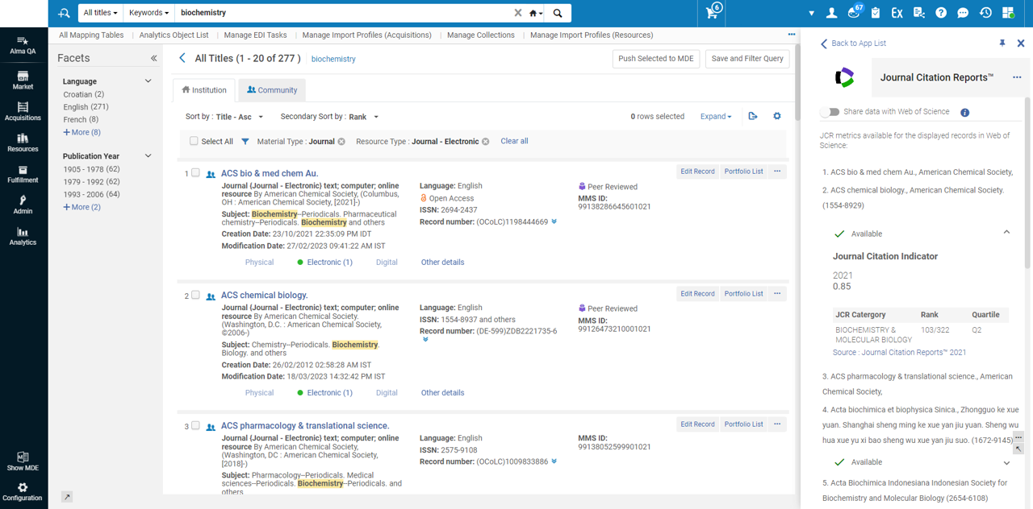
Display of the JCR metrics for all Alma customers

Slide 33


Thank you
About Clarivate
Clarivate is the leading global information services provider. We connect people and organizations to intelligence they can trust to transform their perspective, their work and our world. Our subscription and technology-based solutions are coupled with deep domain expertise and cover the areas of Academia & Government, Life Sciences & Healthcare and Intellectual Property. For more information, please visit clarivate.com
© 2023 Clarivate
Clarivate and its logo, as well as all other trademarks used herein are trademarks of their respective owners and used under license.

