Slide 1





Implementing Open Peer Review at Scale: A Case Study on Transparent Peer Review
24 September 2020
Josh Dahl
Product Director, Clarivate
josh.dahl@clarivate.com
Marc Domingo
Product Manager, Clarivate
marc.domingo@clarivate.com
Dave Evans
Product Manager, IOP Publishing
david.evans@ioppublishing.org
Simon Harris
Managing Editor, IOP Publishing
simon.harris@ioppublishing.org

Slide 2



Questions during the webinar?
Enter them into the Webex chat box (be sure it’s set to go to “All Panelists”)
If we don’t get to your question during the Q&A, we will follow up via email
A link to the recording and slides will be sent to you in the following week

Slide 3
Implementing Open Peer Review at Scale: A Case Study on Transparent Peer Review
24 September 2020
Josh Dahl
Product Director, Clarivate
josh.dahl@clarivate.com
Marc Domingo
Product Manager, Clarivate
marc.domingo@clarivate.com
Dave Evans
Product Manager, IOP Publishing
david.evans@ioppublishing.org
Simon Harris
Managing Editor, IOP Publishing
simon.harris@ioppublishing.org

Slide 4
Agenda
Clarivate & IOP Publishing Partnership
Transparent Peer Review Service Overview
IOP Publishing Pilot: Set-up & Results
Future Plans
Questions

Slide 5


Clarivate & IOP Publishing Partnership​
​

Slide 6
Peer Review and Research Transparency
+ provides greater visibility and recognition for reviewers
+ potential to increase review quality
+ potential to advance research integrity and reproducibility
+ potential to impede research manipulation and fraudulent review

Slide 7
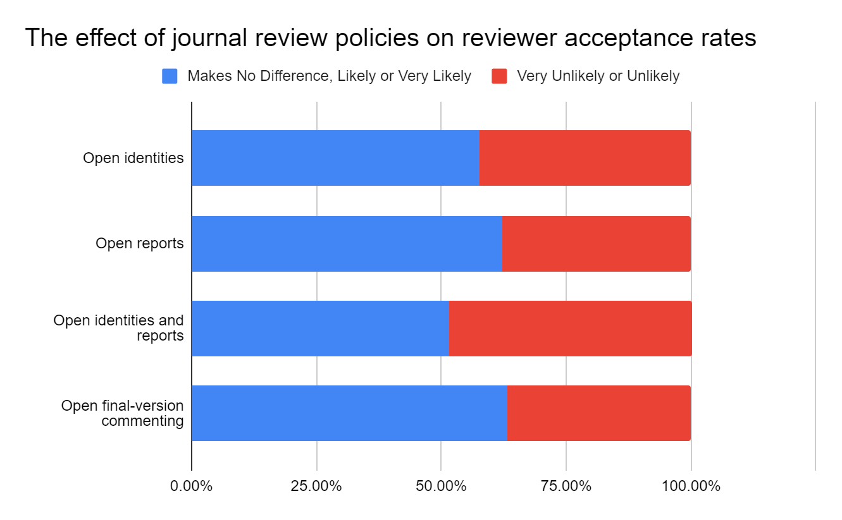
Interest in opening up peer review is growing
Whilst many researchers maintain reservations about opening up peer review, interest and support is growing…
Source: Publons, Global State of Peer Review Report (2018)

Slide 8

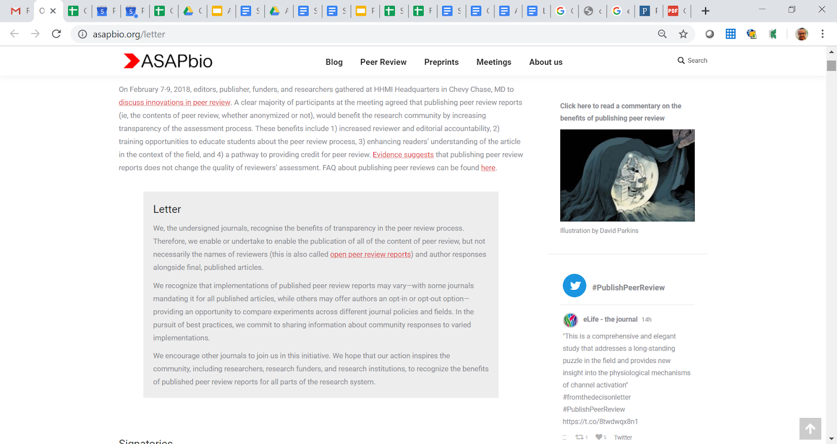
There is a growing interest in transparent & open review models
However, many publishers face practical difficulties in adopting such models
Complex, legacy workflows -> publishers have either avoided opening up peer review or used manual workarounds, soaking up editorial time and limiting rollout
...but, operating more open peer review workflows can be challenging

Slide 9
The Clarivate solution
Clarivate's Publons have developed a robust and scalable model, working within established workflows and systems to support transparent peer review
The Publons model…
  Scalable and robust
  Requires minimal work from the publisher
  Configurable
  Simpler process for researchers
  Provides reviewers, authors and editors a 360° view of their contribution
  Is GDPR compliant
  Why ‘Transparent’ Peer Review?
  While their peer review content (reports etc) is published, reviewers can remain anonymous vs Open Peer Review which generally obliges naming of reviewers

Slide 10
Workflow for Transparent Peer Review
In partnership with ScholarOne
1
2
3
4
5
ScholarOne collects author and reviewer options, and peer review content
Publisher sends feed of accepted articles to Publons
(IOPP uses API)
Publons queries ScholarOne for peer review content
Publons creates article peer review pages and registers peer review content DOIs
Article publication triggers peer review content publication on Publons

Slide 11
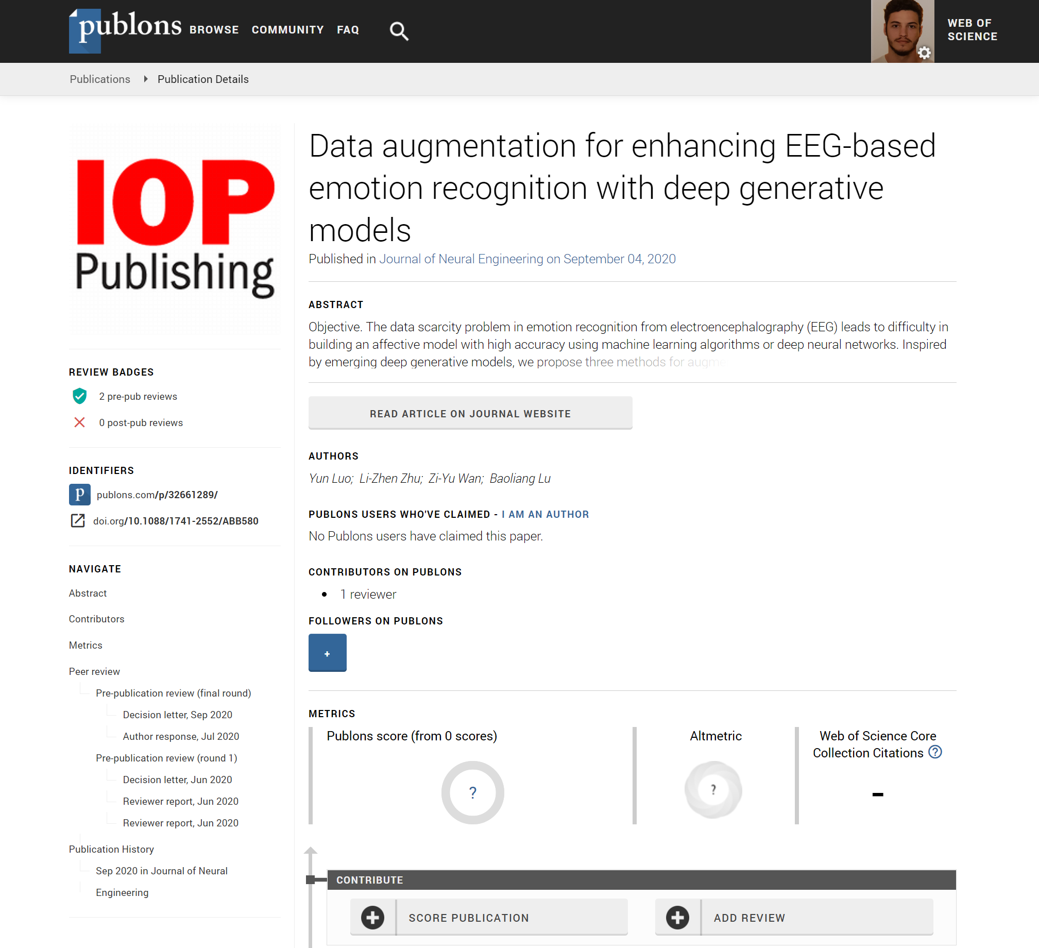
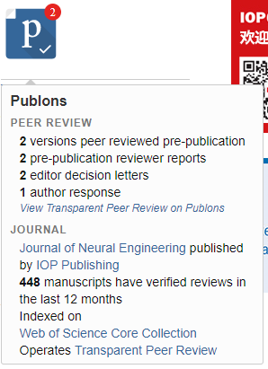
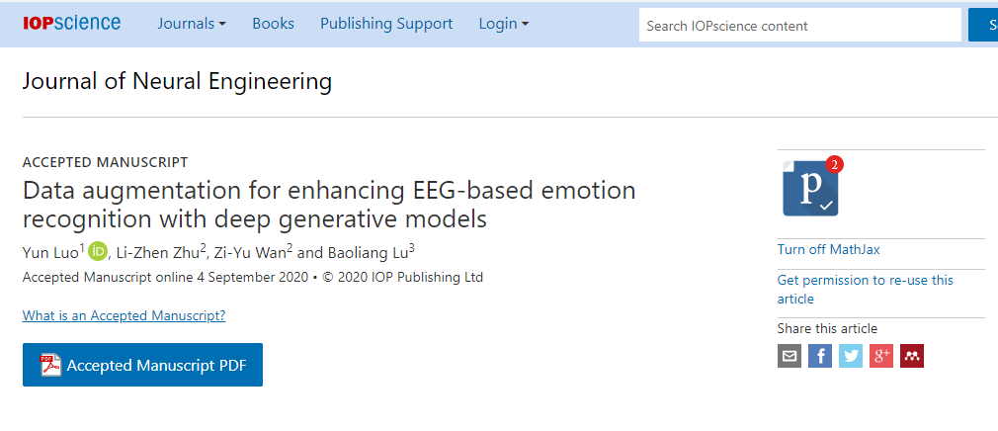
Workflow for Transparent Peer Review
Displaying the peer review content
IOP
Publons

Slide 12
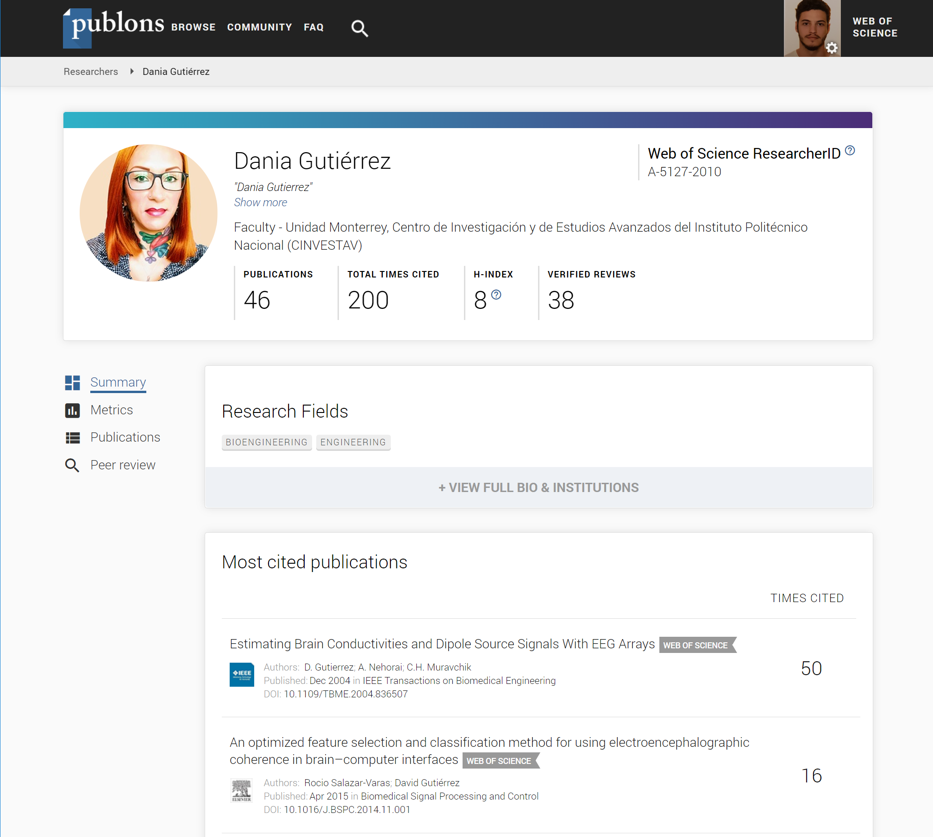
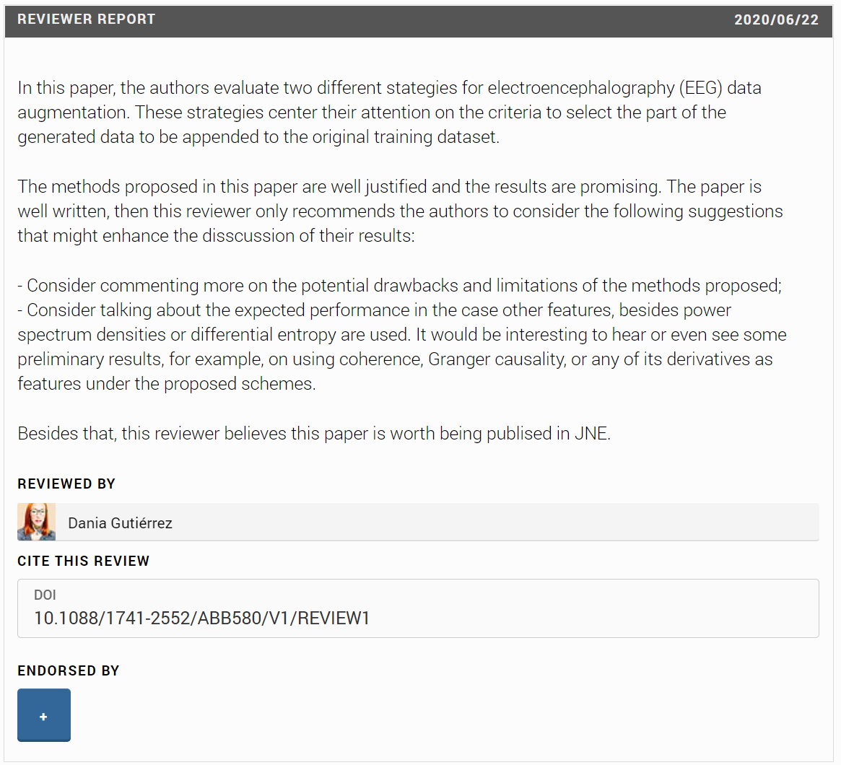
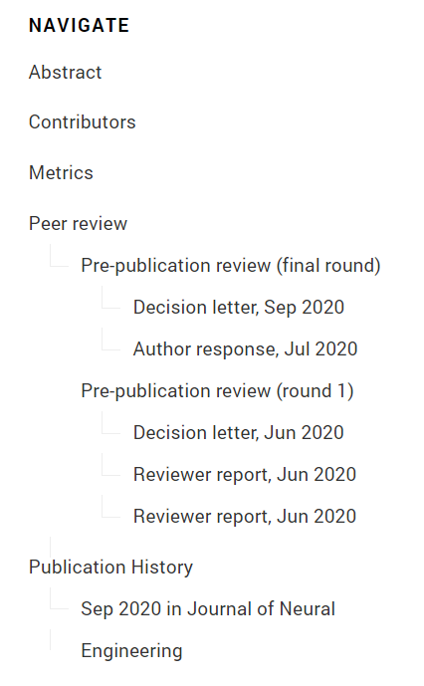
Workflow for Transparent Peer Review
Connecting the reviews with the reviewers
Publons

Slide 13
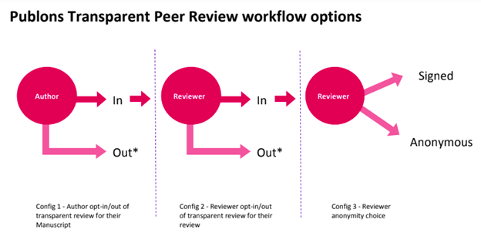
IOPP pilot set-up
  Aim was to test demand for TPR from our authors and reviewers
  Both the authors and all the reviewers have to opt-in for it
  If anyone opts out, no review content is published at all
Notes:
The Publons system accommodated our needs (+offers opt-in refs the chance to be named).

Slide 14
IOPP pilot results
Popularity
  58% of authors opt-in for TPR
  45% of reviewers opt-in for TPR
  10% of articles are published with review content
Author survey feedback positive: “I think that publishing the reviews online with the article is a big positive step forward and suggest that it be made standard for all articles.”
Time to initial decision
No observable impacts on times, or willingness of reviewers to report
Review quality
Small increase in average review quality for TPR articles
Editor behavior/workload
No change in Editor behaviour. Very little manual work required!
(A little administration due to lack of attachment handling.)
Notes:
Remember reviewers and authors have to opt in, so this explains 10% rate.
Review quality does appear to be higher, using S1 ratings.
Editors don’t even look as to whether authors/reviewers have opted in until after 1st decision.
Happy with how going, so rolling out to more journals next week!

Slide 15
Future plans
Publication badge improvements
File attachments support
IOPP to roll-out TPR on all open access journals
TPR available to all ScholarOne journals
Further details of IOPP TPR pilot here:
https://www.csescienceeditor.org/article/transparent-peer-review-a-practical-solution-to-implement-open-peer-review-at-scale-a-case-study

Slide 16




Other partners

Slide 17
We’re not just opening the scholarly record with transparent peer review – we’re actively building it, putting a spotlight on community-led evaluation.

Slide 18
QA
Josh Dahl
Product Director, Clarivate
Josh.dahl@clarivate.com
Marc Domingo
Product Manager, Clarivate
Marc.domingo@clarivate.com
Dave Evans
Product Manager, IOP Publishing
david.evans@ioppublishing.org
Simon Harris
Managing Editor, IOP Publishing
simon.harris@ioppublishing.org

Slide 19
Thank you!
Josh Dahl
Product Director, Clarivate
Josh.dahl@clarivate.com
Marc Domingo
Product Manager, Clarivate
Marc.domingo@clarivate.com
Dave Evans
Product Manager, IOP Publishing
david.evans@ioppublishing.org
Simon Harris
Managing Editor, IOP Publishing
simon.harris@ioppublishing.org

