Slide 1
Making it count
Research credit management in a collaborative world
Jonathan Adams, Ludo Waltman and Ross Potter
April 2022

Slide 2
Background
We don’t want more indicators
We want better versions of the indicators we already have
We want to enable better presentation of indicators
We want more informed interpretation of indicators
We want feedback on ideas from users – not from bibliometric experts
We want to know what works, what is useful
ISI and scientometric indicators
Profiles, not metrics (2019)

Slide 3

The genesis of citation indexing and analysis
Information retrieval:
Eugene Garfield, “Citation indexes for science: a new dimension in documentation through association of ideas,” Science, 122 (3159): 108-11, 15 July 1955
History and sociology of science:
Eugene Garfield, “Citation indexes in sociological and historical research,” American Documentation, 14 (4): 289-291, 1963
Eugene Garfield, “Citation indexing for studying science,” Nature, 227 (5259): 669-671, 1970
Structure and dynamics of science:
Eugene Garfield, M.V. Malin, and H. Small, "A system for automatic classification of scientific literature," Journal of the Indian Institute of Science, 57 (2): 61-74, 1975
Evaluation of research:
Eugene Garfield, “Is citation analysis a legitimate evaluation tool?,” Scientometrics, 1 (4): 359-375, 1979
Notes:
I always like to start at the beginning, with the life and work of information pioneer and our founder, Eugene Garfield. In 1955 he published a paper describing a citation index for science. Garfield recognized that the references authors appended to their papers expertly connected their work to other papers addressing the same topic. He called this an “association-of-ideas index.” It is important to understand that his citation index was invented to make searching the literature more efficient and accurate.
Garfield also realized the data he was collecting could reveal much about scientific activity itself – about its structure, changes through time, as well as a hierarchy of producers of research publications. The data could be analyzed at the level of nations, institutions, even individuals. For each, one could determine publication output as well as influence and impact as reflected by citation counts the publications received.
But determining research performance was a secondary use of citation data.

Slide 4
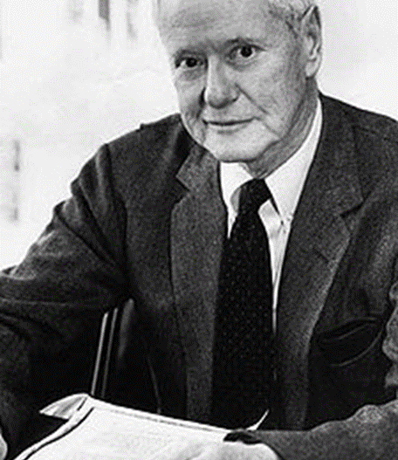
Theories of citation and the normative school
Robert K. Merton (1910-2003),
Merton was a sociologist of science at Columbia University. Normative theory.
Citations as currency used to repay intellectual debts. Those with many citations have gained “credits” from their peers.
The formal nature of publication and the moral imperative to cite.
Other theories, including citations as rhetorical devices, constructivist theories.
Known for coining the concepts and phrases: “self-fulfilling prophecy,” “role model,” “focus group,” “unanticipated consequences,” and “Matthew effect.”
Notes:
What citations represent and how to interpret citation statistics has been debated for many years. Some assert that they convey importance or popularity; others say they function largely as rhetorical devices and collectively create a socially constructed reality. The late Robert K. Merton, the 20th century’s leading sociologist of science, called the citation “a pellet of peer recognition.” Citations, he said, are repayments of intellectual debt to others. He emphasized that citation was an essential part of normative behavior among researchers, that it was a considered, formal, and obligatory activity, one that included a moral imperative to cite others when appropriate. It is largely this perspective that supports citation analysis to identify research influence and success. In most fields, there is a moderate positive correlation between peer esteem and citation frequency of papers and people, shown in a variety of so-called validation studies.

Slide 5
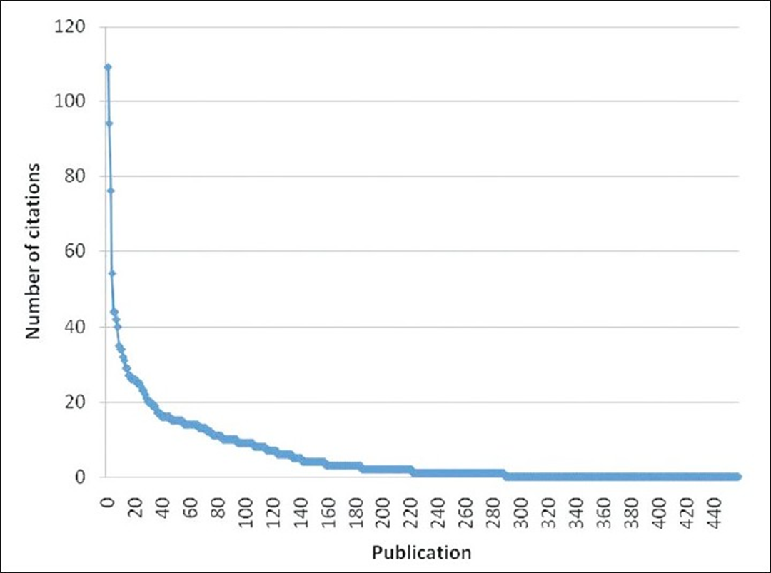
Citation distributions are skewed
Highly-cited chemists
The distribution of citations across people and papers follows a power law model (various models exist)
This is like Pareto’s description of income: 20% of papers attract 80% of citations
Skewed by papers and by authors
Created in a socio-cognitive context, in which contributions of value are recognized and those recognized then tend to attract more citations
Cumulative advantage, preferential attachment, success breeds success, and Merton’s Matthew effect
Notes:
Let’s look at some data that show the characteristic skewed distribution of citations. In brief, it is the 80:20 rule. Italian economist Vilfredo Pareto noted that 80% of the land in his country was owned by 20% of the population, and even that 20% of the pea plants in his garden produced 80% of healthy pea pods. The table at left reveals the top end of a skewed distribution of chemists by total citations. And as a heuristic we expect 20% of papers published to receive 80% of citations given. What is important to grasp is that citations do not conform to a normal, Gaussian distribution.
Also, citation events occur in a social context. It is more than merit that drives the number of citations a paper receives. Once cited, a paper is more likely to be cited, which has been called cumulative advantage, preferential attachment or success-breeds-success. Merton called it the Matthew Effect after the parable of talents in the Gospel of Matthew: “For to everyone who has will more be given, and he will have an abundance.”
This amplifies the stratification of those that are highly cited.

Slide 6
Citation impact
Research is supported by public money
Governments want research funders to demonstrate value and effective resource distribution
Research investment buys research production = papers
Are some publications more significant than others?
What information do the variable numbers of citations provide?
Can the data be used in standardized analyses?
What other metadata are needed to make these analyses valid comparisons (comparing like-with-like)?
Can these analyses be used to inform public policy, guide public funding and encourage better research management?
So, we have a database of publications in dated (when?) journal volumes
Every publication has an author (who?) at an address (where?)
The titles (what?) publications are in a citation network

Slide 7
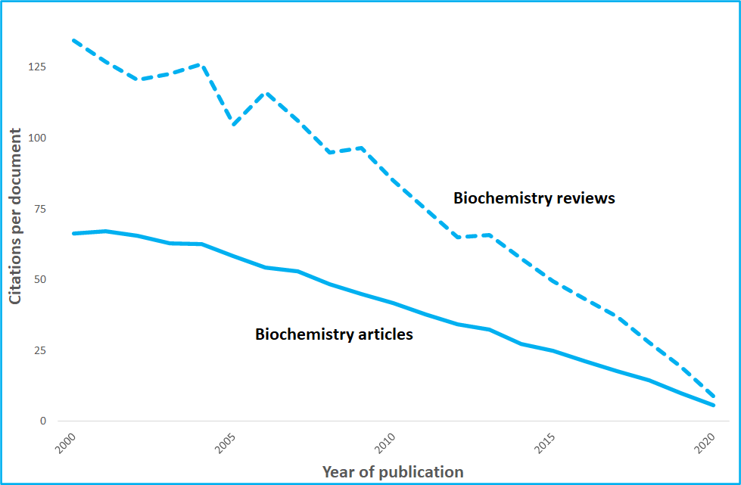
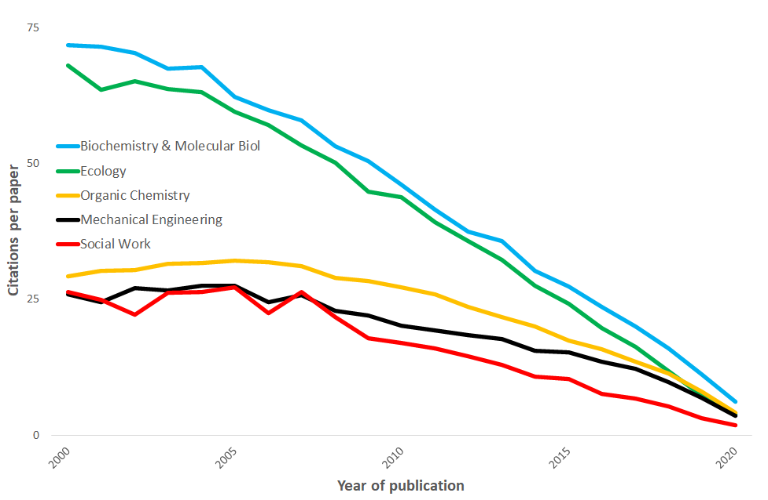
Citation indicators
Garfield recognised journals grouped into categories/fields
Citation counts to any paper (article or review) rise over time at a rate that depends on field and document-type
We index for
  Document type
  Year of publication
  Journal category
This is Category Normalized Citation Impact (CNCI)

Slide 8
Citation impact correlates with peer review
The positive relationship between peer grade and average citation impact was first found in RAE1996 (Adams, J. 1998. Nature, 396, 615-618.)
These data for Chemistry are:
  RAE2001 peer panel grades
  CNCI for university output 1996-2000
There is considerable residual variance but the trend is found across all subjects
These data are for university Chemistry departments grouped by grade (1-5*)

Slide 9
What’s the problem?
Research collaboration is increasing and more collaborative authorship is linked to higher citation counts
Managers want to understand how this affects performance indicators
Standard CNCI uses whole counting
Many analysts prefer Fractional counts but this uses arbitrary weighting and offers only spurious ‘correction’
ISI has developed Collab-CNCI, which keeps standard normalization of citation impact but does so within collaborative types
Collab-CNCI can be used to provide both
  a single summary impact metric
  the distribution of that impact across output types
This provides more complete data for research management and policy-making
Research collaboration affects citation impact
Users of our data and products are not always clear about how this works
They are also unclear about the best way to manage ‘credit’ for multi-author work

Slide 10
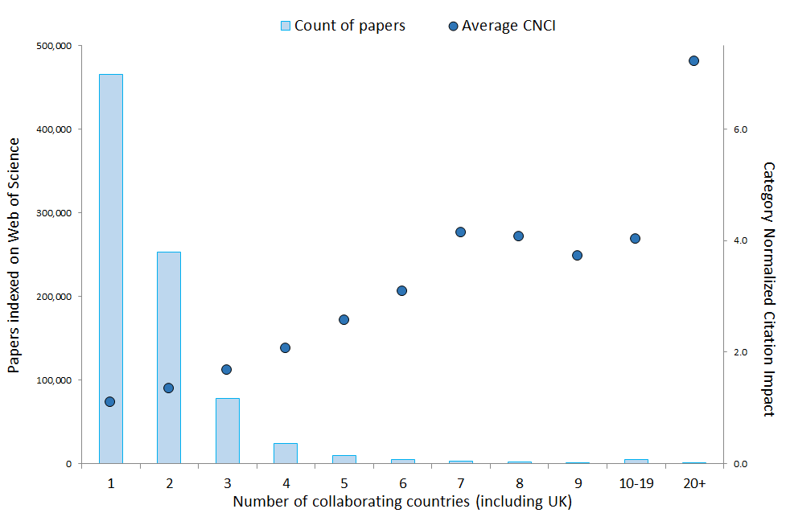
The problem: collaboration and credit
Research collaboration and co-authorship has increased
In the 1980s it was less than 10% of UK output but now stands at 70%
Collaboration is correlated with higher citation counts
How should credit be managed?

Slide 11
Methods for assigning credit
Whole counting
  A paper counts once for each author and once for each institution and each country in their address affiliations
Fractional counting
  Credit is partitioned among the authors and their affiliations
  There are many variants using equal and weighted fractions
  Credit for institutions may be calculated separately or as a sum of the affiliated authors
None of these methods explains the contributions of different collaborations to a final indicator value (such as the average CNCI for a university)
Whole counting was standard but many analysts now use a variant of fractional counting
There is NO definitive ‘correct’ outcome as opinions differ among researchers as to how credit accumulates
Interpretation is difficult

Slide 12
How to count? The collaboration challenge
Ludo Waltman
Centre for Science and Technology Studies (CWTS), Leiden University
Making it count: Research credit management in a collaborative world
April 26, 2022

Slide 13
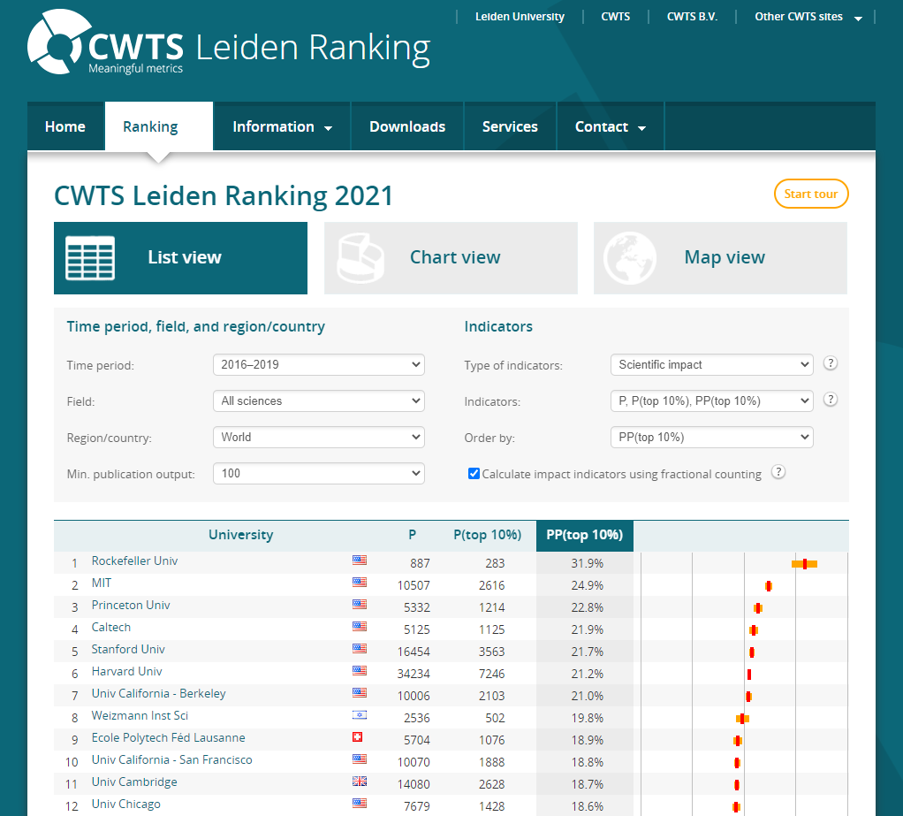
Dashboard offering bibliometric indicators of the performance of universities in four areas:
Scientific impact
Collaboration
Open access
Gender diversity
Scientific impact is measured by counting highly cited publications authored by a university
Two approaches for handling collaborative publications:
Full (whole) counting
Fractional counting

Slide 14
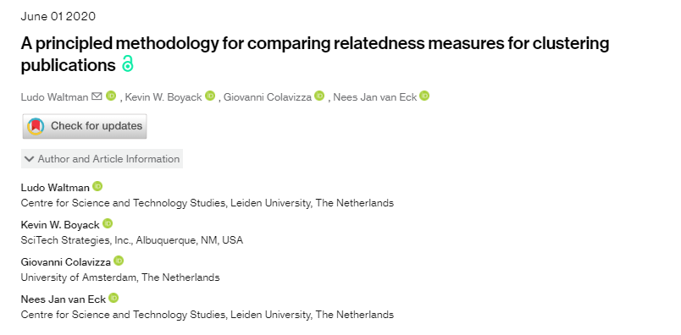
Fractional counting
In the Leiden Ranking fractional counting approach, this publication is assigned to the three collaborating organizations with the following weights:
Leiden University: 0.50
University of Amsterdam: 0.25
SciTech Strategies: 0.25

Slide 15
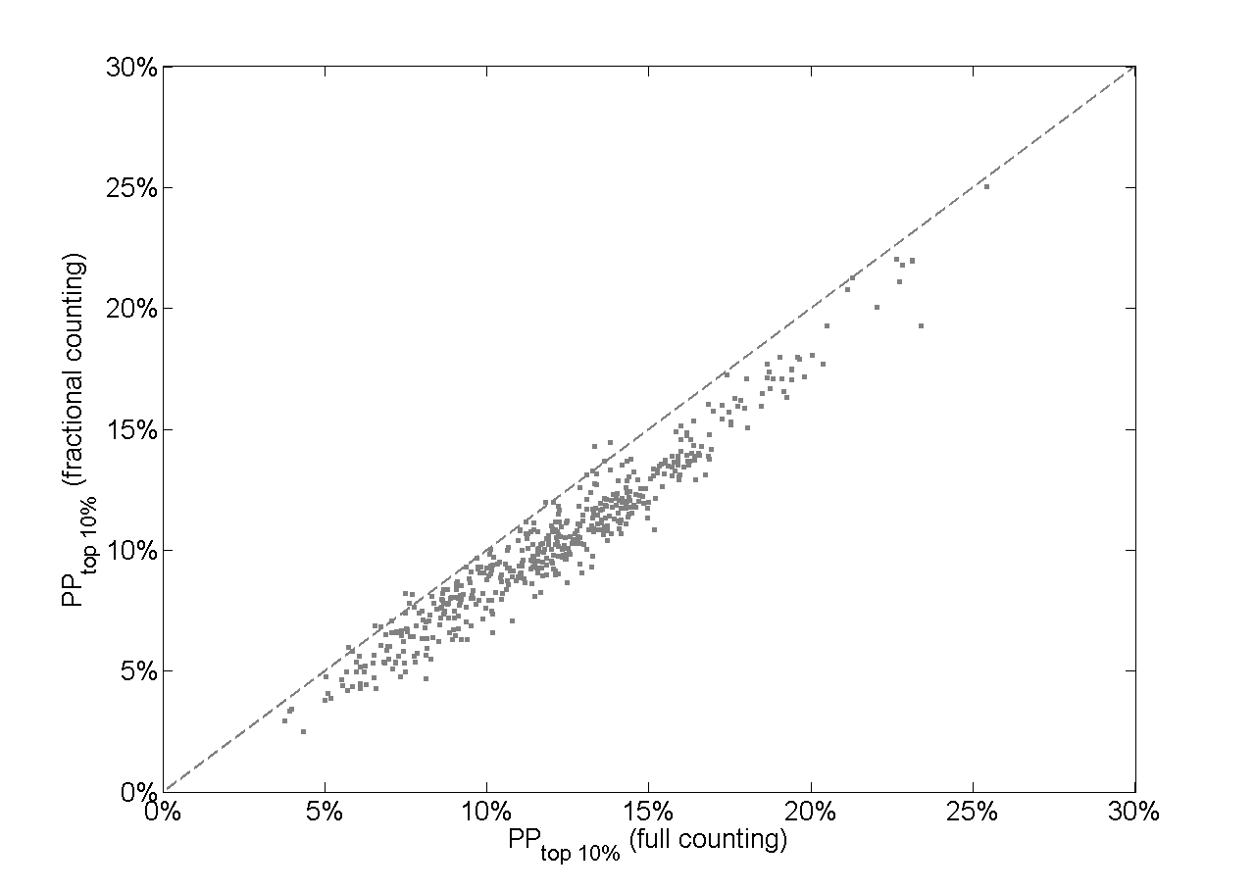

Slide 16
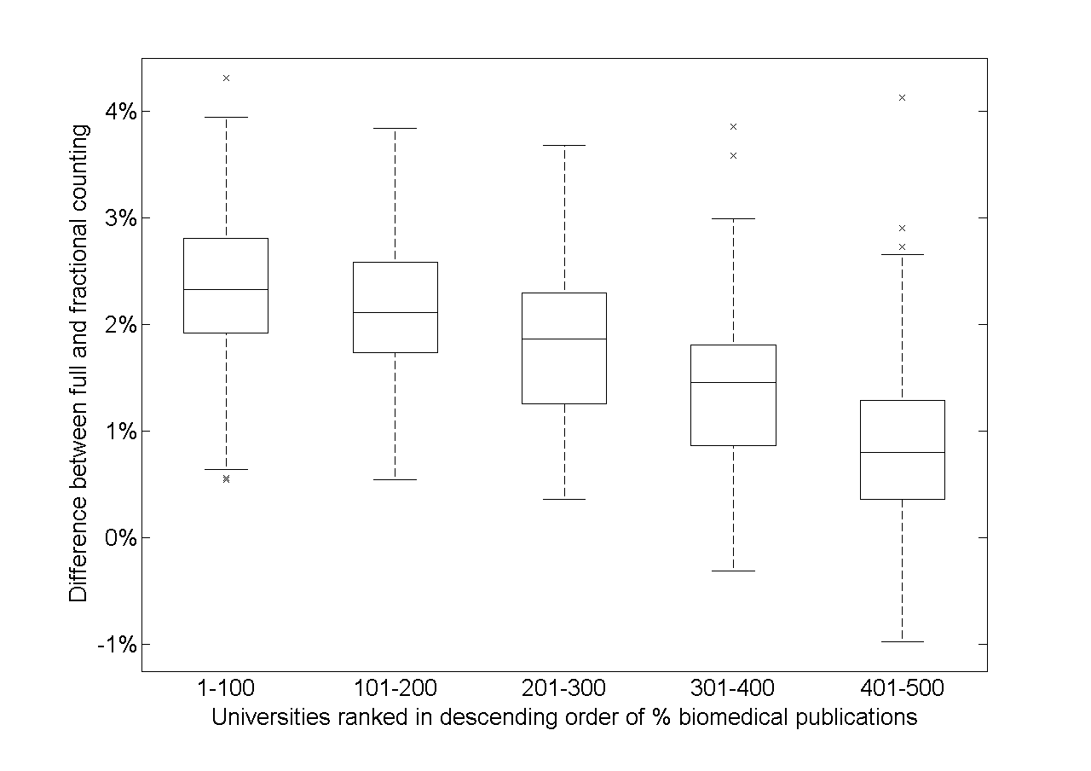
Universities with strong biomedical focus benefit from ‘double counting’ of collaborative publications in full counting approach
Universities focusing on other disciplines, such as social sciences and humanities, are disadvantaged

Slide 17
Conclusions
Full counting approach easily leads to misleading conclusions, biased in favor of disciplines with a high level of collaboration
Fractional counting approach offers an alternative that doesn’t suffer from this problem
New Clarivate approach offers yet another way of understanding the complex interplay between collaboration on research impact

Slide 18
A new approach – Collaborative CNCI
Consider collaboration without fractionalising credit
Domestic papers (no international co-author)
  Single author (dom: single)
  Multiple authors (dom: multi)
Internationally co-authored papers
  Two countries (int: bilat)
  Three countries (int: trilat)
  Four or more countries (int: quad, less than 4%)
Follow the same method as CNCI, but with the additional normalisation by collaboration type
  Avoids complex fractional analysis
  No more difficult to understand or calculate than standard CNCI
  Can compare Collaborative CNCI values to standard and fractional methods
  Deconstruct research portfolios by collaboration type
Profiles, not metrics
ISI’s new method breaks down a typology of collaboration
The components show where impact appears
A net, overall value gives an indicator
Journal of Informetrics paper: https://doi.org/10.1016/j.joi.2020.101075

Slide 19
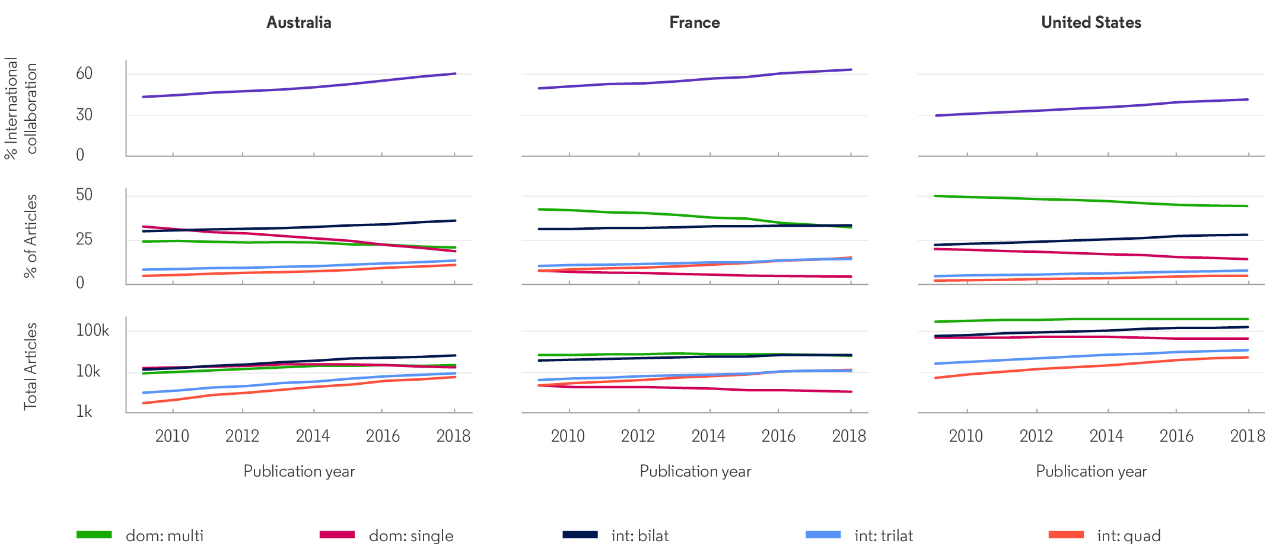
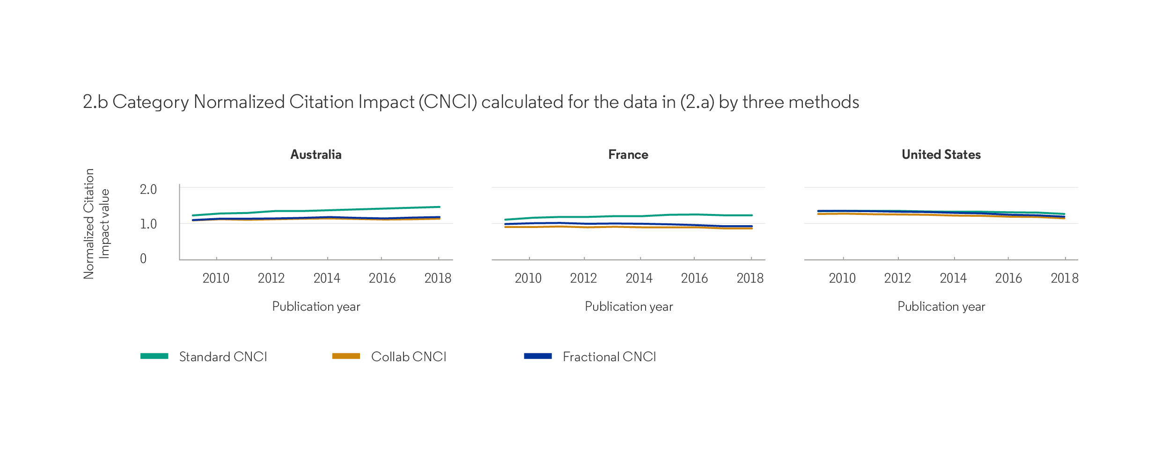
Established research economies
Three countries with a strong research base
Rising collaboration, mostly bilateral
Compare CNCI by three methods
Collab CNCI is generally less than Standard (whole counting) but similar to a common Fractional method

Slide 20
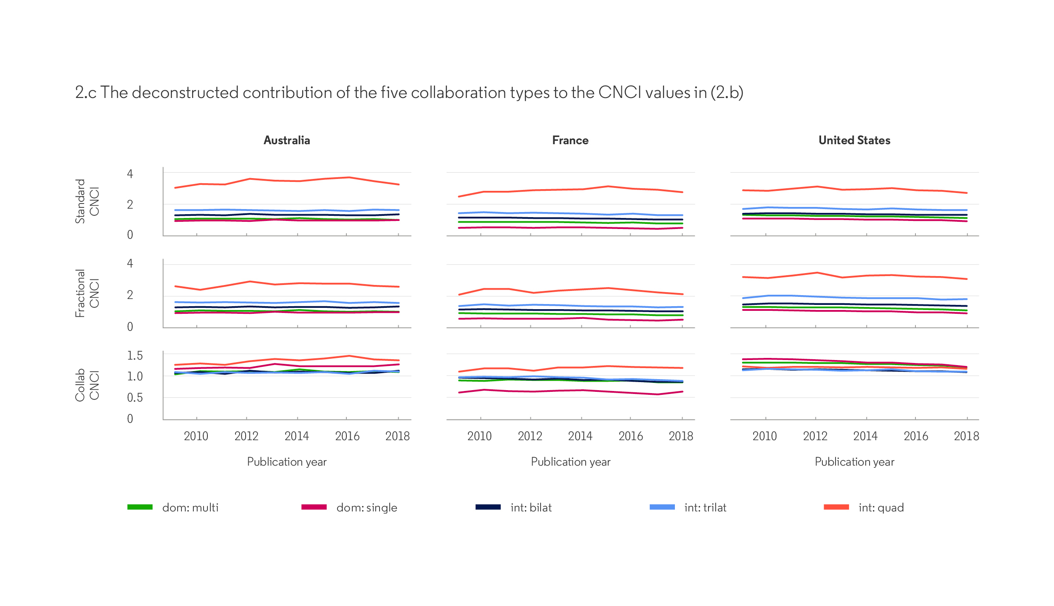
Deconstructed impact
Int:quad has high average CNCI in standard and fractional counting
Normalising by collaboration type moderates this effect
It also reveals other data, such as France’s low domestic impact
Information content is better, interpretation is easier

Slide 21
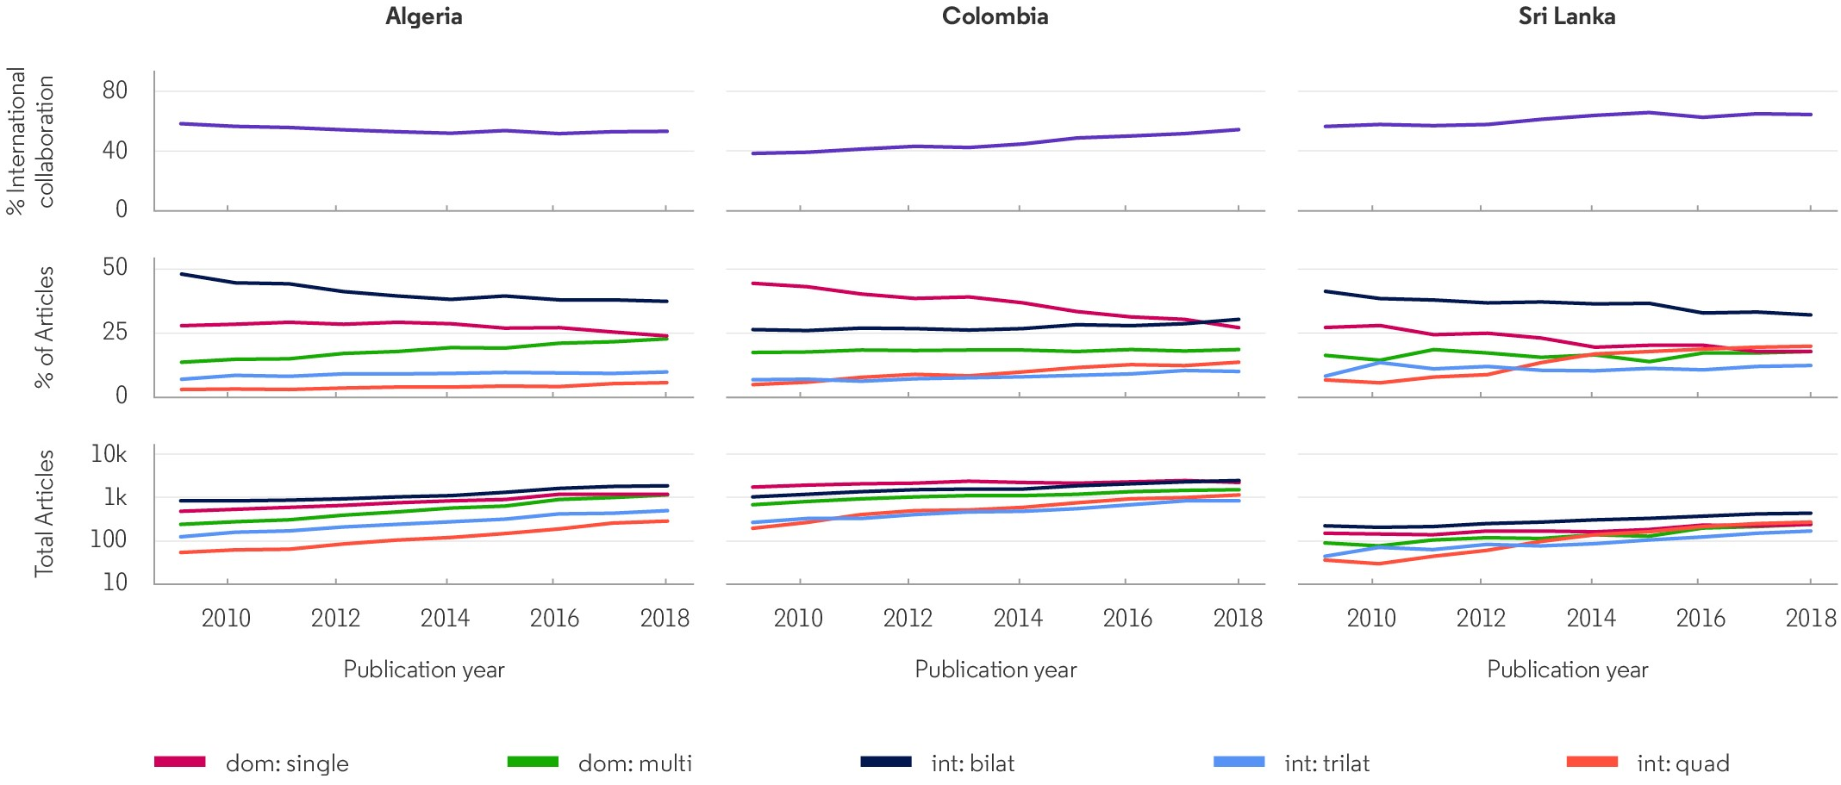
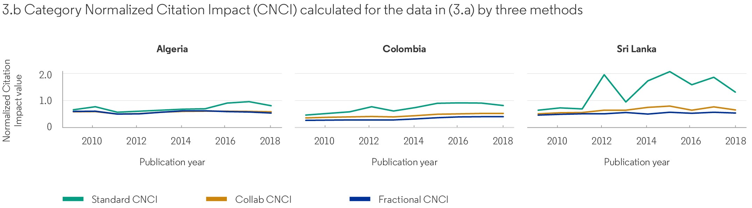
Growing research economies
Many more dom:single papers than larger countries
Higher % international collaboration
Difference between Standard and other results
Erratic variation in Standard metrics

Slide 22
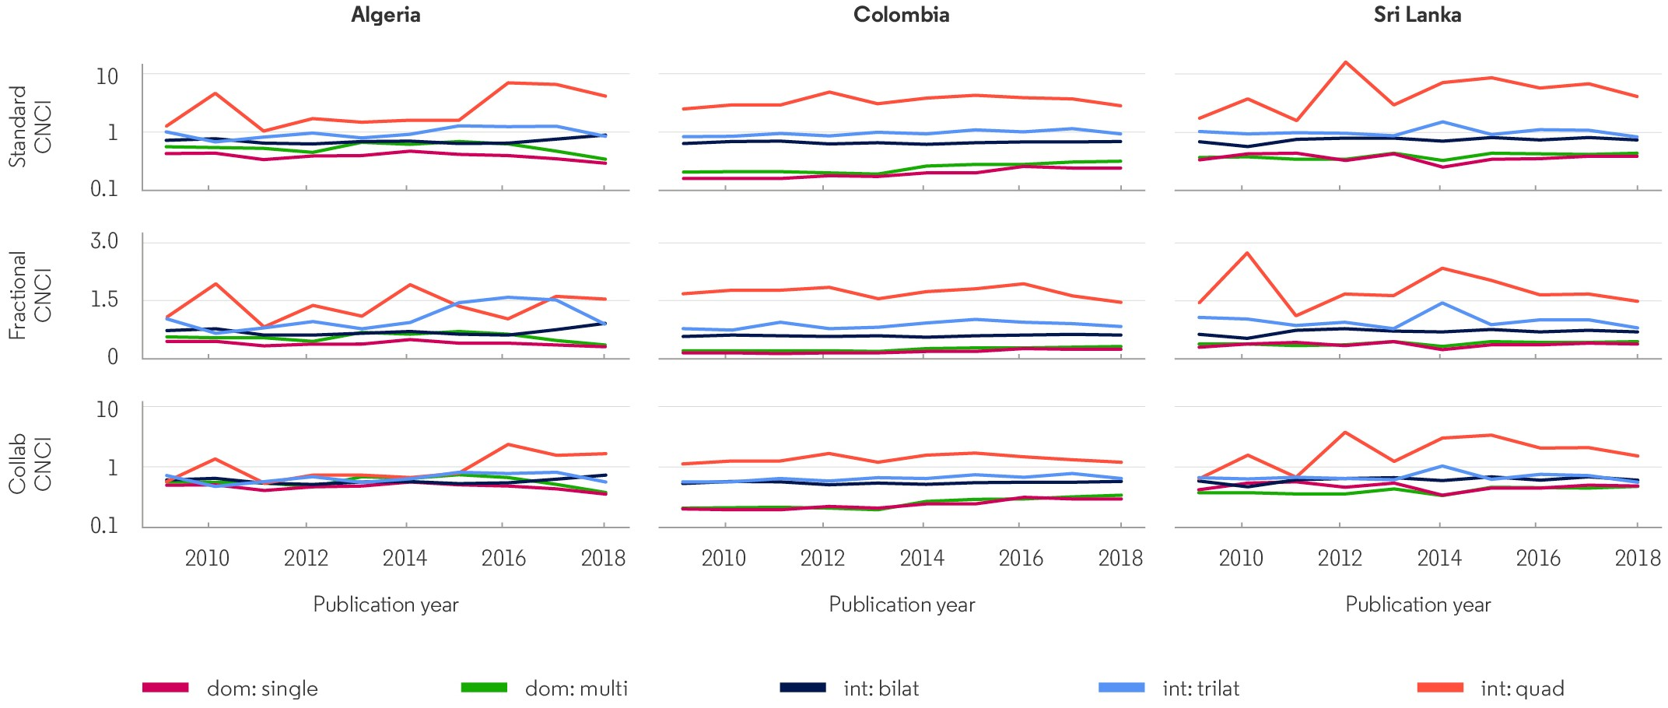
Deconstructed impact
Int-quad stands out for all methods and reveals erratic annual change
Colombia and Sri Lanka – weak domestic research impact
Single indicator values cannot be properly interpreted without the deconstruction

Slide 23
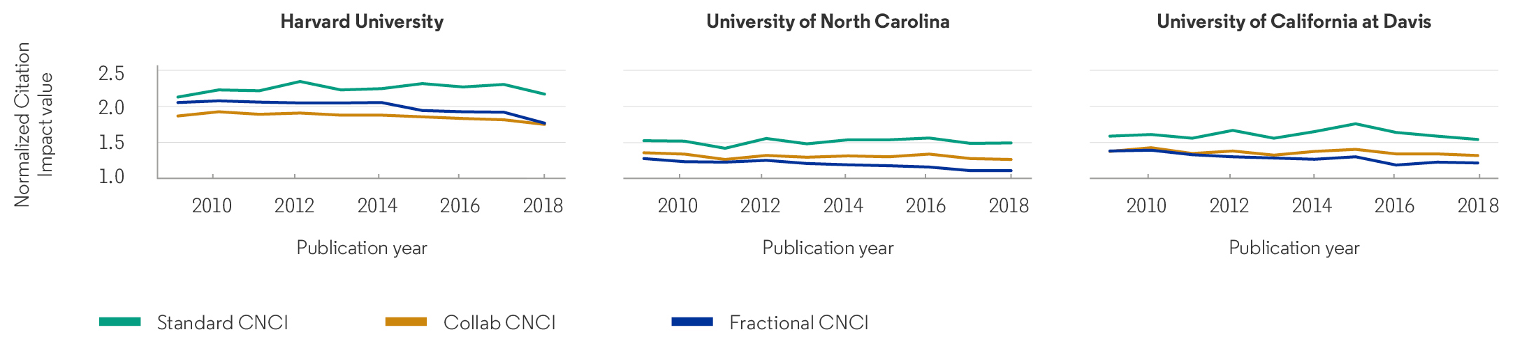
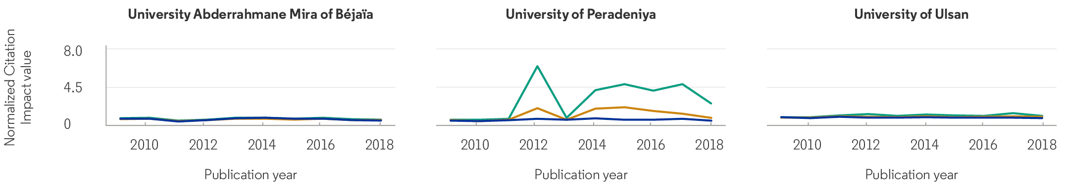
Individual institutions
Three US universities
One from Algeria, Sri Lanka and South Korea
Innovative comparisons – Harvard/collab CNCI
  Peradeniya spikes

Slide 24
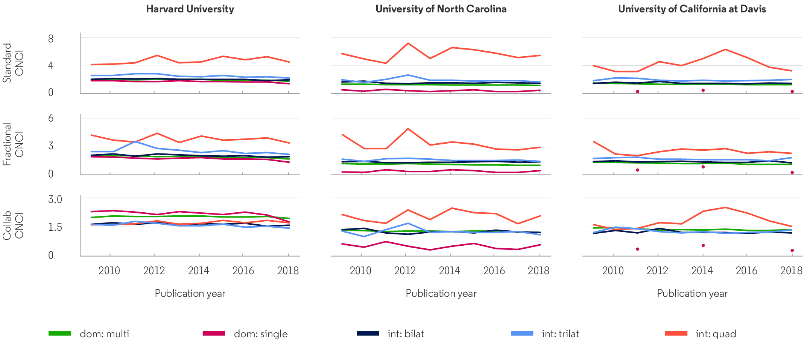
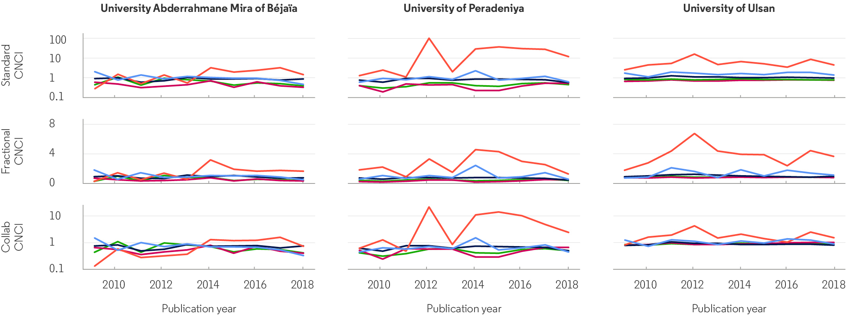
Institutions deconstructed
NOTE linear scale (US) & log scale (OTHERS)
Relative impact value of different modes of publication now clear for managers
Int:quad always high and variable, but more stable for US

Slide 25
Making it count
Thank you for your attention
Jonathan Adams, Ludo Waltman and Ross Potter
April 2022

