Slide 1
Highly Cited
Researchers™ 2021
Marketing and Communications
Launch Guidance
Institute for Scientific Information
Lisa Hulme, Head of Global External Communications – Science

Slide 2

Highly Cited Researchers 2021
Tuesday
Nov 16
Under embargo until November 16th 8.01am Greenwich Mean Time (GMT- LONDON)
4.01pm CST – China Standard Time
9.01am CET – central Europe
3.01am ET – US east coast
12.01am PT – US – west coast

Slide 3

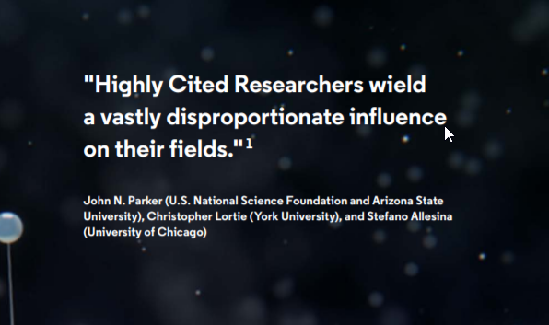
What is a Highly Cited Researcher™?
An individual who has demonstrated significant and broad influence on their field or fields of research.
Influence reflected in their publication of multiple highly cited papers over a decade (2010 – 2020)
These highly cited papers rank in the top 1% by citations for field and publication year in the Web of Science™ citation index
Of the world’s population of scientists and social scientists these individuals are 1 in1,000
The program does not rank people in any order
We do not claim that these are ‘the best researchers in each country’ – only that they demonstrate exceptional impact in their field of research

Slide 4
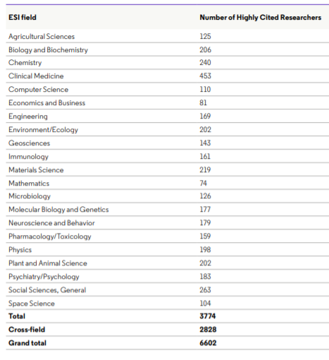
How are they chosen?
We use citation analysis to identify research influence.
A citation is a pellet of peer recognition^{1,} or a repayment of intellectual debt to others and an essential part of normative behavior among researchers.
We identify authors of highly cited papers. Quantitative analysis of top 1% cited papers and their authors across 21 fields of sciences and social sciences limited to the square root of the population represented as indexed in the Web of Science Core Collection for 11 years (2010 – 2020), Square root is often used to represent the elite of a population (Rousseau’s Law).
Using our InCites analytics tool data are derived from the ESI database
Crossfield category – contribute an equivalent number of highly cited papers in several fields as those selected in one or more ESI fields. It also recognizes early and mid-career researchers
The threshold differs by field, from Clinical Medicine to Pharmacology and Toxicology
Notes:
The 6,602 Highly Cited Researchers of 2021 are unevenly distributed by field, in accordance with the size of each.
There is no universally agreed concept of what constitutes extraordinary research performance. elite status in the sciences and social sciences. Consequently, no quantitative indicators will produce a list that satisfies all expectations or requirements. Moreover, a different basis or formula for selection would generate a different – though likely overlapping – list of names. Thus, the absence of a name on our list cannot be interpreted as inferior performance or stature in comparison to those selected. To understand both the meaning and the inevitable limitations of our analytical approach, a careful reading of the methodology is required.
Cross field – this is the fourth year that we have identified researchers with cross-field impact.
Recognizing early and midcareer as well as senior researchers is one of our goals in generating Highly Cited Researchers lists. In 2018, for the first time, we introduced a new Highly Cited Researchers crossfield category to identify researchers with substantial influence across several fields during the data census period. discriminates against researchers who publish highly cited papers in several fields but not enough in any one field to be chosen..
Of course, there are many highly accomplished and influential researchers who are not recognized by the method described above and whose names do not appear in the 2021 list. This outcome would hold no matter what specific method were chosen for selection

Slide 5
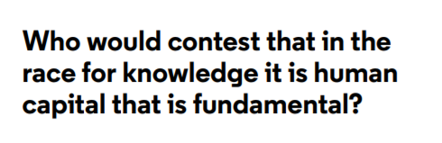
Why does it matter?
Talent outpaces other capacities such as access to funding and facilities
The list helps identify that small fraction of the researcher population that contributes disproportionately to extending the frontiers of knowledge and gaining for society innovations that make the world healthier, richer, more sustainable and more secure.
National research assessment and policy: Recognition and support of the scientific elite, both fully formed and incipient, is important for a nation or an institution's plans for efficient and accelerated advancement.
Talent: the list is used for promotion and tenure and to identify and attract new talent as bibliometric assessment is used as an evaluative indicator in many institutions.
“At Wits…. we strive to achieve impact through quality research. Being a highly cited researcher means that an academic’s published research is making an impact in the peer community. Thus, sharing information about our highly cited researchers encourages others to strive for greater quality and impact.”
Dr Robin Drennan, Director: Research and Innovation at the University of the Witwatersrand

Slide 6


Rankings
ARWU adopts objective indicators to rank world universities, including:
  the number of alumni and staff winning Nobel Prizes and Fields Medals, the number of articles published in journals of Nature and Science
  the number of Highly Cited Researchers and articles indexed in Science Citation Index - Expanded (SCIE) and Social Sciences Citation Index™ (SCI) based on data in the Web of Science
  More than 2,000 universities are ranked by ARWU every year and the best 1,000 universities are published.
Link to whitepaper
Notes:
Primary affiliation only provided to ARWU

Slide 7
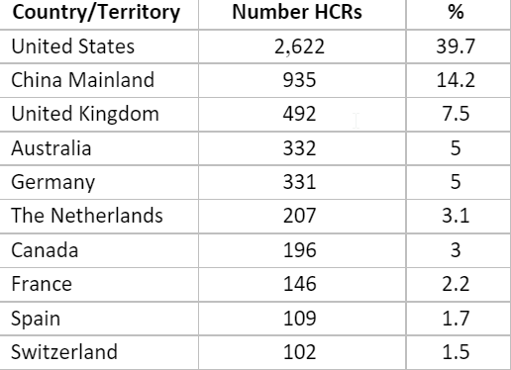
The 2021 National Outlook
Some 6,600 researchers from 70+ countries and regions were recognized this year
Welcome to: Bangladesh, Kuwait, Mauritius, Morocco, Republic of Georgia

Slide 8
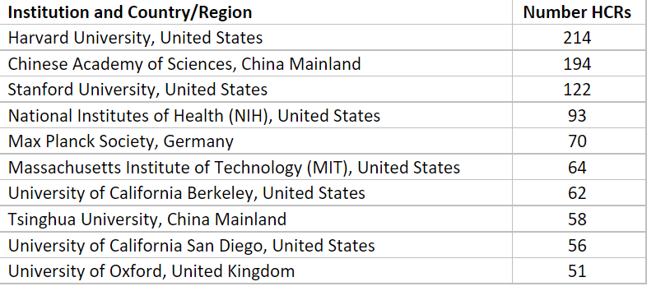
The Homes of Highly Cited Researchers
New to top 50:
University of Hong Kong
University of Sydney
University of Texas Austin
University of Edinburgh
University of Science & Technology, China
Up 10 or more places:
University of California Los Angeles,
University of Queensland
University of Science & Technology, China
National University of Singapore
Northwestern University Zhejiang University
There are approx. 1300 institutions on the list this year. These include Universities, government agencies and commercial research laboratories.
75% of these are home to three or less researchers.
40% have one researcher.

Slide 9
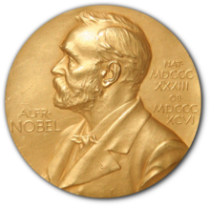
The Nobel Laureates & recognition in multiple categories
24 Nobel Laureates on the 2021 list, including five announced this year
+ 23 individuals honored in three or more fields of research
Professor Rob Knight from the University of San Diego California is alone in being named for four ESI fields (Biology and Biochemistry; Environment/Ecology; Microbiology; Molecular Biology and Genetics).
Notes:
A man is judged by the company he keeps.
: David Julius, University of California San Francisco, San Francisco, CA, U.S. (Physiology or Medicine); Ardem Patapoutian, Scripps Research, La Jolla, CA, U.S. (Physiology or Medicine); and, David W. C. MacMillan, Princeton University, Princeton, NJ, U.S. (Chemistry).

Slide 10
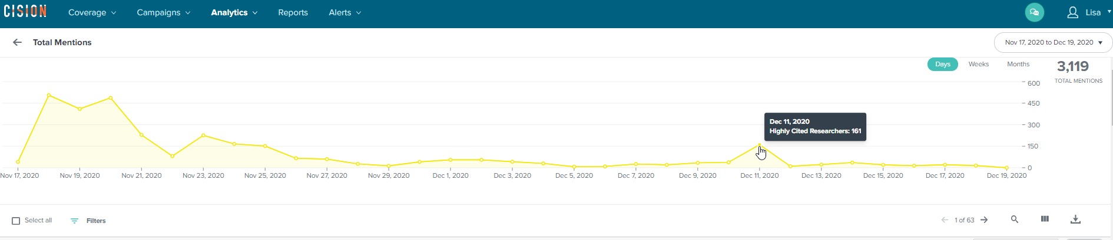
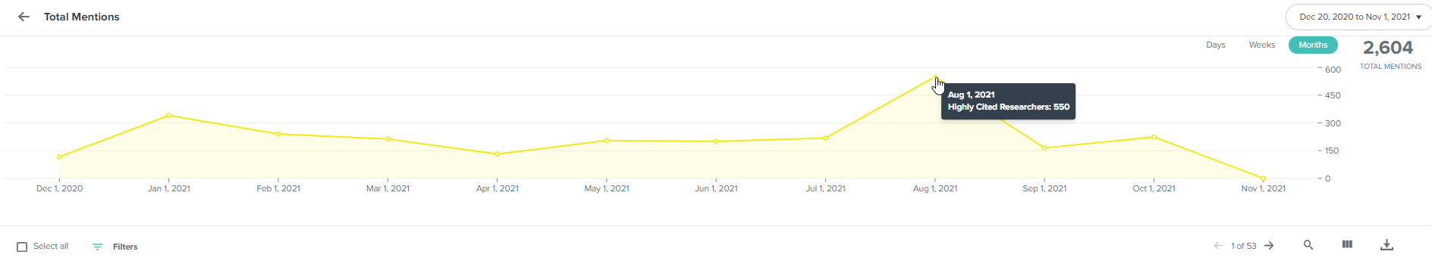
Highly Cited Researchers 2020: A whole year of recognition

Slide 11
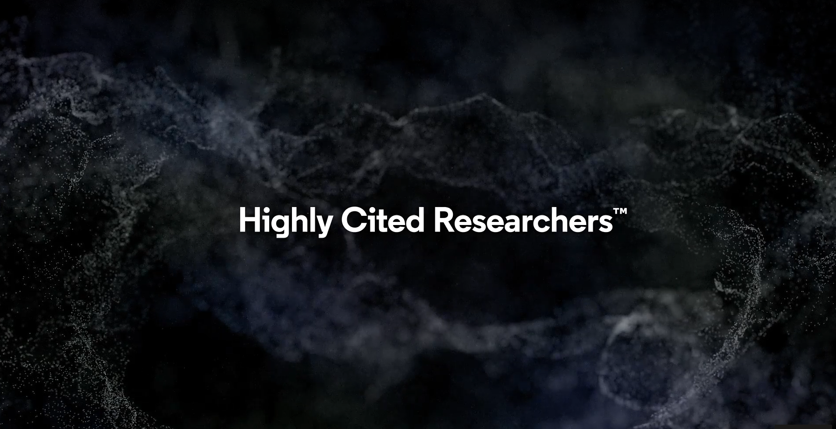
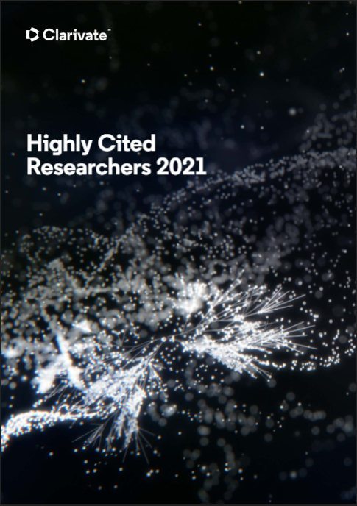
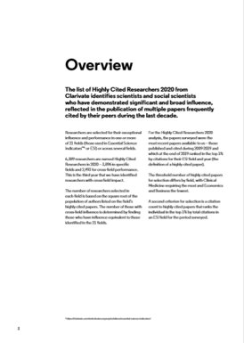

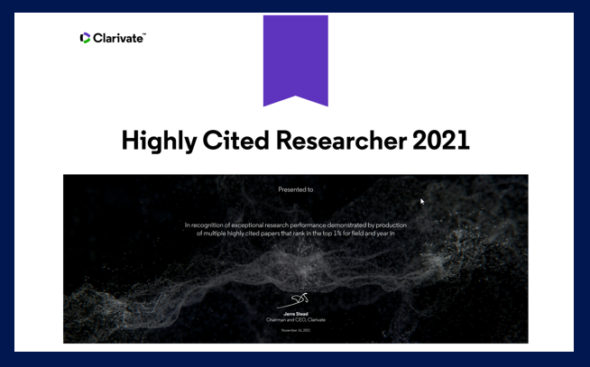

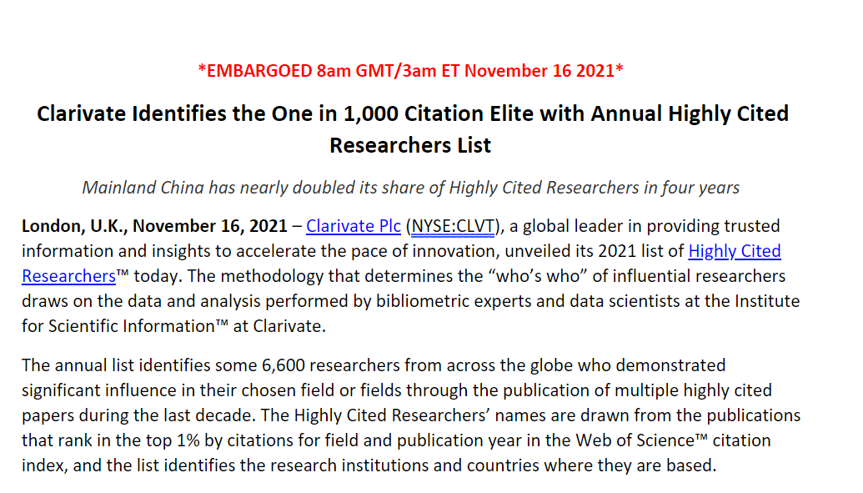

Marketing assets 2021: https://clarivate.com/highly-cited-researchers/hcr-2021-guidance-pr-departments/
Hype video
Digital ribbons
Executive summary & methodology
Certificate – download online
Social cards
News release under embargo + template

Slide 12
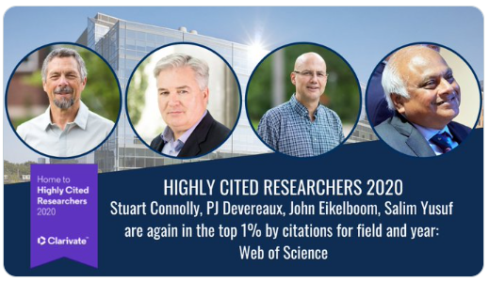
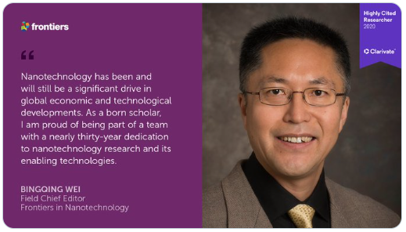
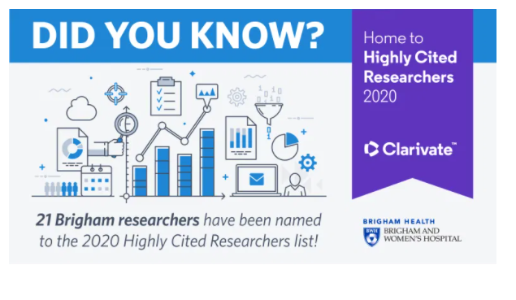
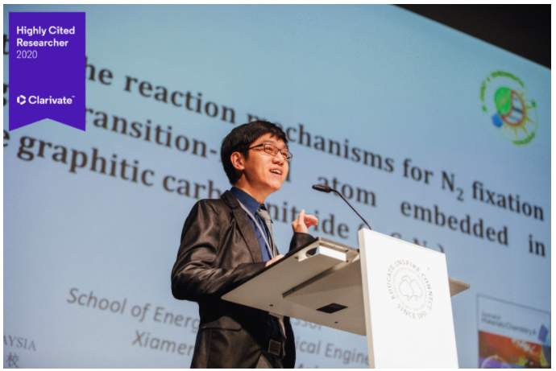

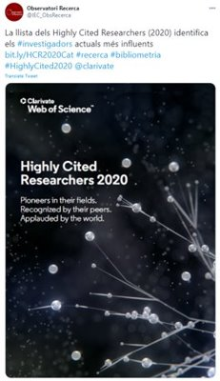
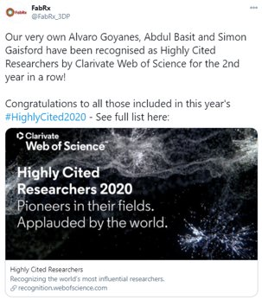

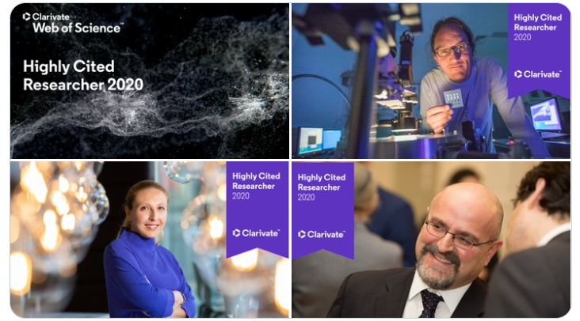
Our creative assets used by institutions - 2020

Slide 13
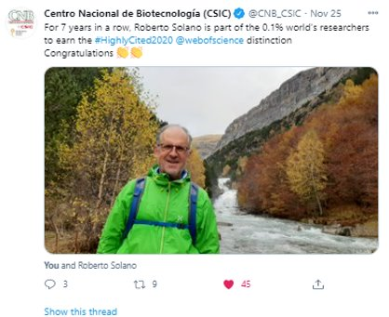
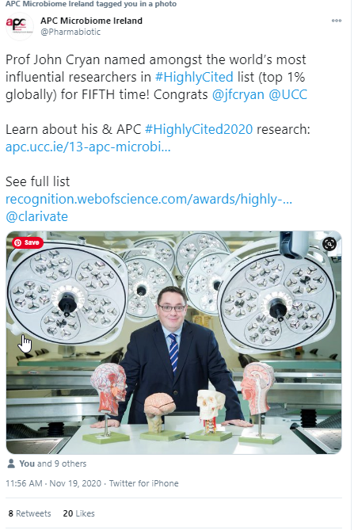
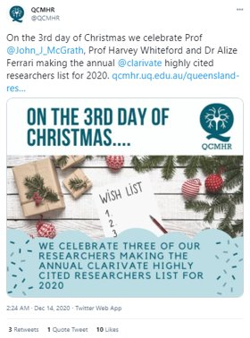
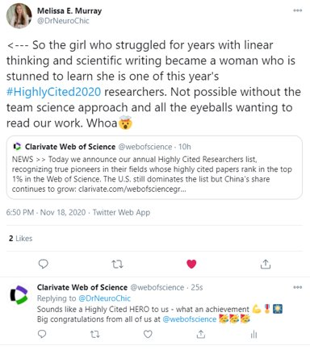
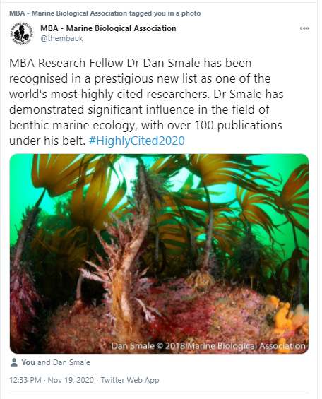
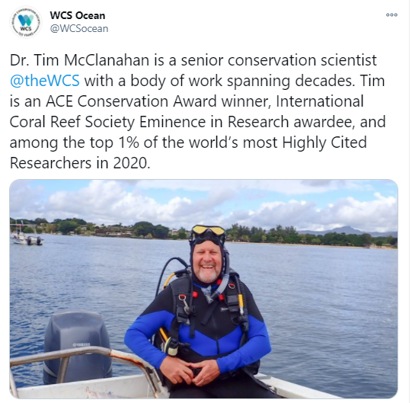
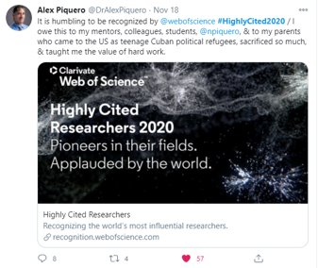
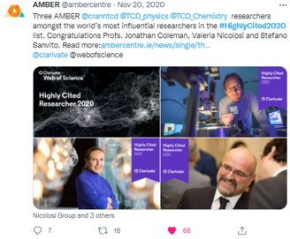
Use images and personal stories to highlight your research

Slide 14
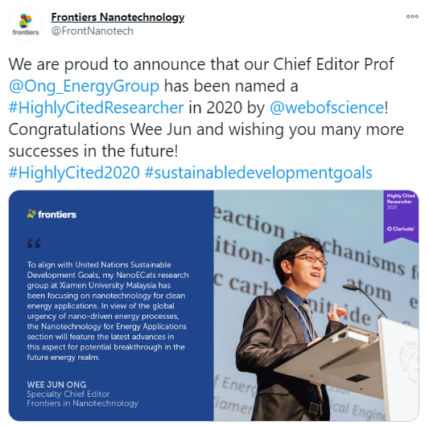
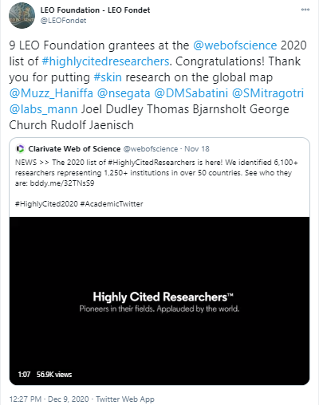
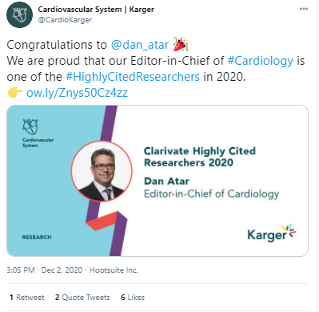
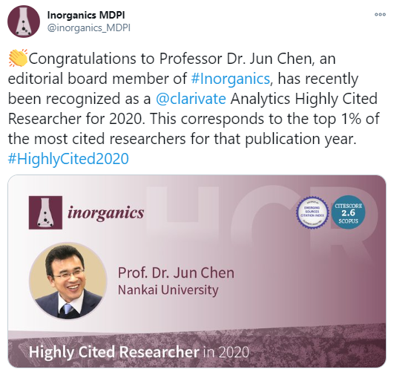
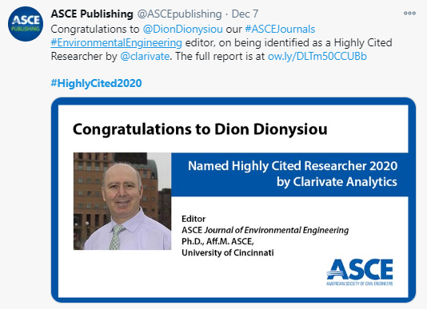
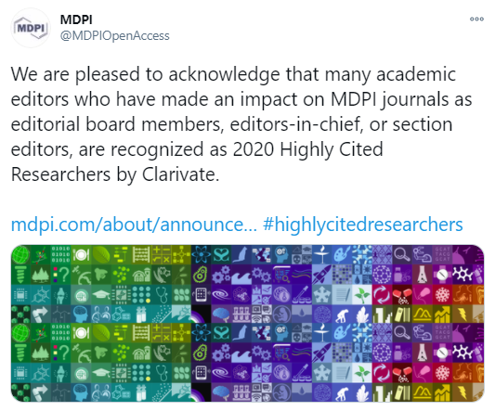
Publishers & funders also celebrate their researchers

Slide 15
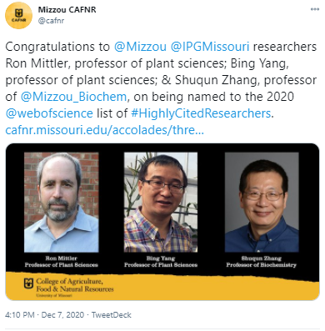
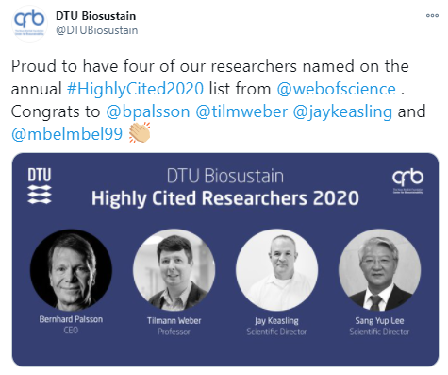
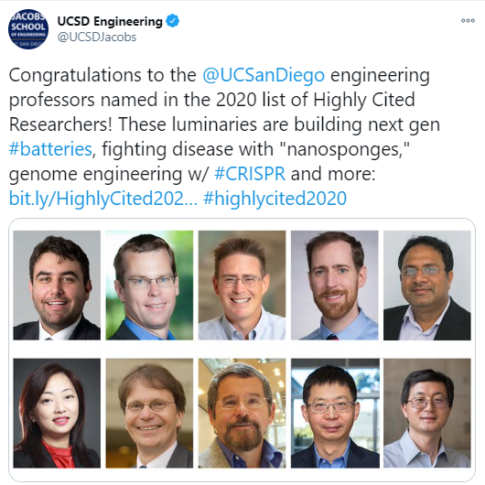

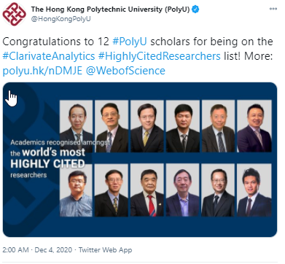
The list reflects the global scientific community we represent

Slide 16
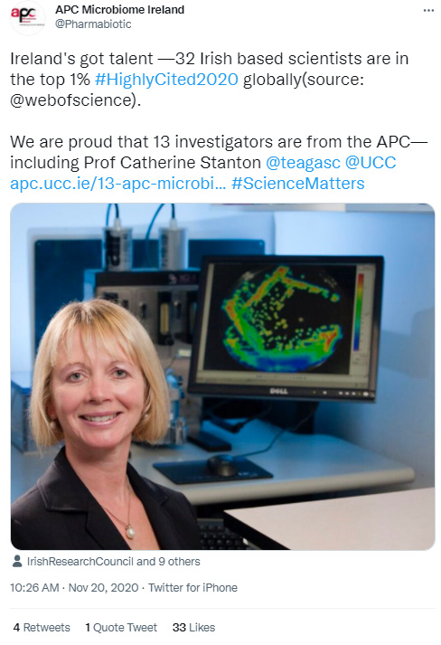
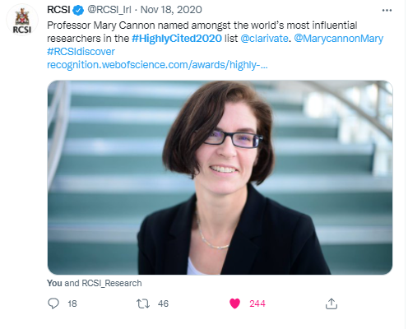
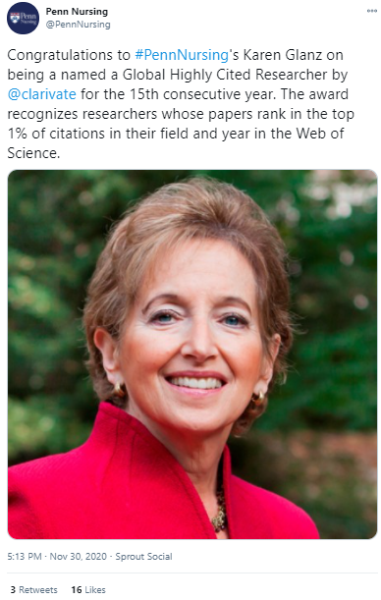
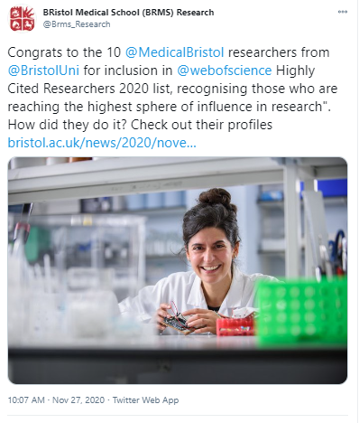
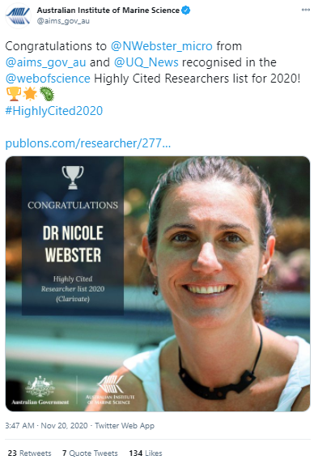
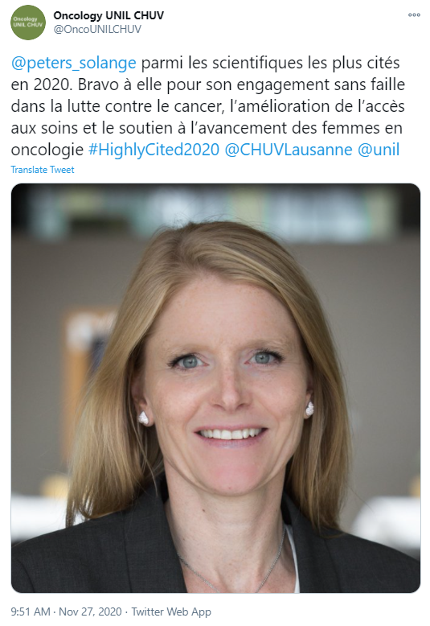
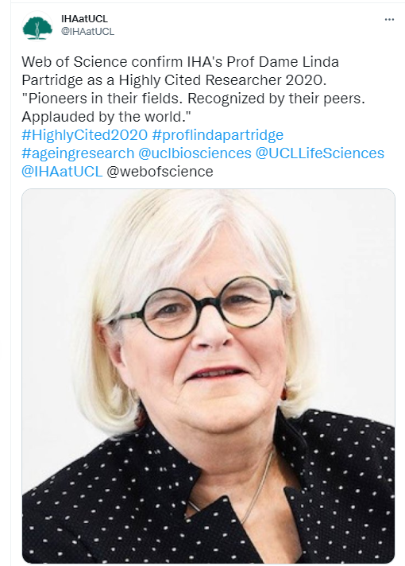

Let’s promote the diverse members of the list
Notes:
Out of the complaints – an opportunity with Monash #Findher with CSIRO

Slide 17

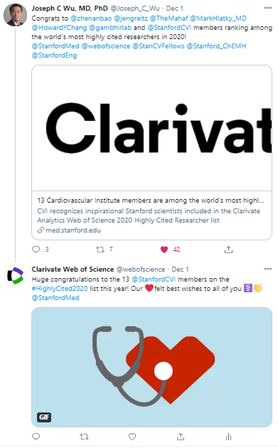
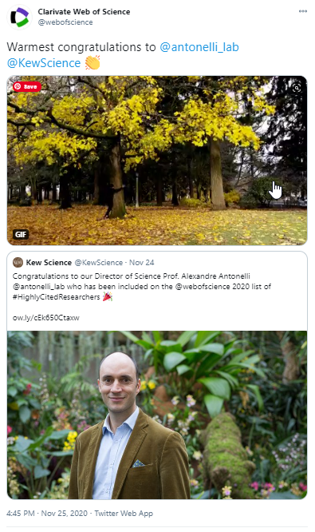
Celebrating with our researchers on social:
#HighlyCited2021
This year we've also identified a group of super-engaged 'social ambassadors' from our Highly Cited Researchers list.
We'll be sharing extra social assets with them to help generate buzz within their communities.
If you'd like to nominate any HCRs from your institution as 2021 social ambassadors, please let us know!
ISI@clarivate.com

Slide 18




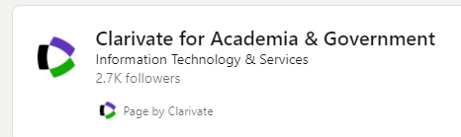


Join the conversation on all our digital platforms
Want to be featured
on our podcast?
#HighlyCited2021
We're looking for people to take part in a conversation around what Highly Cited Researchers means to your organization
Recording will take place in late Nov/early Dec, after launch
Please get in touch if you'd like to be involved!

Slide 19
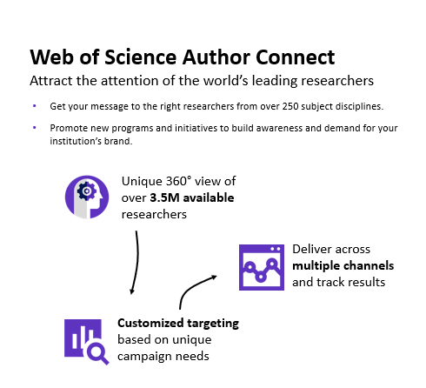
Web of Science Author Connect: Driving rankings performance by improving international reputation
A marketing database of engaged and opted-in researchers indexed in the Web of Science
Provides precisely segmented and targeted mailing lists based on subject, region and medium for each campaign
Can be used to promote institutional news, research articles, talent-recruitment advertisements, and university-hosted international conferences.
Link for more info
e: ISI@Clarivate.com

Slide 20
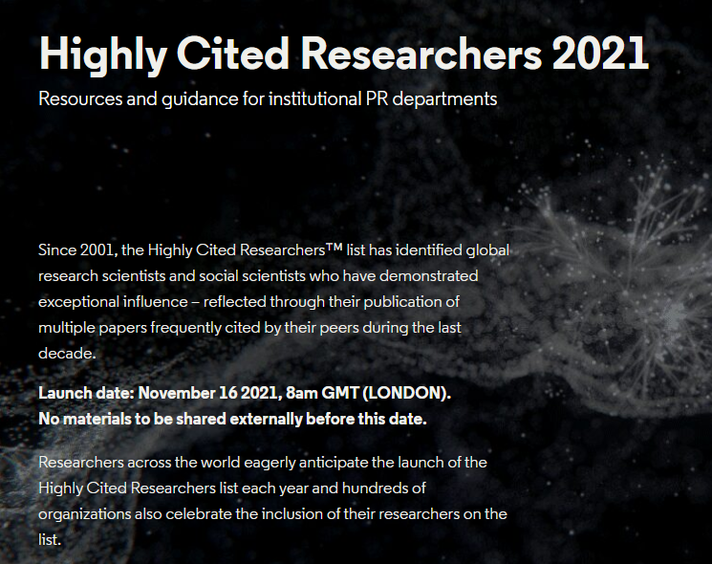

Materials available to you:
Embargo until 08:00am GMT (LONDON)
A recording of this webinar and slides from today
Access to our online media toolkit: https://clarivate.com/highly-cited-researchers/hcr-2021-guidance-pr-departments/
Includes:
  Our news release under embargo + template
  Artwork and logos
  Badges for researchers and for their institutions
Opportunity to join our Ideas to Innovation podcast
Our executive summary, including methodology – coming soon
  Contact us: ISI@clarivate.com

Slide 21
Any questions?
Communications team
Email: ISI@clarivate.com

